Slide 1
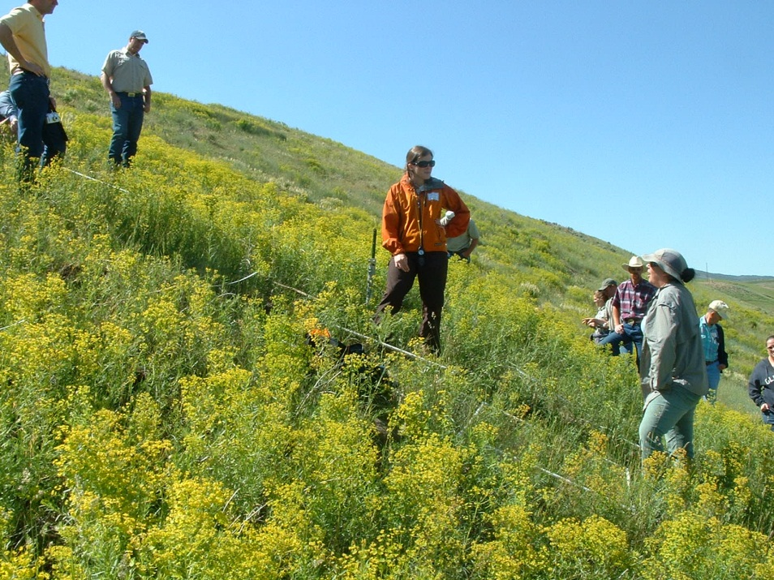
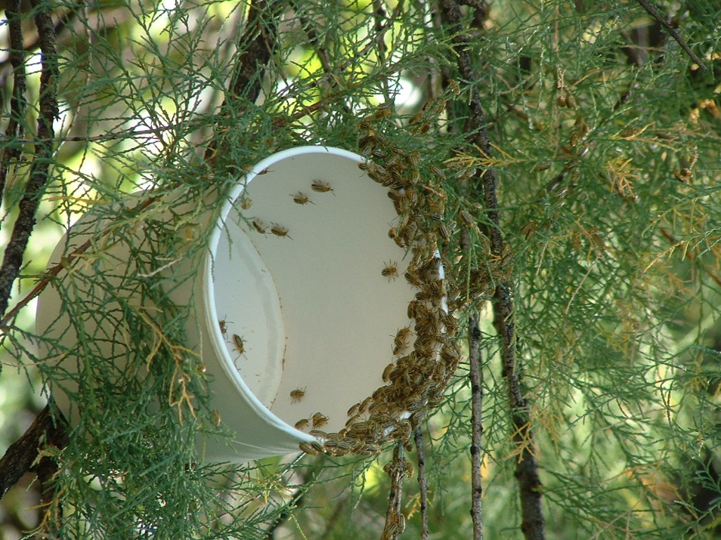
Biocontrol of Rangeland Weeds Upper Arkansas Cooperative Weed Management Area November 5, 2014
Dan Bean
Colorado Department of Agriculture
Palisade Insectary
dan.bean@state.co.us

Slide 2
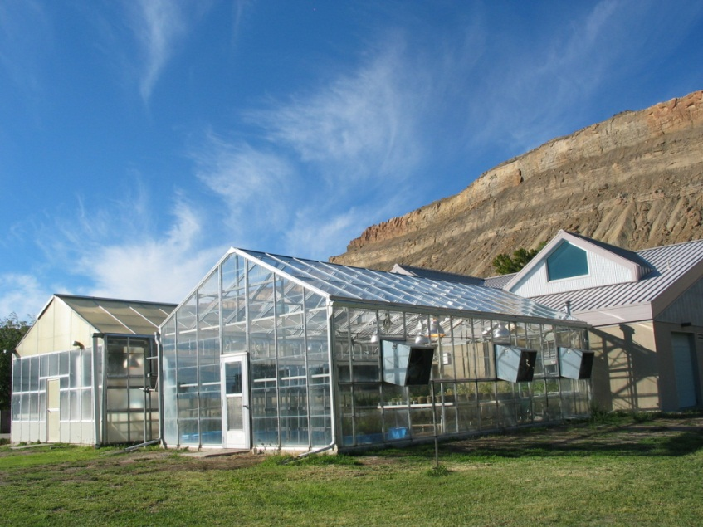
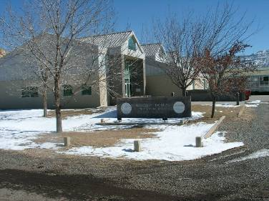
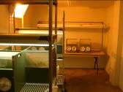
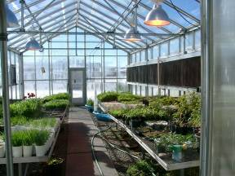
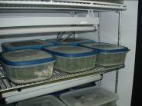
Who are we?
Palisade Insectary
Began in the 1940’s to fight Oriental fruit moth, a project that helped peach farmers and is still going
Moved to new 14,000 sq. ft. facility in 1992
Distributes over 20 biocontrol agents for the control of insect pests and weeds
Is a partner in pest management

Slide 3
Outline
What is biological control?
Is biological control safe?
Is biological control effective?
What weeds can we control using biological agents?
Russian knapweed, yellow toadflax and Canada thistle; new agents for rangeland weeds.

Slide 4
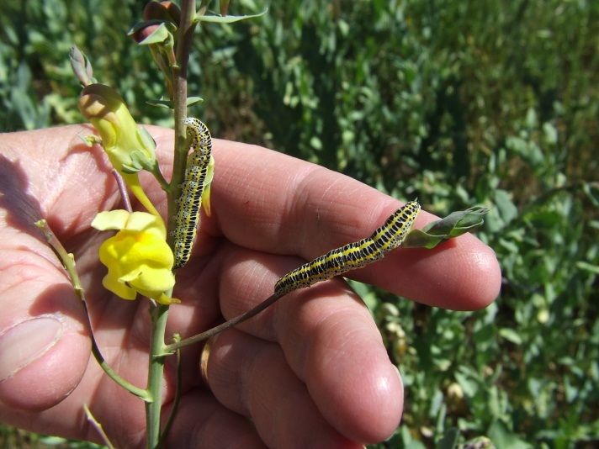
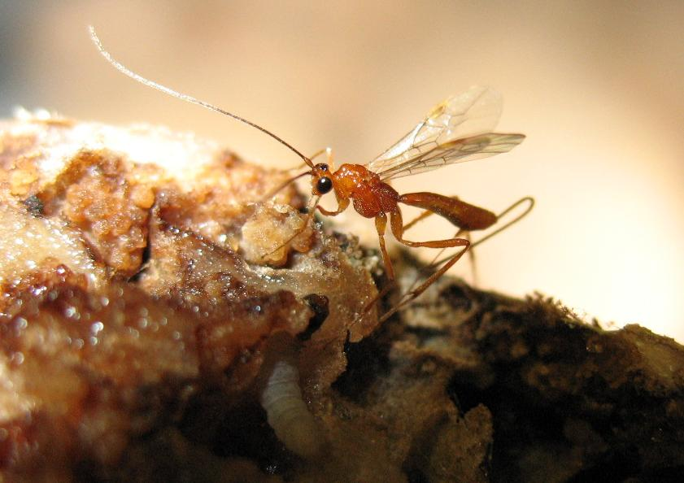
What is biological control?
1. Biological control (biocontrol) is the use of natural enemies, including insects, mites and pathogens, to control pests, including insect pests and noxious weeds.
Calophasia lunula on Dalmatian toadflax
Macrocentrus ancylivorus stings host
2. Biocontrol is an ecologically based pest control method. The goal is suppression of the weed or insect pest, not eradication. Often the desired end result takes years to achieve.

Slide 5
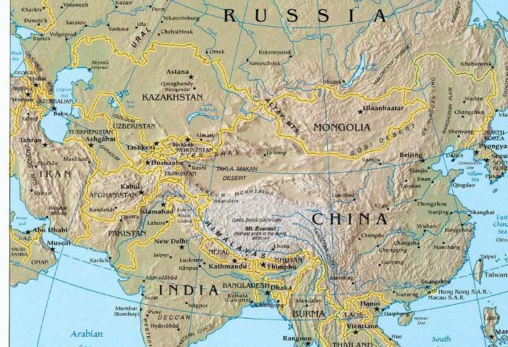
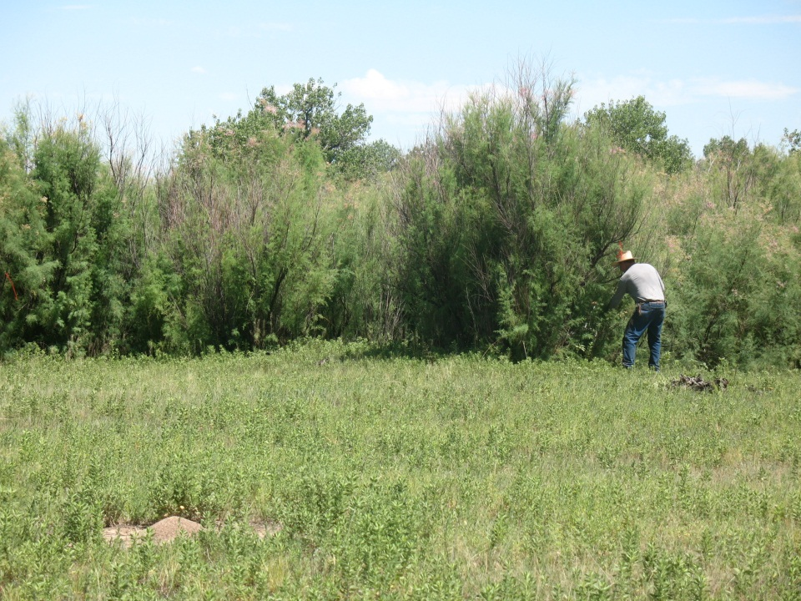
Classical Biological Control
The reunification of host specific natural enemies with insect pests or invasive plants
Host specific natural enemies establish self propagating populations, becoming part of the ecosystem
Diorhabda carinulata
Arkansas River Valley
Central Asia

Slide 6
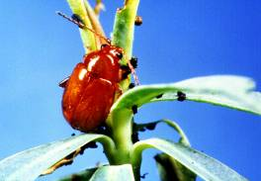
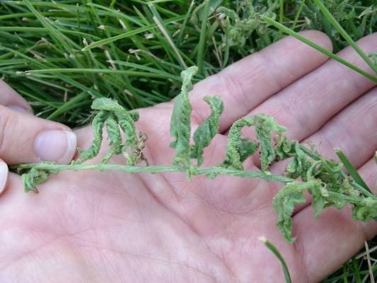
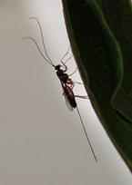
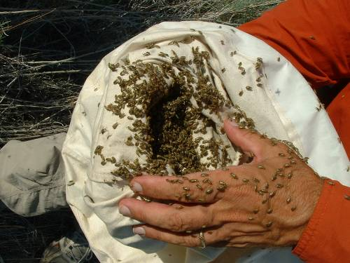
Biological Control
The use of natural enemies to control pest organisms
Safe
Effective
Inexpensive
Sustainable
Flea beetle on leafy spurge
Field bindweed gall mites
Macrocentrus parasitic wasp
tamarisk leaf beetle collection

Slide 7
Biological Control
The use of natural enemies to control pest organisms
Field bindweed gall mites
Macrocentrus parasitic wasp
Flea beetle on leafy spurge
Cultural, Mechanical
Chemical, Biological
balance
What are your management goals?
tamarisk leaf beetle collection

Slide 8
The results of weed biocontrol are a new equilibrium between the introduced plant and natural enemies of the plant
Natural enemy added…
…long term ecological solution
Weed Suppression
Never Eradication!

Slide 9
Ecologically Based Invasive Plant Management
(successional weed management)
Site Availability
Species Availability
Species Performance
www.ebipm.org

Slide 10
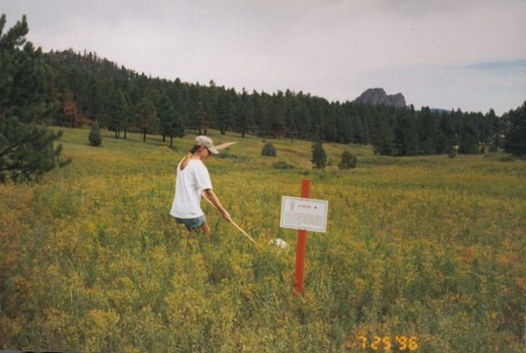
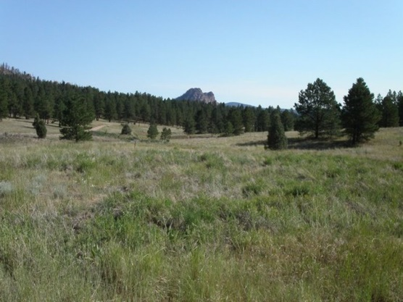
Ecologically Based Invasive Plant Management
(successional weed management)
Site Availability
Biocontrol can open up new sites for desired plant establishment
www.ebipm.org

Slide 11
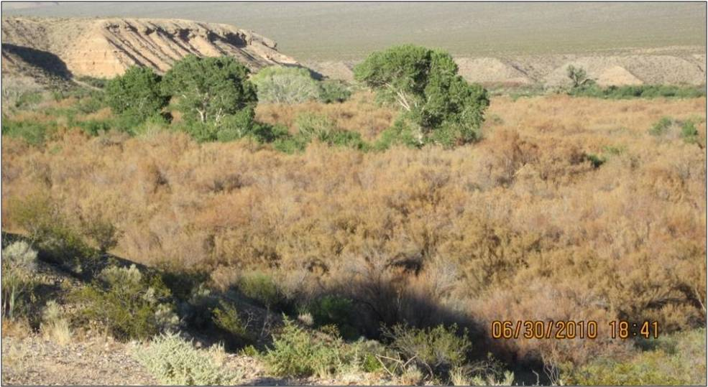
Ecologically Based Invasive Plant Management
(successional weed management)
Site Availability
Species Availability
What desirable plants do you have in the system?
Active vs passive restoration
www.ebipm.org

Slide 12
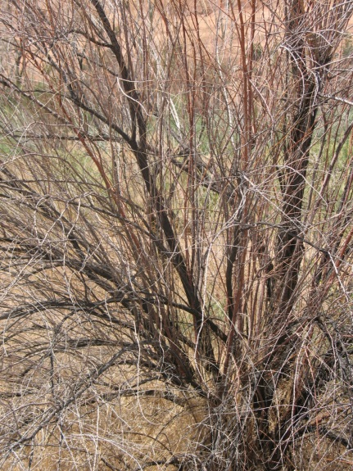
Ecologically Based Invasive Plant Management
(successional weed management)
Site Availability
Species Availability
Species Performance
After weeds are controlled what will keep them from returning?
Biocontrol will help desirable plants continue to outperform weeds.
After fire tamarisk cannot make a strong comeback with beetles in the system
www.ebipm.org

Slide 13
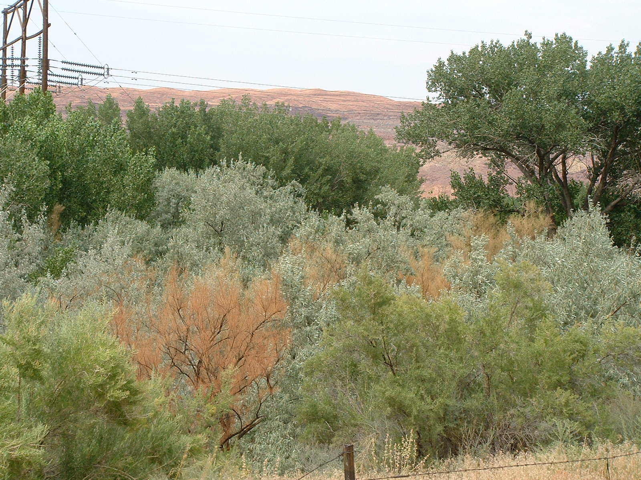
Is Biocontrol Safe?

Slide 14
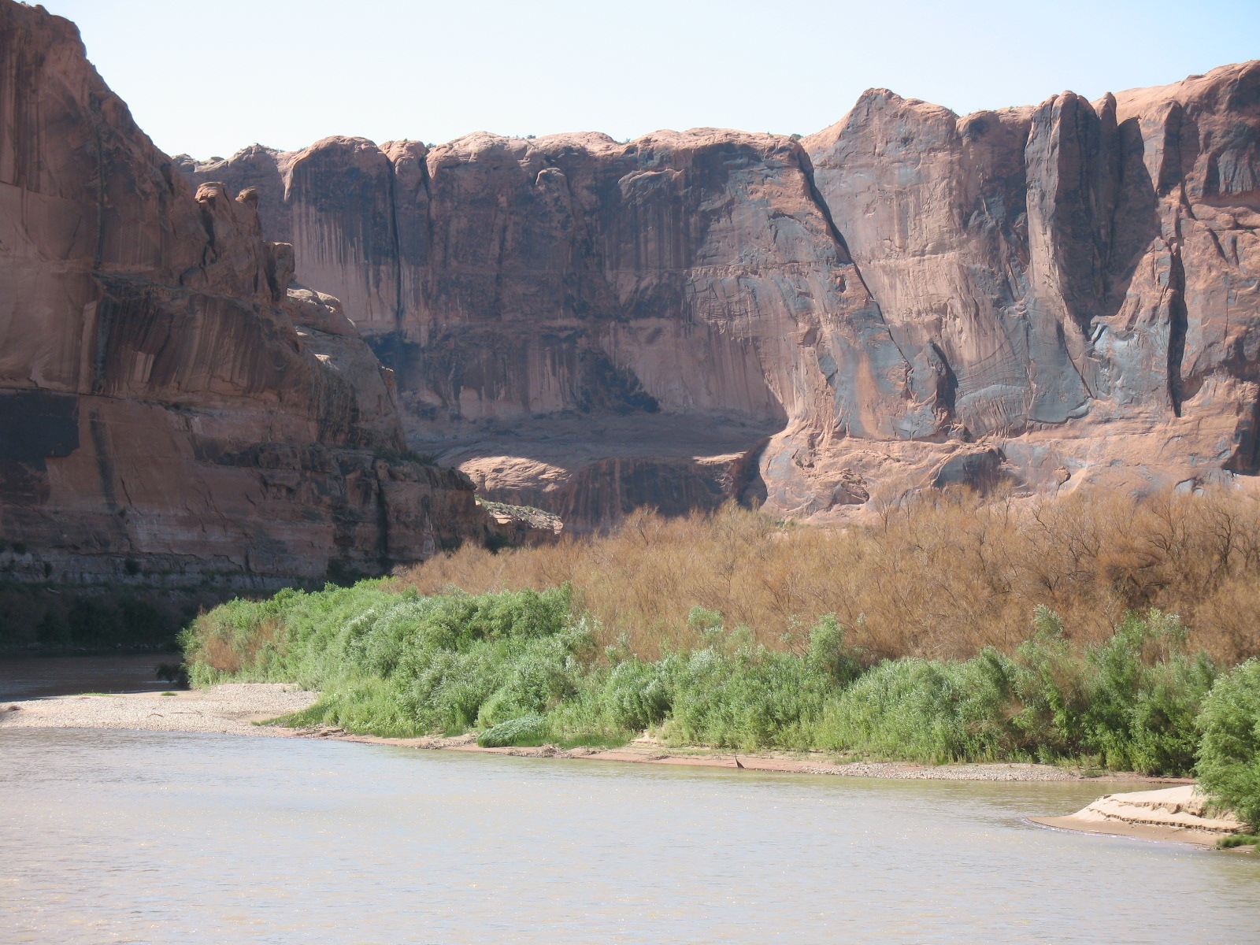
Yes, only host specific insects are used and no record of host switches during the 65 years of weed biocontrol in North America
Is Biocontrol Safe?
Colorado River near Moab, 8-31-10

Slide 15
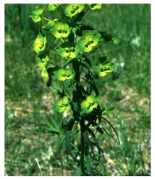
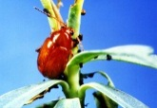
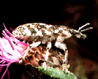
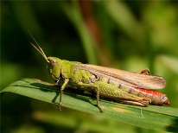
Generalists vs. Specialists: Only Specialists are used!
Insect
Leafy spurge flea beetles
Knapweed root weevil
Russian knapweed gall fly
Tamarisk beetle
Grasshoppers (various species)
Host Plant
Leafy spurge
Diffuse and spotted knapweed
Russian knapweed
tamarisk
Various crops
Most plant feeding insects are adapted to a single plant species or a small group of closely related plant species. Some groups, like many grasshopper species, are generalists and feed on a wide range of plants

Slide 16
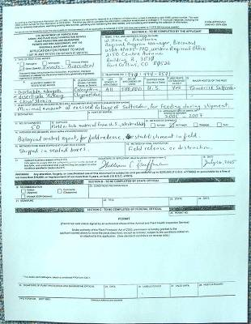
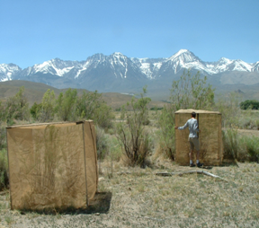
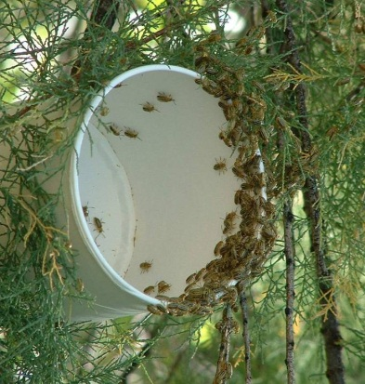
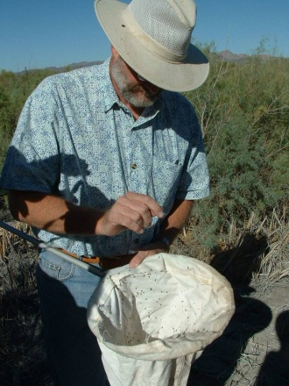
Steps in weed biological control
Identification of target/background research
Overseas exploration and research to find agent or agents
Quarantine work including agent cleanup and host range testing
Approval from regulatory agencies (TAG, APHIS)
Field testing including monitoring
Full scale implementation
10-20 years!

Slide 17
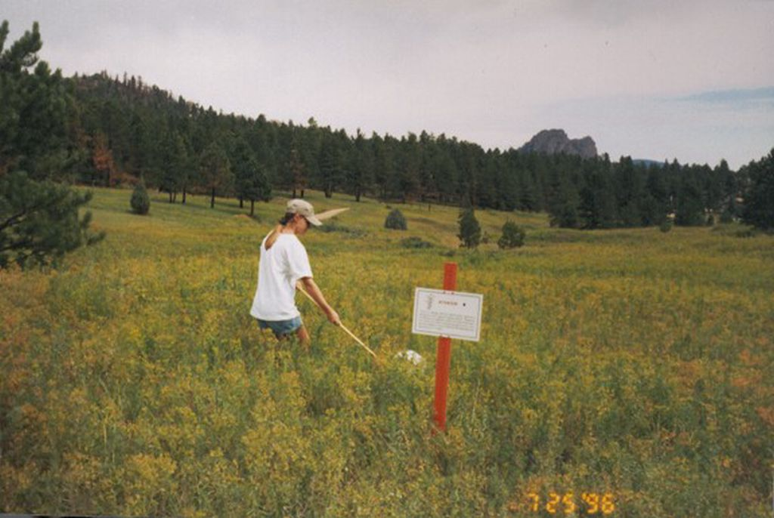
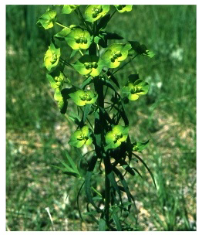
Is biological control effective?
before biocontrol
after biocontrol
leafy spurge control near Pine, Colorado

Slide 18
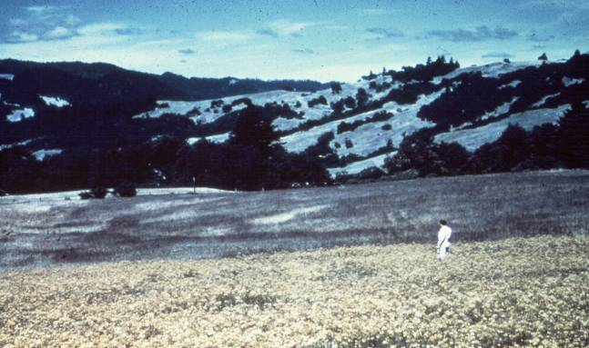
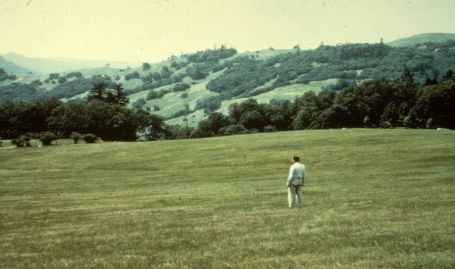
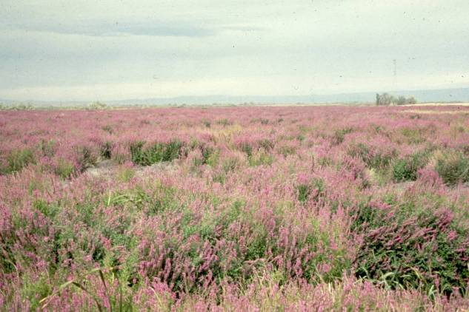
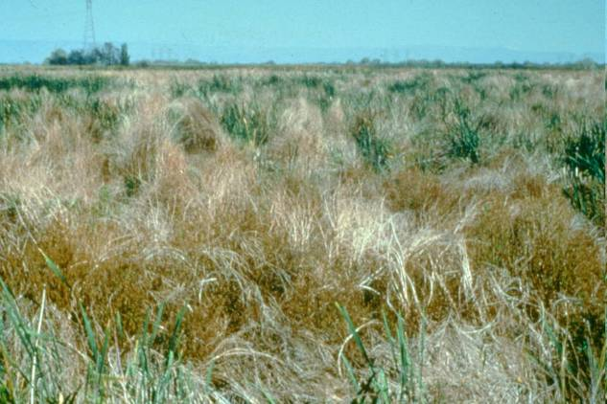
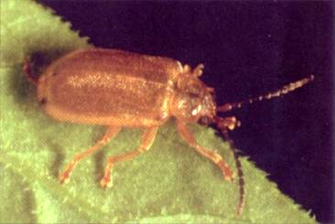
Biological control has resulted in some spectacular successes
Release Point
Chrysolina quadrigemina
St. Johnswort in Northern California, before/after
Galerucella spp
Purple loosestrife infestation in Washington, before/after

Slide 19
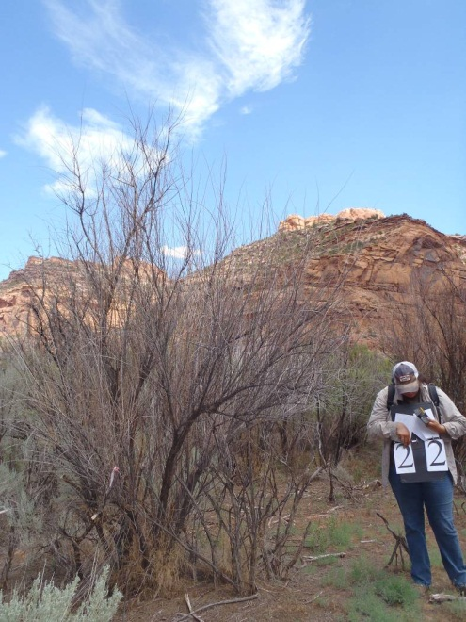
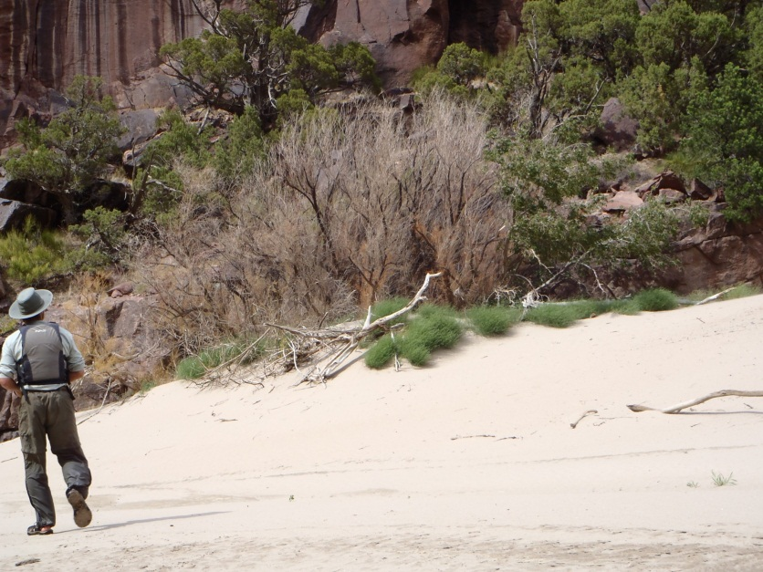
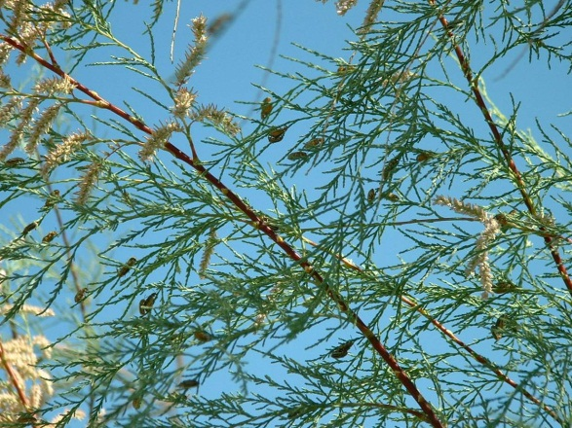
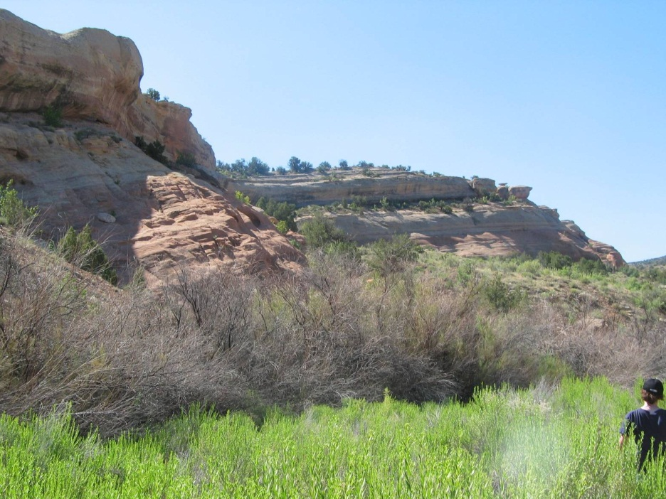
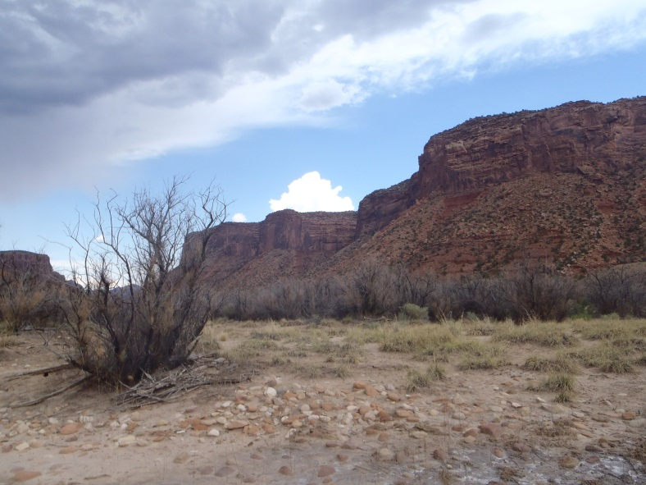
The tamarisk biocontrol program is on the way to being a tremendous success, bringing about with tamarisk decline over tens of thousands of acres in highly valued riparian zones of the west

Slide 20
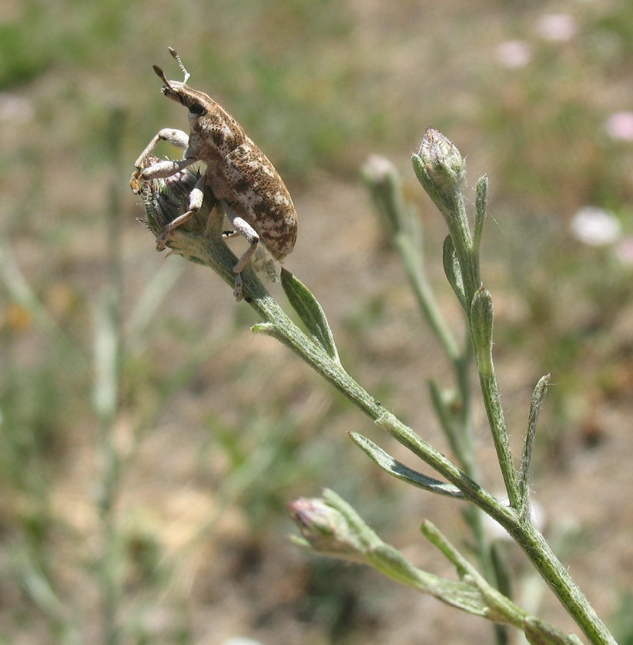
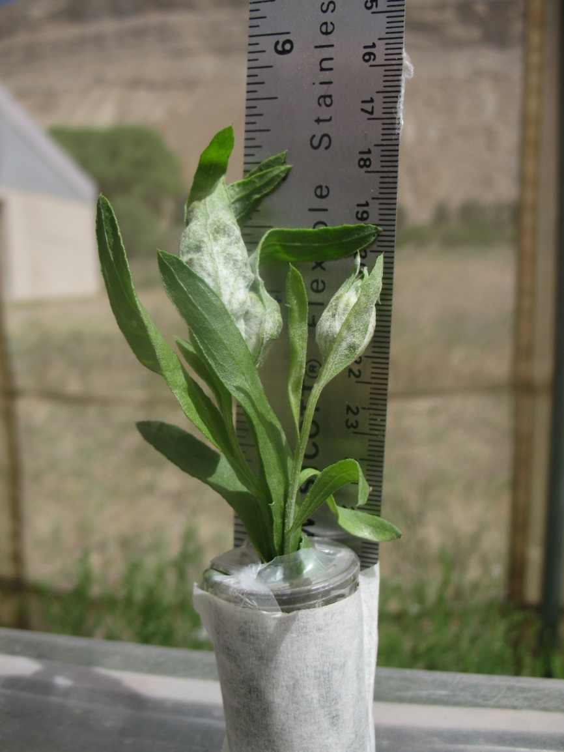
What weeds can we control using biological agents?
spotted knapweed
Russian knapweed

Slide 21
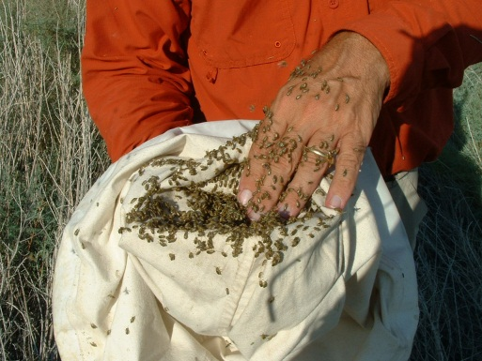
Providing biocontrol agents/ developing biocontrol programs
(numbers are for 2010 except for J. ivannikovi which is 2012)
Leafy Spurge Aphthona spp 200,000
Oberea erythrocephala 1000
Field Bindweed Aceria malherbae 900,000 (est)
Tyta luctuosa 27,410
Dalmatian toadflax Mecinus janthiniformis 11,115
Calophasia lunula 6806
Yellow toadflax Rhinusa linariae 300
Mecinus janthinus 800
Knapweeds Larinus minutus 4600
Russian knapweed Jaapiella ivannikovi 1,788 galls
Musk thistle Trichosirocalus horridus 3400
Canada thistle Urophora cardui 5020
Puncturevine Microlarinus spp 4300
Tamarisk Diorhabda carinulata 300,000

Slide 22
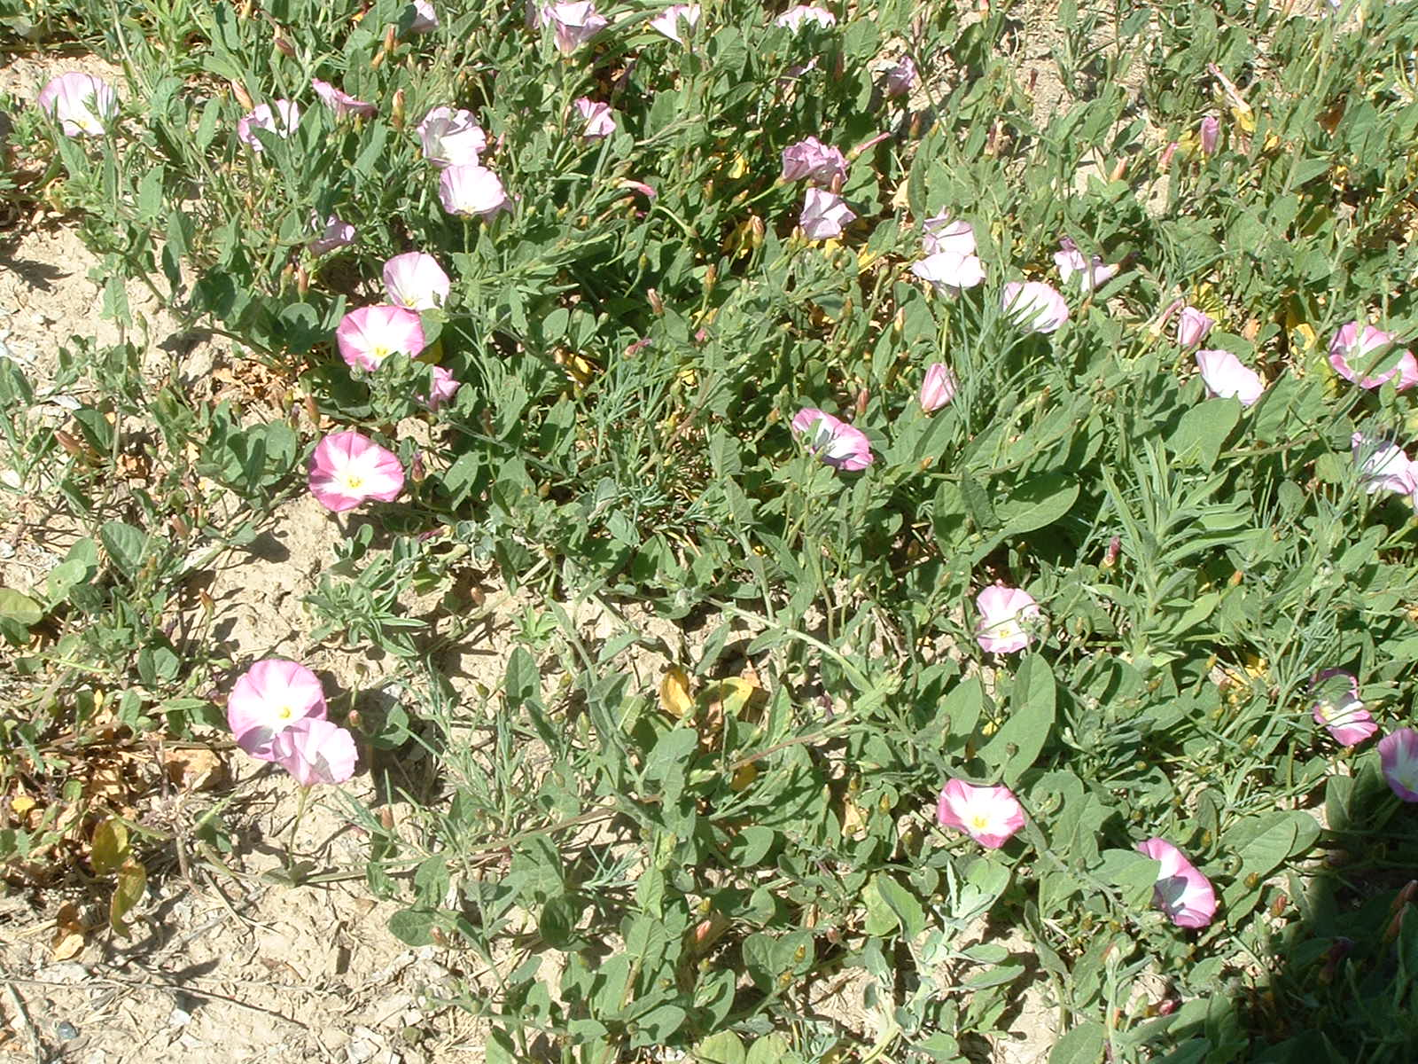
field bindweed

Slide 23
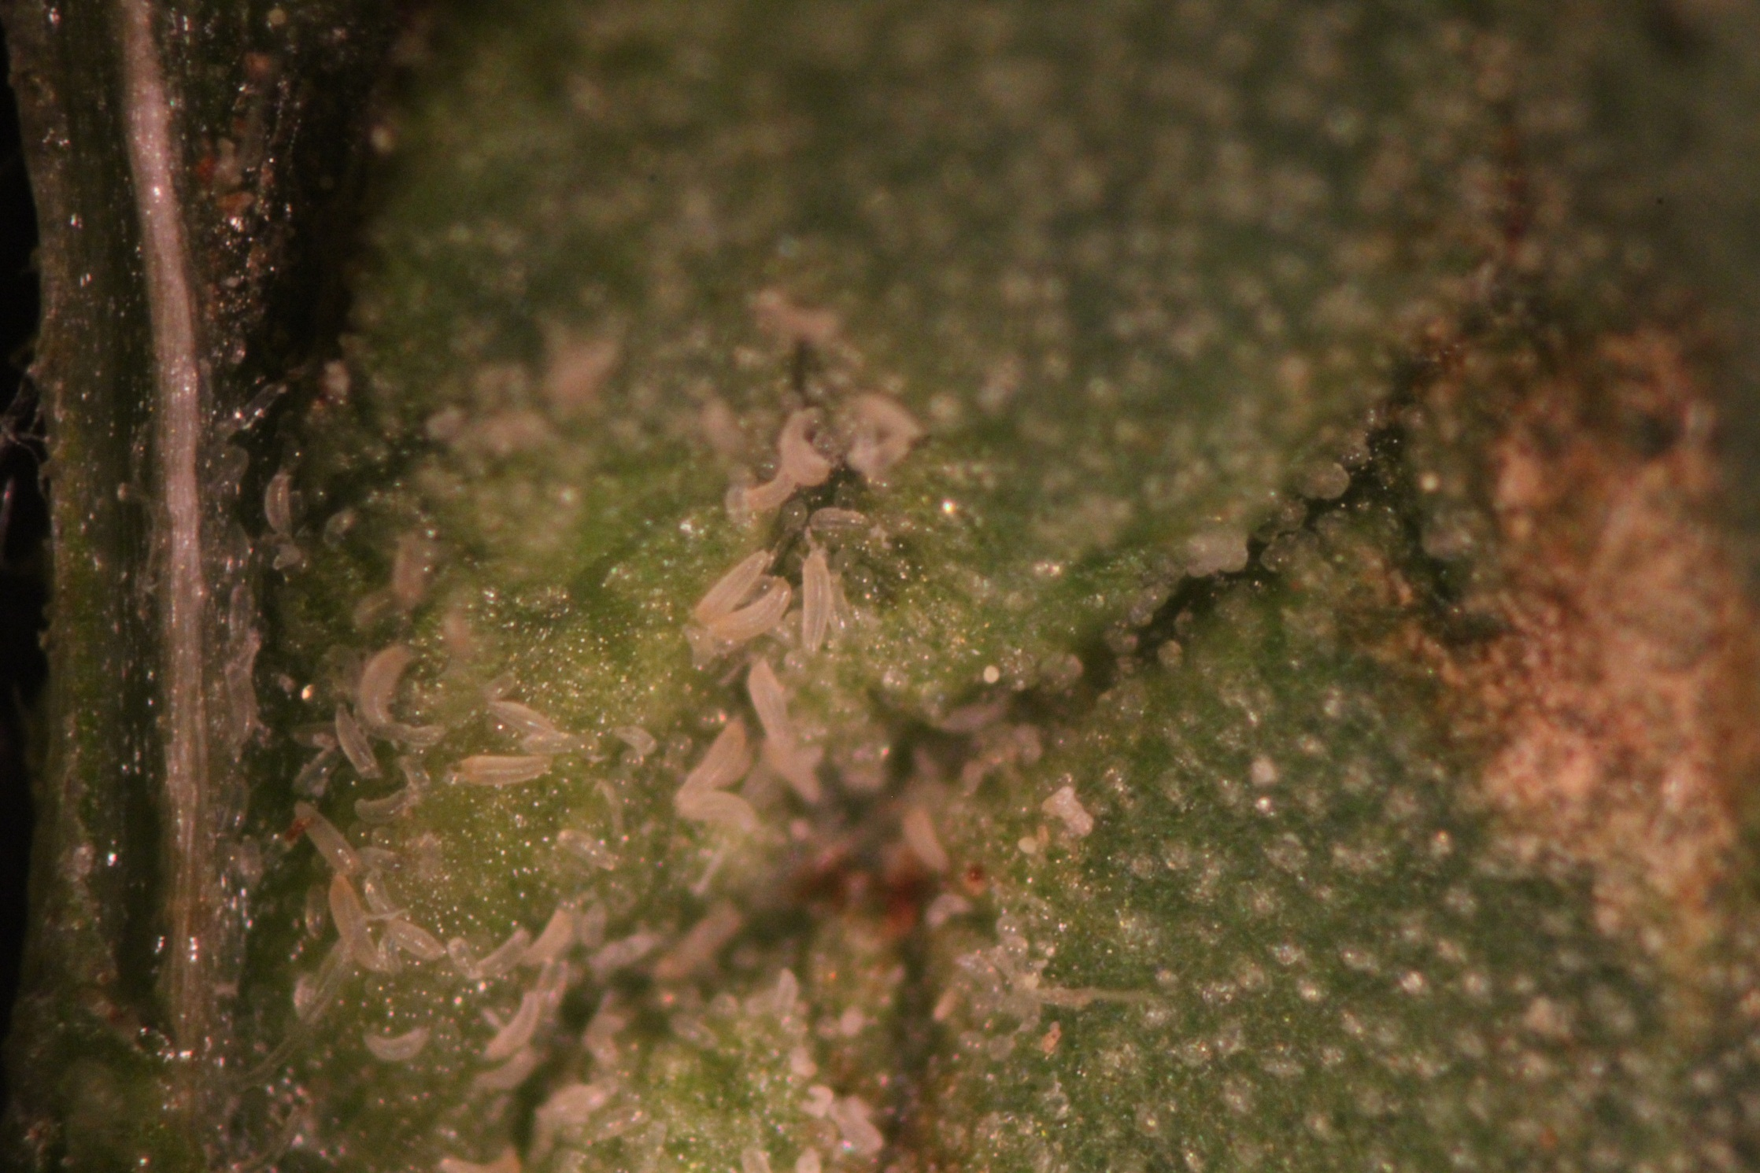
Bindweed mites are microscopic and cause the leaves to curl into galls

Slide 24
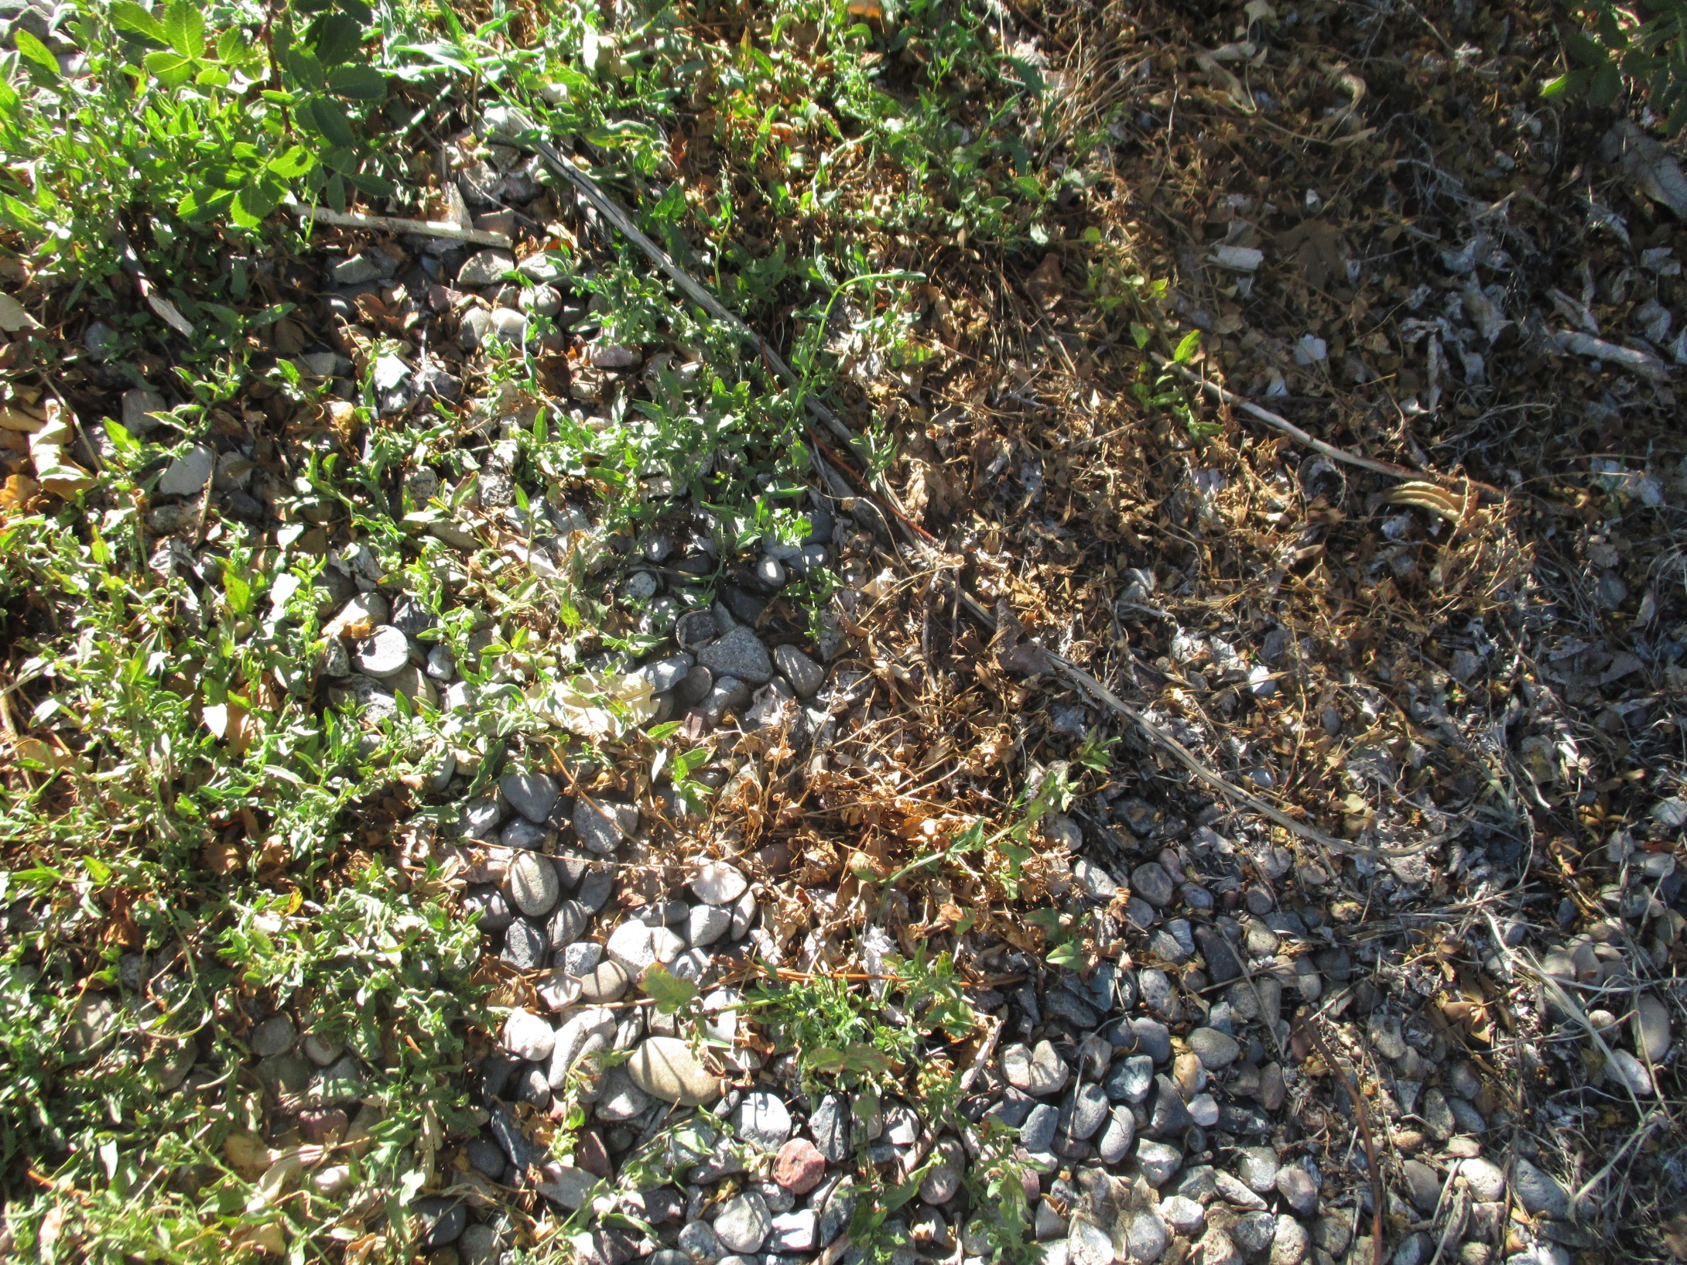
damaged field bindweed

Slide 25
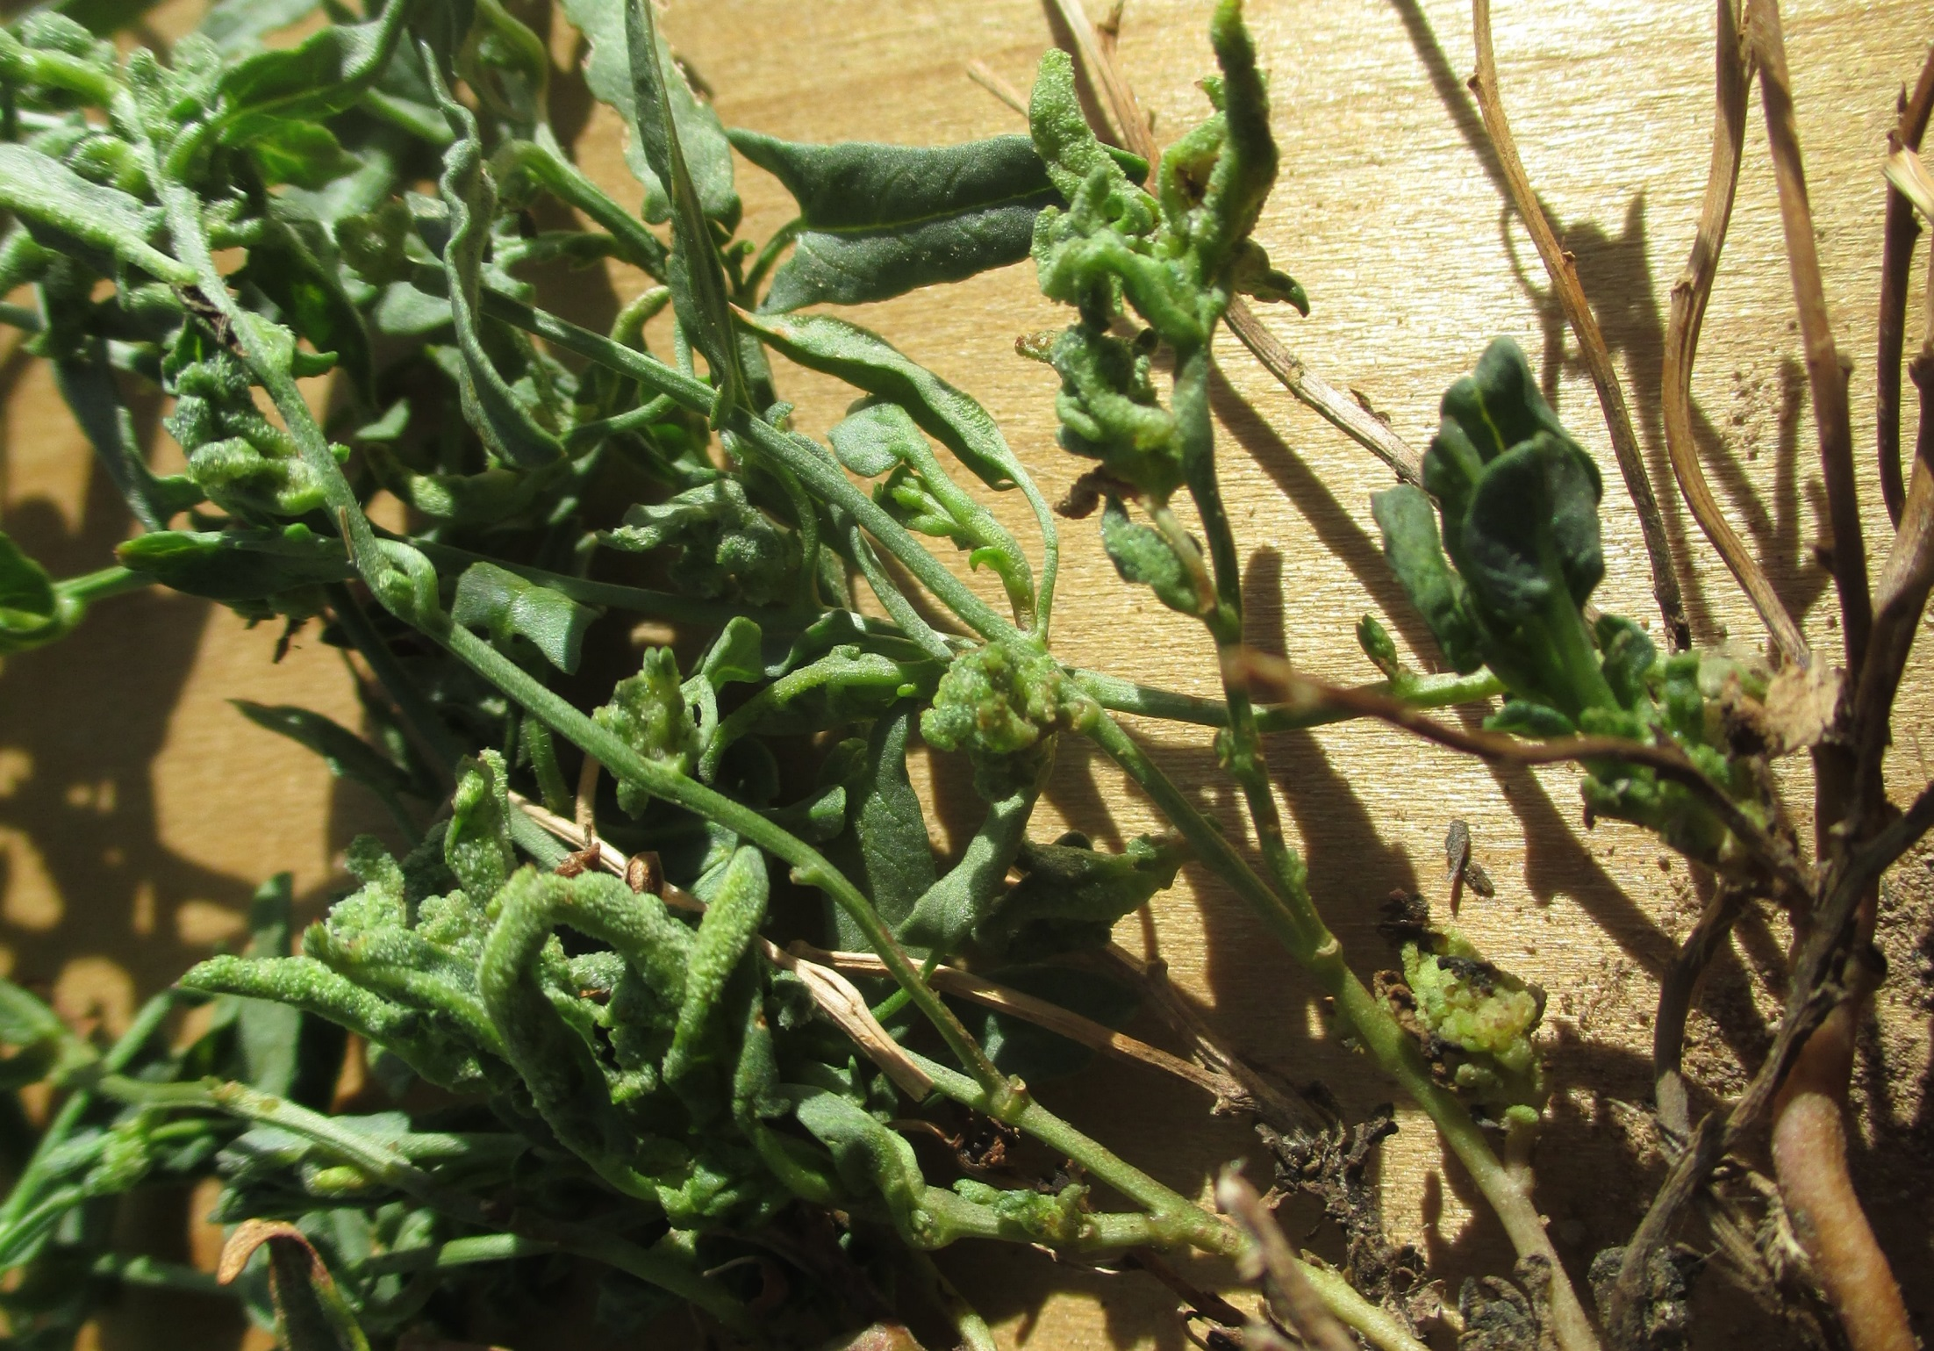
Mite induced galls

Slide 26
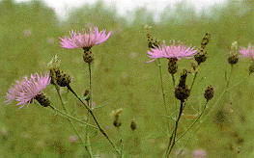
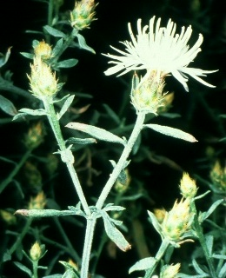
Diffuse and spotted knapweed biological control

Slide 27
Cyphocleonus achates
prefers spotted, will hit diffuse
larvae feed on roots

Slide 28
Larinus minutus
eggs
adults feed on foliage
Larvae
Knapweeds (diffuse and spotted)
pupae

Slide 29
Tamarisk biological control
Diorhabda carinulata

Slide 30
egg mass
Larva
Adult
Diorhabda carinulata

Slide 31
Bedrock 2010
Bedrock 2007
(prior to beetles)

Slide 32
Bedrock 2007
(prior to beetles)

Slide 33
few or no defoliations
?

Slide 35
Coniatus splendidulus
A new tamarisk feeder enters the system

Slide 36
Coniatus larva on tamarisk, highly cryptic
Woven basket where Coniatus pupates
This offers protection from predators found in the leaf litter.

Slide 37
Coniatus begin feeding earlier in the spring and remain active later in the summer/fall than Diorhabda
Tamarisk branch collected September 28. Diorhabda have been in diapause for about 30 days, Coniatus populations have exploded on the regrowth. Adults abundant, baskets abundant on branches with regrowth.

Slide 38
There are major tamarisk infestations south of Eads. Diorhabda have established there and Coniatus have now become abundant in some areas.

Slide 39
Coniatus near Eads, CO, 2014
Coniatus enter Colorado in 2011 and are now widespread
baskets
larvae
damage

Slide 40
Diorhabda are present but not in densities sufficient for widespread defoliation. Can pheromones be used to concentrate them?

Slide 41
Five pairs of trees were selected at the Sweetwater site near Eads, one tree from each pair was baited with pheromone. In three out of five pairs, the baited tree experienced some level of feeding damage and had higher densities of beetles at the end of the experiment.

Slide 42
D. carinata did poorly because of early season emergence from diapause which left populations vulnerable to the inevitable late freezes of the high plains (Milbrath et al 2007).
D. carinata x D. elongata produce viable eggs and hybrids are stable in culture (Bean et al 2013).
Cimarron River, near Ashland, KS (photo by Dave Arnold)
Molecular identification shows these beetles are primarily D. carinata

Slide 43
D. carinata
D. elongata
D. elongata x D. carinata

Slide 44
D. carinata
D. elongata
D. elongata x D. carinata

Slide 45
Pheromone traps failed to detect movement of Diorhabda carinata into Colorado
D. carinata
D. elongata
D. elongata x D. carinata

Slide 46
Will tamarisk biocontrol put water back into the system?

Slide 47
Nagler, P.L., S. Pearlstein, E.P. Glenn, T.B. Brown, H.L. Bateman, D.W. Bean and K.R. Hultine (2014) Rapid dispersal of saltcedar (Tamarix spp.) biocontrol beetles (Diorhabda carinulata) on a desert river detected by phenocams, MODIS imagery and ground observations. Remote Sensing of Environment 140: 206-219
We measured the rate of dispersal of saltcedar leaf beetles (Diorhabda carinulata), a defoliating insect released on western rivers to control saltcedar shrubs (Tamarix spp.), on a 63 km reach of the Virgin River, U.S. Dispersal was measured by satellite imagery, ground surveys and phenocams. Pixels from the Moderate Resolution Imaging Spectrometer (MODIS) sensors on the Terra satellite showed a sharp drop in NDVI in midsummer followed by recovery, correlated with defoliation events as revealed in networked digital camera images and ground surveys. Ground surveys and MODIS imagery showed that beetle damage progressed downstream at a rate of about 25 km yr−1 in 2010 and 2011, producing a 50% reduction in saltcedar leaf area index and evapotranspiration by 2012, as estimated by algorithms based on MODIS Enhanced Vegetation Index values and local meteorological data for Mesquite, Nevada. This reduction is the equivalent of 10.4% of mean annual river flows on this river reach. Our results confirm other observations that saltcedar beetles are dispersing much faster than originally predicted in pre-release biological assessments, presenting new challenges and opportunities for land, water and wildlife managers on western rivers. Despite relatively coarse resolution (250 m) and gridding artifacts, single MODIS
pixels can be useful in tracking the effects of defoliating insects in riparian corridors.

Slide 48
Yellow toadflax biological control

Slide 49
Mecinus janthinus a stem boring weevil on yellow toadflax
this species was collected on both yellow and Dalmatian toadflax in Europe. The Dalmatian toadflax weevil was later found to be a separate species, now named Mecinus janthiniformis.

Slide 50
Colleen Jandreau puts up yellow toadflax tent
Mecinus hits yellow toadflax in Colorado

Slide 51
Mecinus janthinus on yellow toadflax has outstanding promise

Slide 52
Russian knapweed biological control

Slide 53
Jaapiella ivannikovi

Slide 54
gall
adult fly
Jaapiella ivannikovi is looking like a promising agent. This fly lays eggs in shoot tips and stops growth and flowering.
The flies were obtained from Rich Hansen, USDA APHIS in Ft. Collins.

Slide 55
2 mm
A gall may contain up to 30 larvae of the gall fly. They are small but very effective in stopping shoot growth.

Slide 56
Larvae pupate within galls
Adults emerge about 2 weeks after gall formation. Adults are about the size of a fruit fly.

Slide 59
Jess McKenney, Nina Louden and Dick Reardon inspect RK biocontrol site

Slide 60
Crowley County near Lake Meredith

Slide 61
Aulacidea acroptilonica

Slide 65
The Russian knapweed biocontrol program
We harvested about 5,000 galls in 2014
We did more than 60 open field releases in 2014
We monitored 15 field sites in 2014 and assisted with others in a cooperative program with CSU
We continued the gall wasp program.

Slide 66
Canada thistle biocontrol using a rust fungus

Slide 67
Dr. Dana Berner, USDA ARS

Slide 68
Roots
Dr. Dana Berner, USDA ARS

Slide 69
Puccinia punctiformis in the spring. Plants are yellowish and smell like flowers, even though they are weeks away from flowering. The most likely fate of these plants is death.

Slide 71
Systemically infected shoots in the spring
these smell like thistle flowers
X
After crossing, brown aeciospores are formed

Slide 72
yellowing neighbors
marked for teliospore production

Slide 73
Teliospore bearing leaves are dried and ground into a powder

Slide 74
Inoculation of rosettes in the fall

Slide 77
CT rust releases include monitoring transects at the release sites
We now have 80 release and monitoring points

Slide 79
Monitoring sites needed for release and evaluation of biological controls by the CDA
Russian knapweed infestations, 2 acres or more, need to set up long term monitoring and release of gall flies and possibly other agents as they became available
Canada thistle infestations, half an acre or more where no spraying is planned. We will set up monitoring site and release Canada thistle rust, which is host specific and already found in the US.
Russian knapweed monitoring
Please contact Dan Bean at (970) 464-7916 or write to dan.bean@state.co.us

Slide 80
Thanks to:
Everyone at the Palisade Insectary, especially Nina Louden, Sonya Ortega and Karen Rosen
Our cooperators
Dr. Dana Berner of the USDA ARS for the Canada thistle rust slide

