Slide 1
Musk Thistle Management In Rangeland Environments
John Coyle

Slide 2
Blue Creek Ranch
Cimarron, Colorado
Notes:
What I want to talk about today is the research I’ve been involved with at CSU as a master’s student. And that is centered around BCR…

Slide 4
Content
Determining the extent of the problem using geostatistical analysis
Herbicide research
Notes:
We needed a way to quantify the problem other than
The solutions are already out there, we want to know whats happening in the environment around the problem

Slide 5
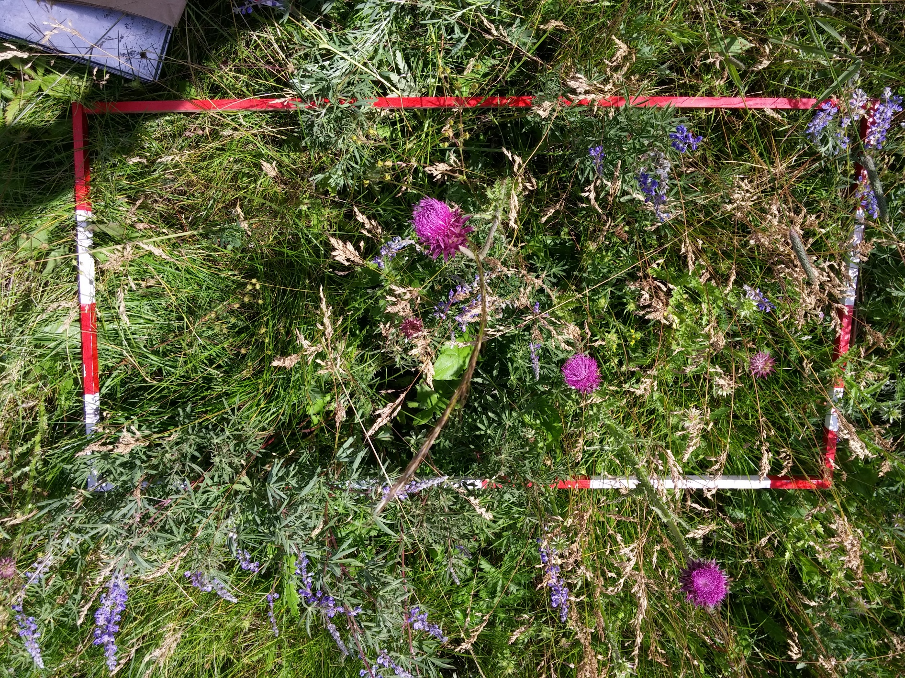
The Problem
Notes:
Musk thistle- biennial sometimes annual weed. Many herbicide choices, not particularly difficult to manage. But after years of an ineffective management strategy has left a considerably portion of the ranch infested. Encroachment.

Slide 8
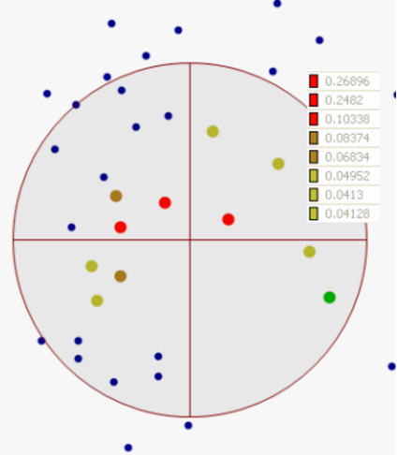
Inverse Distance Weighting (IDW)
To predict a value for any unmeasured location, IDW uses the measured values surrounding the prediction location.
Assumptions
Values in close proximity are more alike than values further away
IDW assumes that each measured point has a local influence that diminishes with distance.
http://pro.arcgis.com/en/pro-app/help/analysis/geostatistical-analyst/how-inverse-distance-weighted-interpolation-works.htm
Notes:
A method to predict the intensity of the infestation without directly observing it.

Slide 9
Results
Mechanism of seed dispersal (Wind/Road/Cattle)
Elevation and musk thistle presence
Cattle distribution and land degradation
Aspect: all except southern (135 to 225 degrees)
Slope: <20.2%
Notes:
Prevailing winds evidence to confirm suspicions

Slide 10
Management Implications
Utility of an in-depth geostatistical analysis on weed density and distribution largely situational.
Resource allocation
Scope of project
Difficulty of terrain
Help focus management actions and avoid wasting resources.
Focus work where the greatest impact can be made
Track progress over the course of the project
Offers an easy to understand representation of a weed infestation
Notes:
99% this is probably unnecessary and resources can be better allocated elsewhere.
But

Slide 11
Effects of Musk Thistle Management on Forage Quality in Montane Rangelands
John Coyle
Dr. Scott Nissen
Dr. Paul Meiman

Slide 12
Notes:
Right in the “red”
2 sites cut by ridge, very different

Slide 13
Musk Thistle on BCR
Competitive with native vegetation
Integrated into healthy rangeland
Biocontrol is not keeping pace
Psychological
Notes:
Unique qualities
Vigorous native plant community (ref pic)
Barrier to travel (ref pic)
No evidence of overgrazing, over use

Slide 14
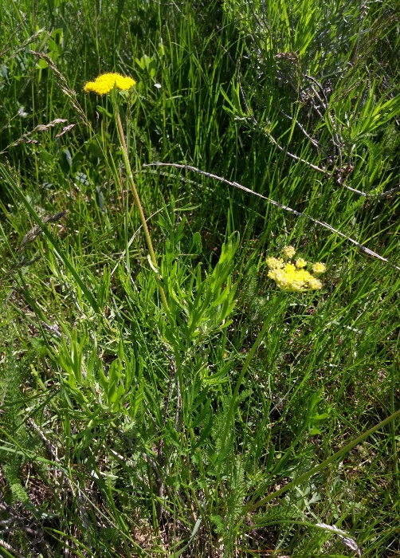
Research Objectives
Evaluate the efficacy of several herbicides for musk thistle control
Evaluate the impacts of herbicide treatments on the overall species diversity and forage quality
Notes:
Are we effective
Already mentioned
Dense cover interception
Sometimes Duality of management correctly with care

Slide 15
Materials and Methods
Herbicide | Product Name | Product (oz/A)
Aminopyralid (Low) | Milestone | 3
Aminopyralid (High) | Milestone | 7
Picloram | Tordon | 16
Aminocyclopyrachlor (AMCP) + chlorsulfuron | Perspective | 3

Slide 16
Herbicide Treatments
The first herbicide treatment was made on each plot in fall of 2014.
The treatment plots were split in fall of 2015 and a second consecutive treatment was applied on half of the plot.

Slide 17
Materials and Methods
Biomass data (2015)
Cover data (2015 and 2016)
Feed analysis (2015)
Wet chemistry
Total Digestible Nutrients (TDN)
Notes:
To evaluate
TDN as a composite measure of digestible energy (Protein, lipid, carbohydrate, dig. fiber)

Slide 18
Results 12 Months After Treatment (MAT)

Slide 19
Effect of Herbicide Treatment on Musk Thistle (12 MAT)

Slide 20
Forb Cover Response 12 MAT

Slide 21
Species Richness 12 MAT

Slide 22
Total Biomass of Grass and Edible Forbs (12 MAT)
Results
Notes:
EDIBLE FORBS!!!

Slide 23
Results
Total Digestible Nutrients (Forbs+Grass)
Notes:
Digestible energy
Go through axes
Grass biomass unchanged

Slide 24
Results 24 MAT

Slide 25
Musk Thistle Cover Response 24 MAT (East)

Slide 26
Musk thistle Cover Response 24 MAT (West)

Slide 27
Forb Cover Response 24 MAT (East)

Slide 28
Forb Cover Response 24 MAT (West)

Slide 29
Grass Cover Response 24 MAT (East)

Slide 30
Grass Cover Response 24 MAT (West)

Slide 31
Conclusions
All tested herbicides controlled musk thistle
Forb cover was generally reduced by 20% of absolute cover
There was some site dependent reduction of unique species
None of the tested herbicides reduced forage quality or abundance

Slide 32
Management Implications
All treatments performed satisfactorily at reducing musk thistle cover while preserving forage quality and species richness
The areas of concern (lower forb cover and lowered species richness) are mitigated by the fact that the ranch has abundant co-occurring species.
Other factors can be used in the decision making process: cost, availability, labeling…

Slide 33
Questions?

