Slide 1
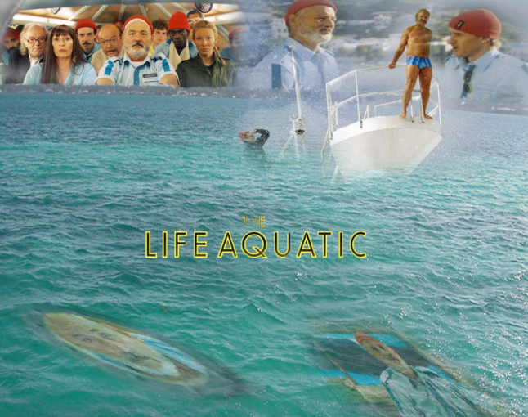
Upper Arkansas Cooperative Weed Management Association
Fall 2016
Dr. Scott Nissen
Western Invasive Weed Short Course
Colorado State University

Slide 2
Outline
Aquatic Plant Species
Noxious weed species
Other species
Problem Species
Eurasian watermilfoil
Sago pondweed
Aquatic Weed Control Methods

Slide 3
CDA Aquatic Noxious Species
A List
Hydrilla
Giant Salvinia
B List
Eurasian watermilfoil

Slide 4
Eurasian Watermilfoil
Only aquatic species on the Noxious Weed List found in Colorado
Occurs in most western states
Submerged perennial with an annual growth habit
Grows in waters up to 20 feet deep, but most abundant between 3 and 12 feet
Reproduction in through fragmenting, after flowering
Has no overwintering structures, is essentially evergreen
Fragments easily transported between water bodies

Slide 5
Eurasian Watermilfoil
Can quickly colonize ponds, lakes, and irrigation canals
Most commonly found in shallow ponds
Also found in irrigation canals
Will form very dense mats
Commonly found in monoculture stands, often misplacing native and desirable species

Slide 6
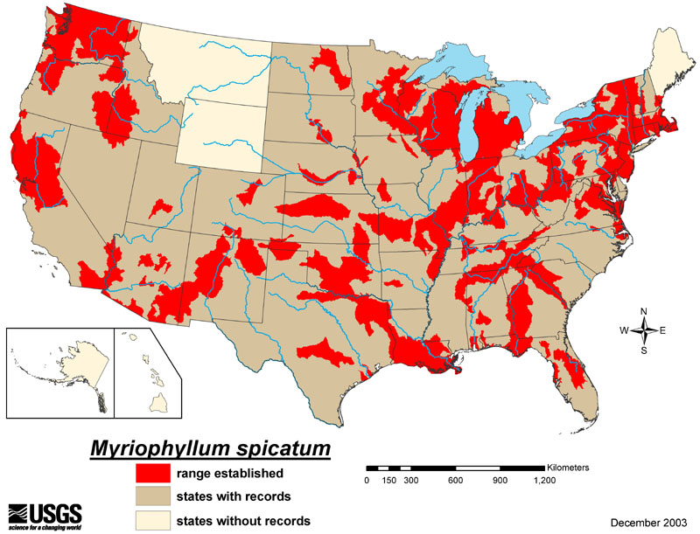

Slide 7
Eurasian Watermilfoil
Negative impacts on:
Recreation-Fishing, swimming, boating, etc…
Water delivery
Habitat-Mats can lead to a reduction in dissolved oxygen

Slide 8
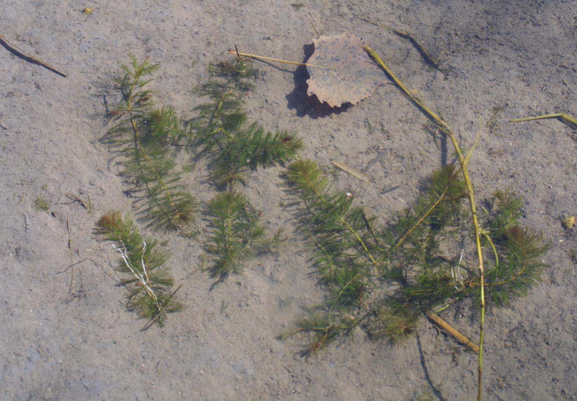
Rooted Eurasian watermilfoil fragments

Slide 9
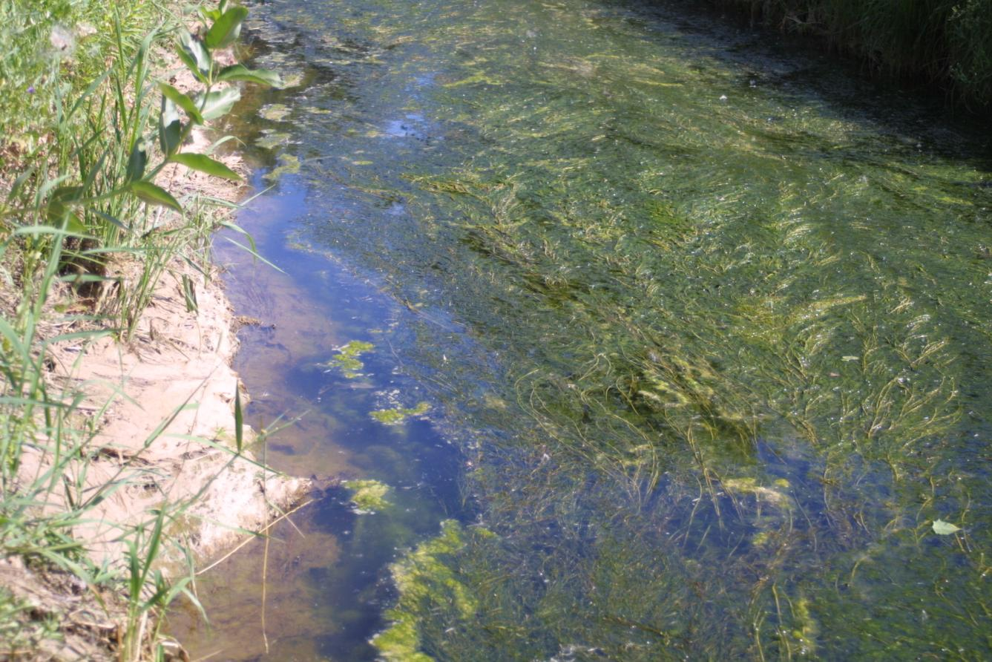
Same irrigation canal the following summer

Slide 10
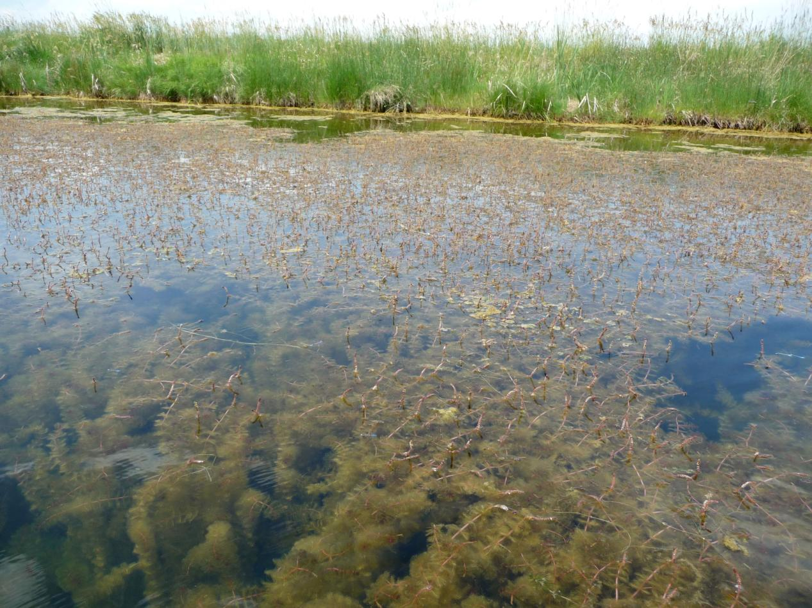
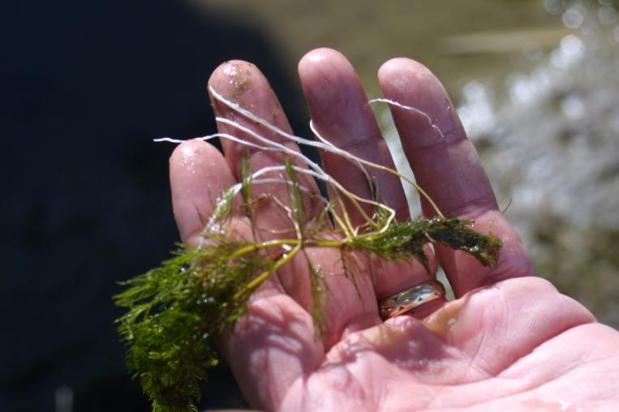

Slide 11
Other Common Species
Sago pondweed
Horned pondweed
Curlyleaf Pondweed
Native Milfoils
Coontail
Common Elodea
Chara

Slide 12
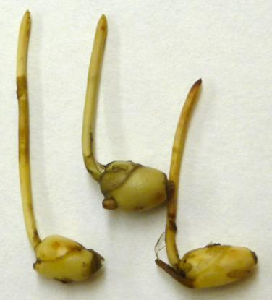
Sago pondweed
Native submersed perennial
Thrives in flowing water
Reproduction and overwintering through tubers
Can form tubers up to 18 inches deep
Leaves are alternate

Slide 13
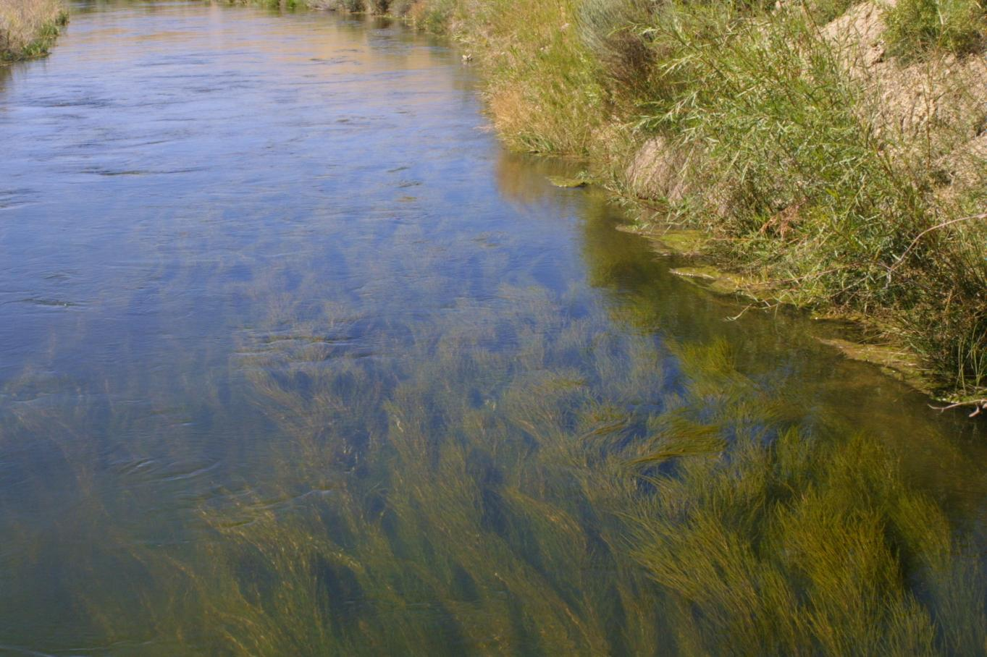
Sago pondweed infestation near Platteville, CO

Slide 14
Horned pondweed
Annul submerged species, acts as an annual where water is seasonal (irrigation canals)
Spreads through seeds as well as creeping rhizomes
Long slender leaves
Looks very similar to sago pondweed, but has “horns” at each node
Leaves are opposite

Slide 15
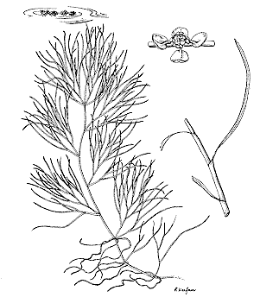
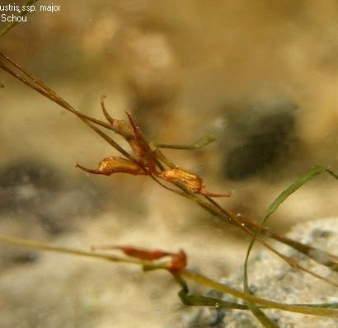
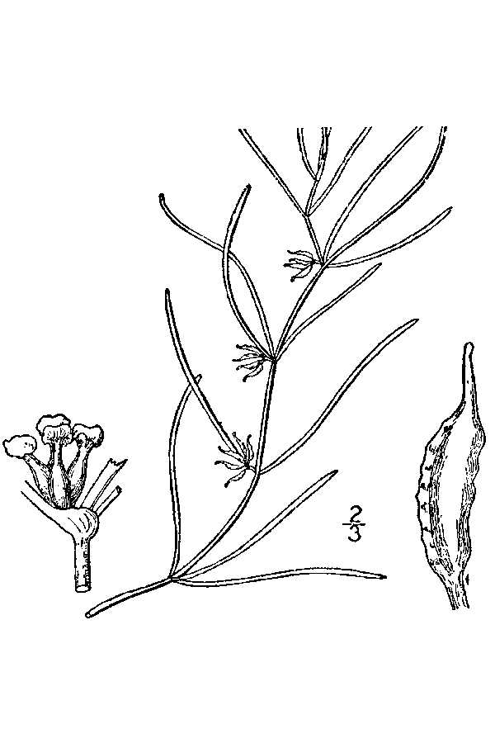
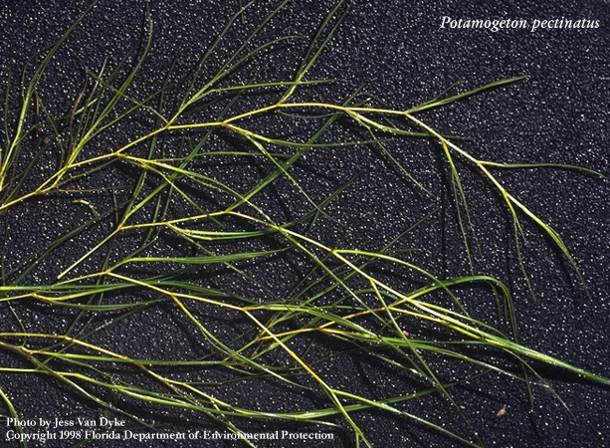
Horned Pondweed
Sago Pondweed

Slide 16
Curlyleaf pondweed
Wider leaves than Sago pondweed
Does produce seed, but main means of reproduction are through turions and fragments
Turions allow plants to over-winter
Has leaves that are 2-3” long that have leaf margins that are “wavy”

Slide 17
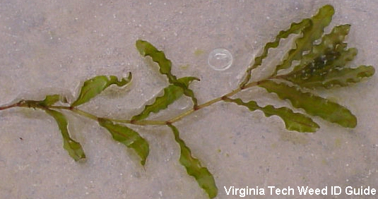

Slide 18
Native Milfoils
Northern milfoil
Very similar in growth habit to Eurasian watermilfoil, can hybridize with EWM
Although native, can still form dense stands and be troublesome
To identify hybrids requires genetic testing

Slide 19
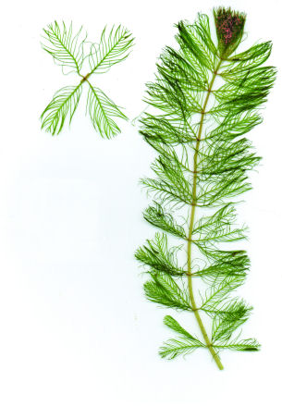
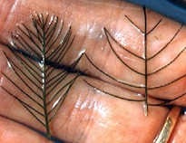
Native Milfoils

Slide 20
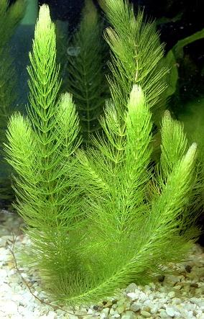
Coontail
Submerged species with no roots
Has a free floating life form
At first glance can resemble a milfoil species

Slide 21
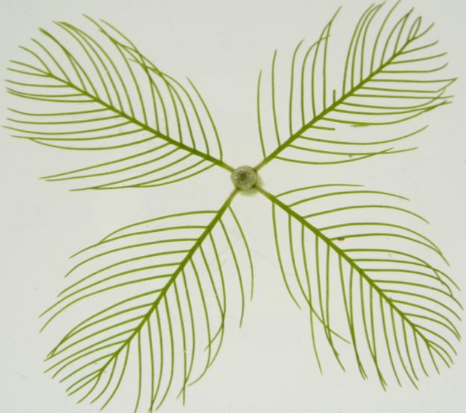
Coontail
Eurasian Watermilfoil

Slide 22
Common elodea
Occurs as a submerged perennial species
Has long, slender stems with 3-4 leaves at each node
Can sometimes be confused with hydrilla

Slide 23
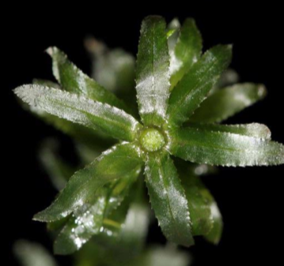
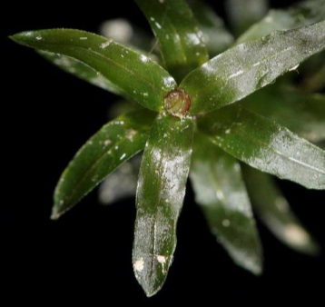
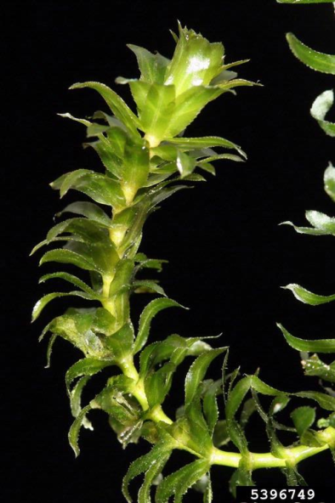
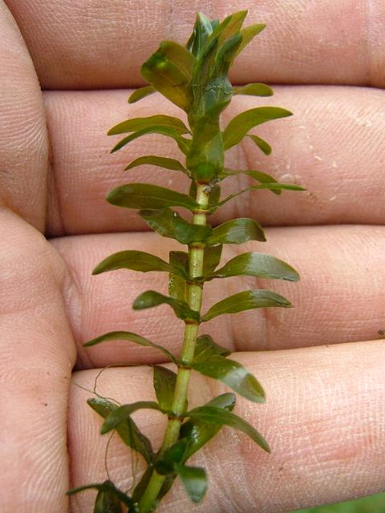
A
B
Hydrilla
Whorls of 4-8 (most 5)
Toothed margins
Toothed midrib
Larger leaves
Elodea
Whorls of 3 (or 4)
Smooth leaves
Smaller leaves

Slide 24
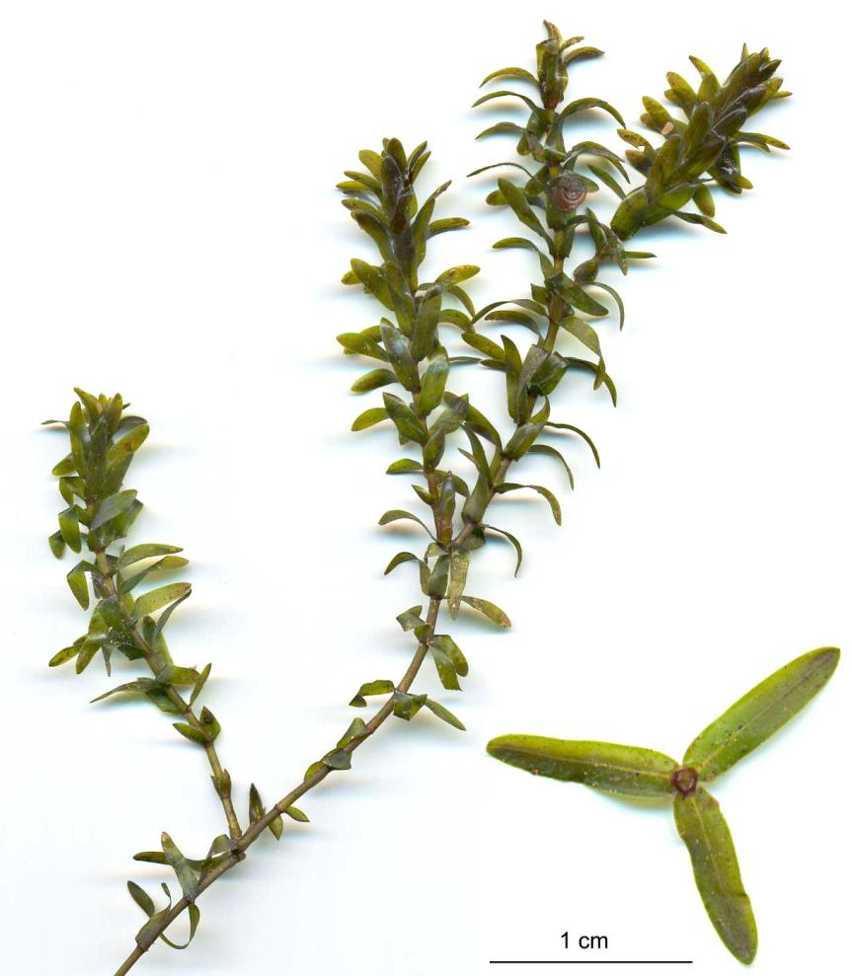

Slide 25
Chara
Resembles a vascular plant, but is actually an algae
Are anchored to the sediment by root-like structures
Have whorls of branches at each node
Can also be identified by a skunklike odor when branches are crushed

Slide 26
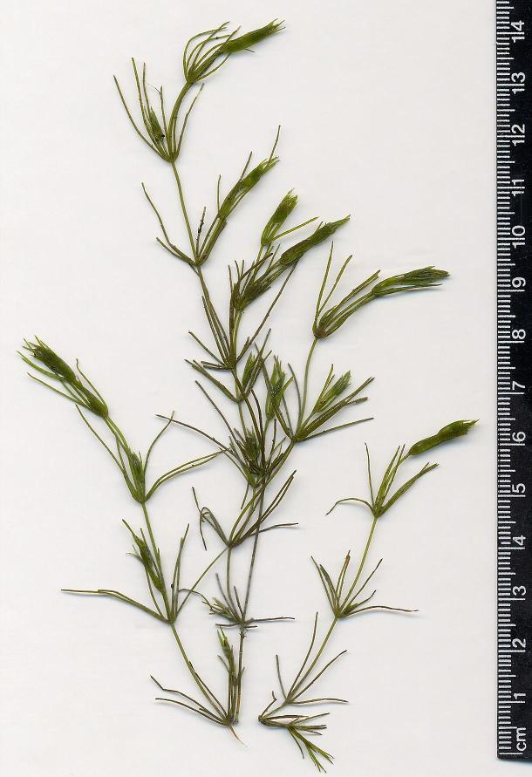
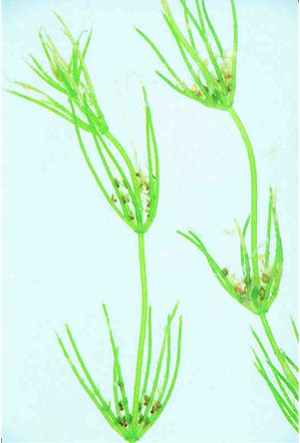

Slide 27
Control Methods For Aquatic Species

Slide 28
Control Methods
Mechanical
Rotovation
Aquatic harvester
Dredging
Biological
Physical
Benthic barrier
Hand pulling
Chemical
Contact herbicides
Systemic herbicides
Application methods

Slide 29
Mechanical Control
Rotovation
Bascially works as an underwater rototiller
Can provide temporary control
Aquatic harvester
Cuts off plants 2-3 feet below the water surface
Can provide re-infestation if not all fragments are collected
Dredging
Mechanically digging out plants
Very time consuming

Slide 30
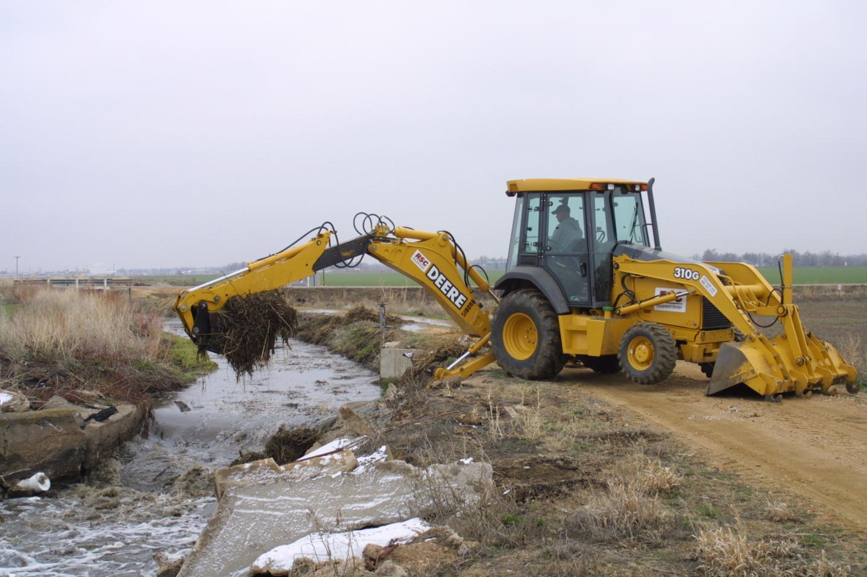
Dredging a canal infested with Sago pondweed

Slide 31
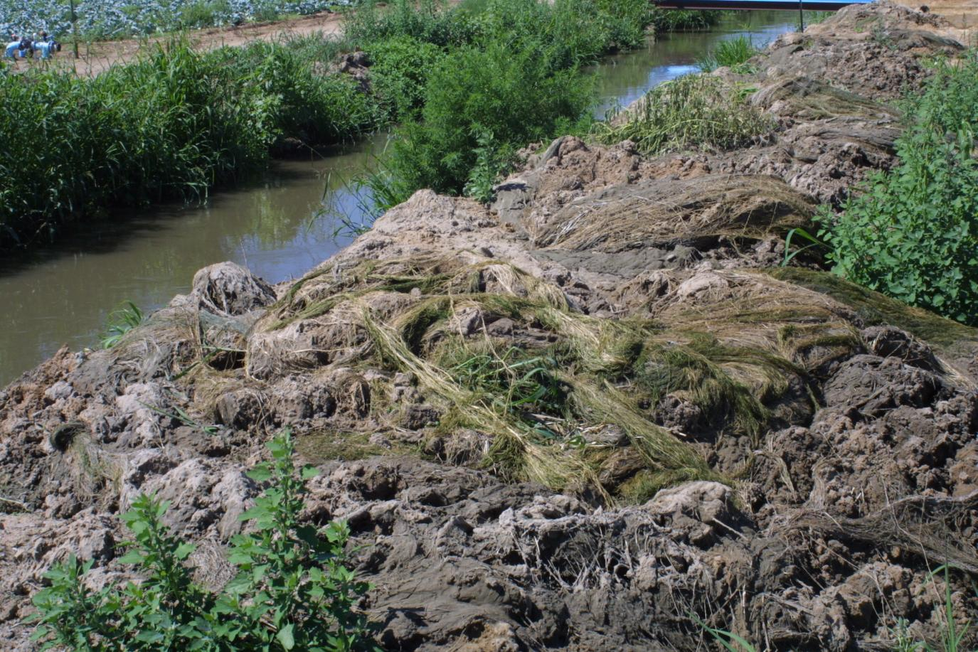
Sago pondweed removed from canal

Slide 32
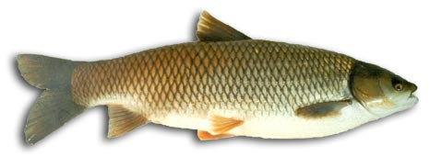
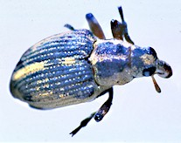
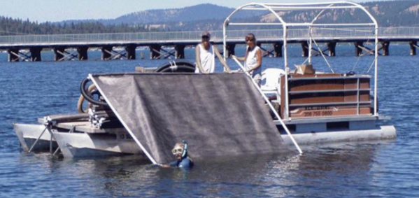
Control Methods
Mechanical
Rotovation
Aquatic harvester
Dredging
Biological
Physical
Benthic barrier
Hand pulling
Chemical
Contact herbicides
Systemic herbicides
Application methods

Slide 33
Control Methods
Mechanical
Rotovation
Aquatic harvester
Dredging
Biological
Physical
Benthic barrier
Hand pulling
Chemical
Contact herbicides
Systemic herbicides
Application methods

Slide 34
Contact Herbicides
Faster burndown of aquatic plants.
Do not translocate throughout the plant.
High herbicide concentrations for shorter exposure time.
Known as Contact Exposure Time (CET)
Need to match CET with situation
Ideal for areas with high water exchange.
Currently only 5 ai’s with 3 MOA’s
Notes:
Total of 13 aquatic herbicides registered for use.

Slide 35
Contact Herbicides
Herbicide | Use Rates | Exposure Time | Selectivity | MOA
Clearigate/Nautique Copper chelate | Up to 1 ppm | hours to 1 day | Broad Spectrum | Unknown
Cascade/Teton Endothall | Up to 5 ppm | hours to days | Depends on Rate | Unknown
Reward* Diquat | Up to 1.5 ppm | hours to days | Broad Spectrum | PS I
Stingray Carfentrazone | Up to 0.2 ppm | hours to 1 day | Selective | PPO
Clipper Flumioxazin | 0.1-0.4 ppm | Hours to days | Selective | PPO

Slide 36
Systemic Herbicides
Slower acting that contact herbicides
Translocate throughout the plant.
Work on a range of submersed, emergent, and floating aquatic plants.
Can require much longer exposure times (hours to weeks)
Ideal for whole-lake or low water exchange treatments
Currently only 8 ai’s with 4 MOA’s

Slide 37
Systemic Herbicides
Herbicide | Use Rates | Exposure Time | Selectivity | MOA
Navigate* 2,4-D ester | 0.5 – 3.0 ppm | hours to days | Selective | Auxinic
Renovate* Triclopyr | 0.75 – 2.5 ppm | hours to days | Selective | Auxinic
Rodeo* Glyphosate | N/A | not for submersed | Non-selective | EPSPS
Habitat* Imazapyr | N/A | not for submersed | Non-selective | ALS
Sonar* Fluridone | 10 – 90 ppb | 45+ days | Selective | Pigment
Galleon Penoxsulam | 5 - 15 ppb | 45+ days | Selective | ALS
Clearcast Imazamox | 50 – 500 ppb | 14+ days | Selective | ALS
Tradewind Bispyrabac | 20 – 45 ppb | 45+ days | Selective | ALS

Slide 38
Chemical Control
Things to consider when choosing an aquatic herbicide:
Required exposure time
Selectivity
Potential non-target effects
Potential irrigation restrictions
Potential drinking water restrictions
Water flow

Slide 39
Chemical Control
In order to obtain control you must:
Correctly identify the species
Use the correct product
Apply at the correct time
Maintain the required concentration
Keep that concentration for the required exposure time
Also keep in mind resistance management
Rotate MOA’s
Combination treatments

Slide 40
Example: Algae Control

Slide 41
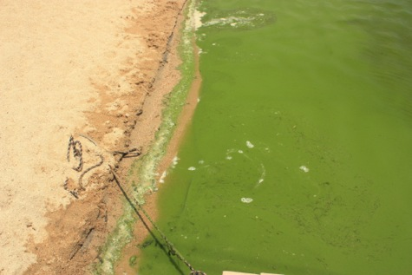
Planktonic Algae (0 DAT)
Clarity 33 inches
Temp 26.4 C
DO 7.8 mg/ml

Slide 42
3 DAT (July 5)
Clarity 54.5 inches
DO 6.9 mg/l

Slide 43
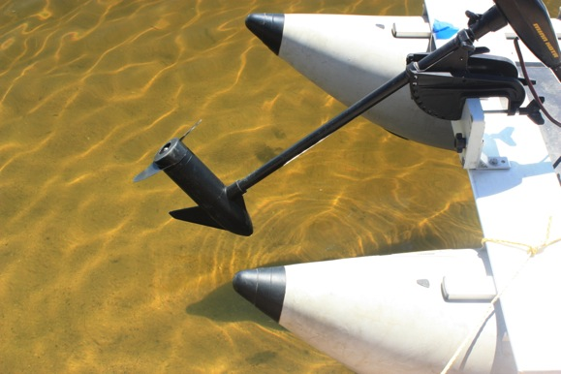
14 DAT (July 17)
Clarity 80 inches
DO 6.7 mg/l

Slide 44
Herbicide Application Methods

Slide 45
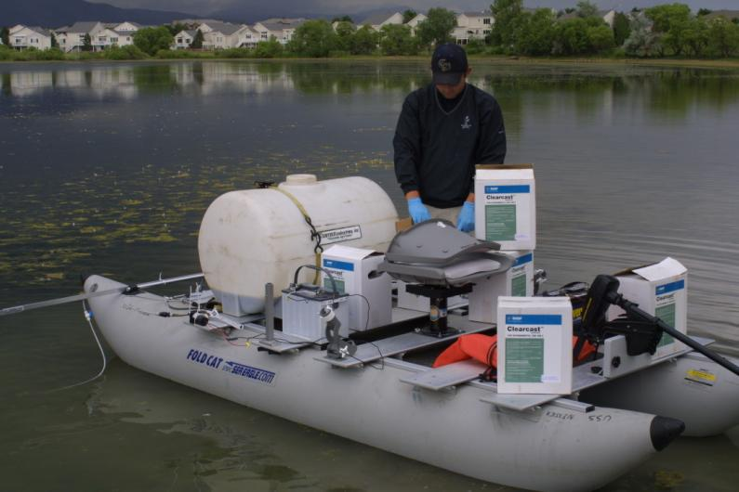
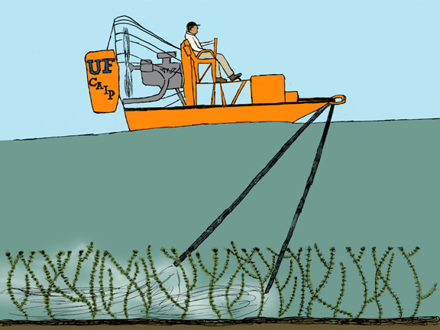
Injection Treatments

Slide 46
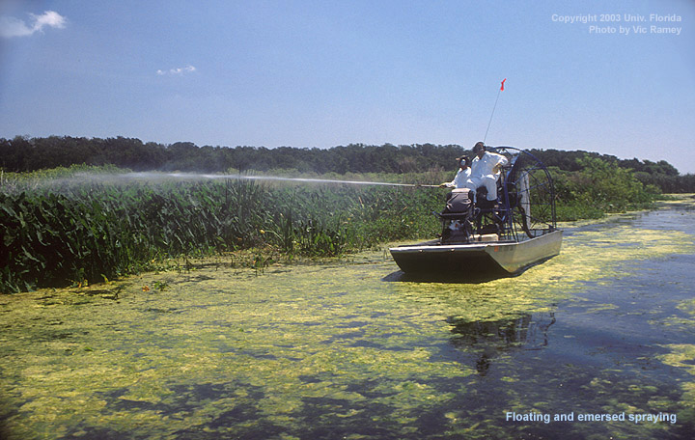
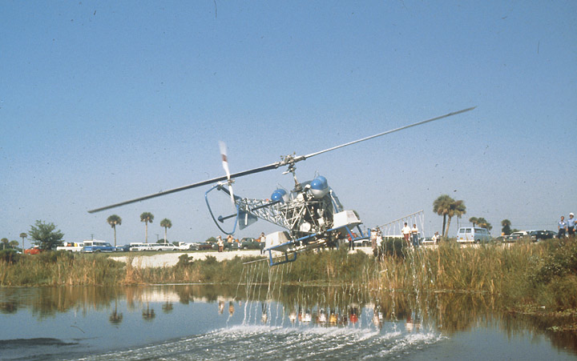
Foliar Applications

Slide 47
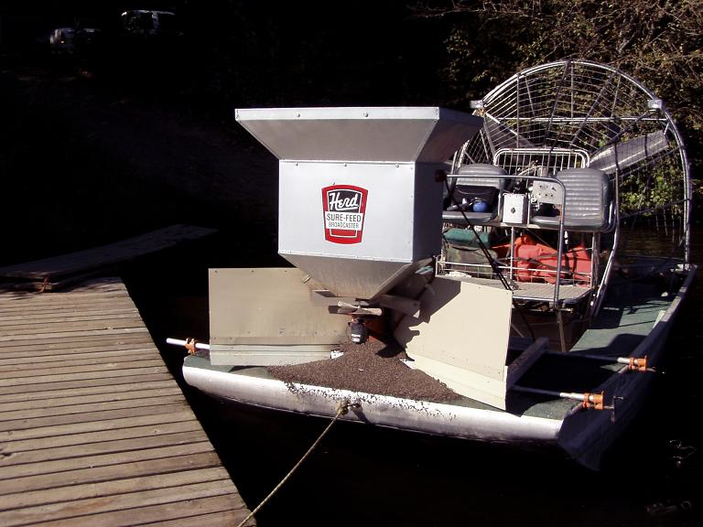
Granular Application

Slide 48
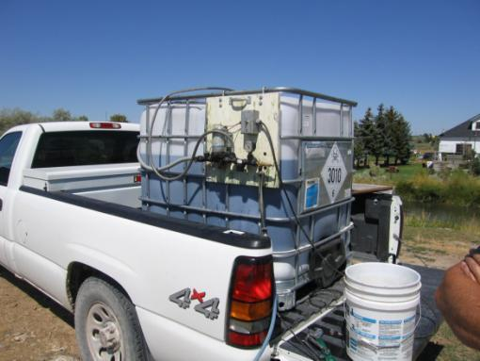
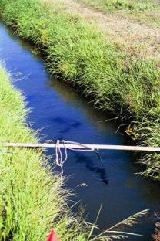
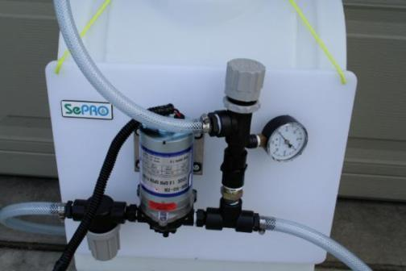
Flowing Water Treatments

Slide 49
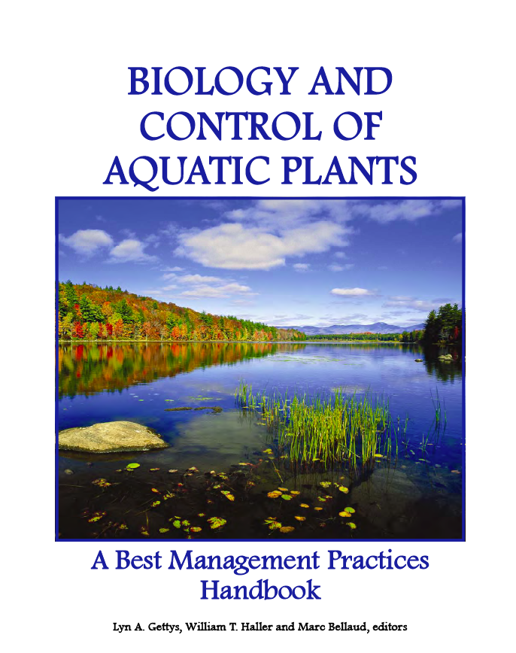
For More Information
Available at: www.aquatics.org

Slide 50
Questions?
Dr. Scott Nissen
970-491-3489
Scott.Nissen@ColoState.edu

