Slide 1
AQUATIC WEED CONTROL 2015 PERSEVERANCE AND HUMILITY

Slide 2
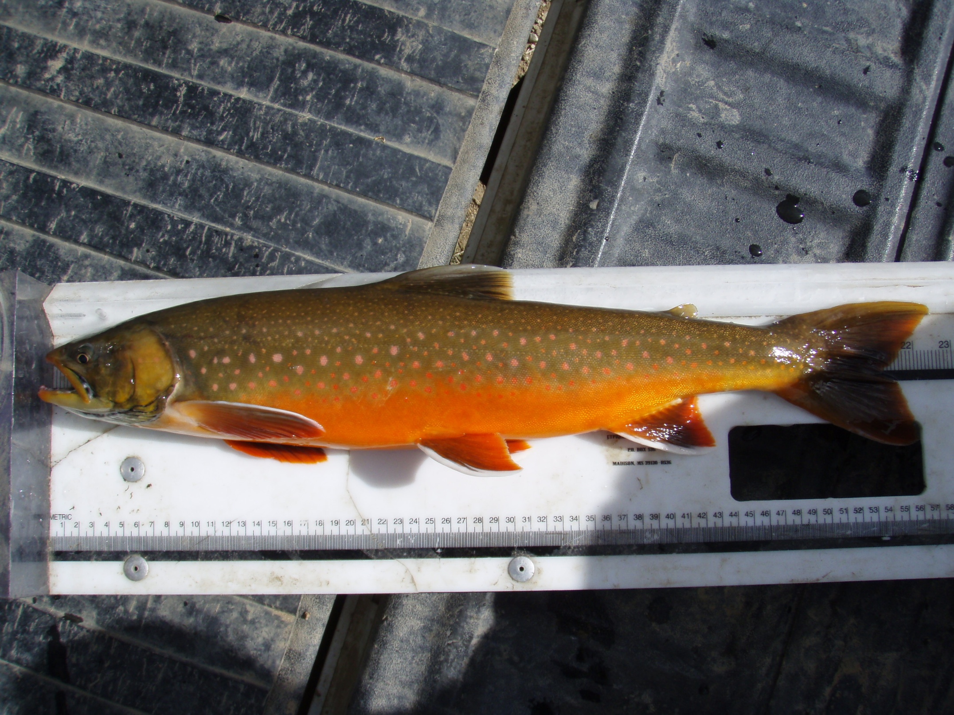

Slide 4
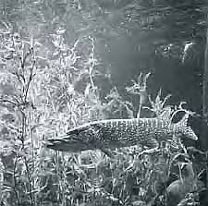
Role of Aquatic Plants
Aquatic macrophytes benefit the system as:
A source of dissolved oxygen (O₂)
A sink for Carbon Dioxide (CO₂)
Bank, bed and shoreline protection
Habitat for macroinvertebrates and fish
Food for waterfowl and animals
Nutrient cycling and slowing of sediment transport

Slide 5
How Many Plants Are Too Many?
Depends on the water body size and type of fishery.
There should be a narrow band of underwater and emergent plants around much of the water's edge. These plants will stabilize the shoreline and attract fish from deeper water.
~10-20% cover in ponds and small lakes
~10-30% cover in larger lakes and reservoirs
Literature varies – Know Your Site!

Slide 6
“ Aquatic plants become weeds when they hinder human uses of water and threaten the structure and function of diverse aquatic habitats.”

Slide 7
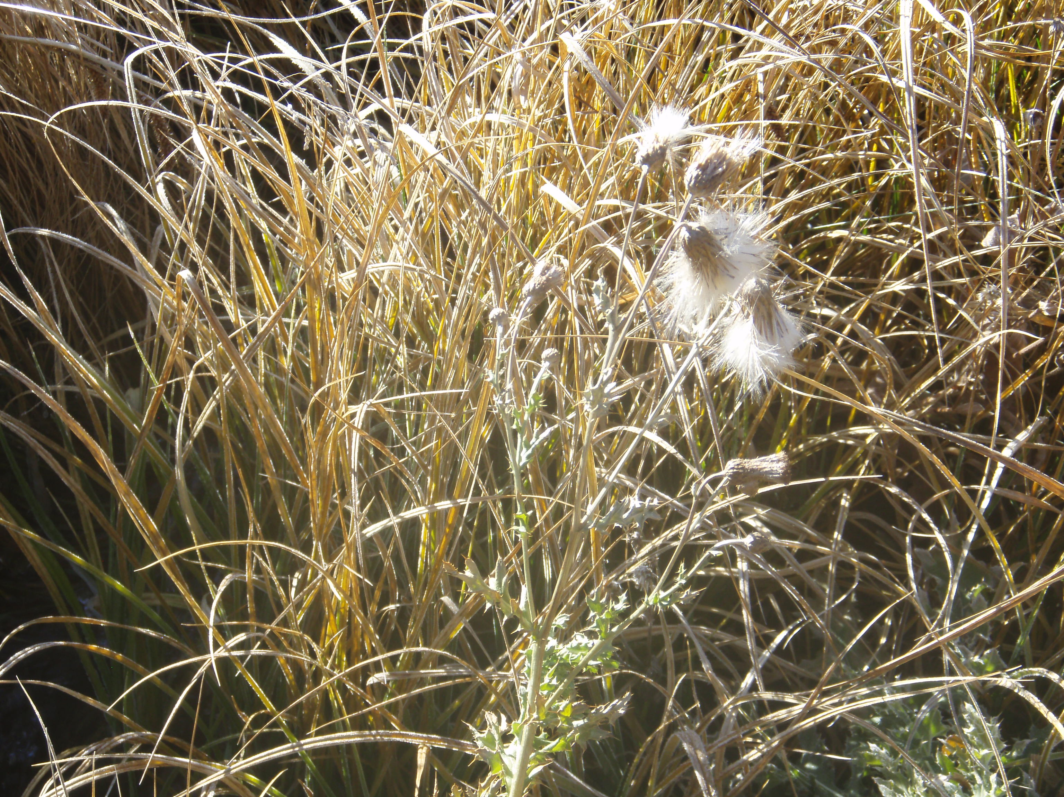

Slide 8
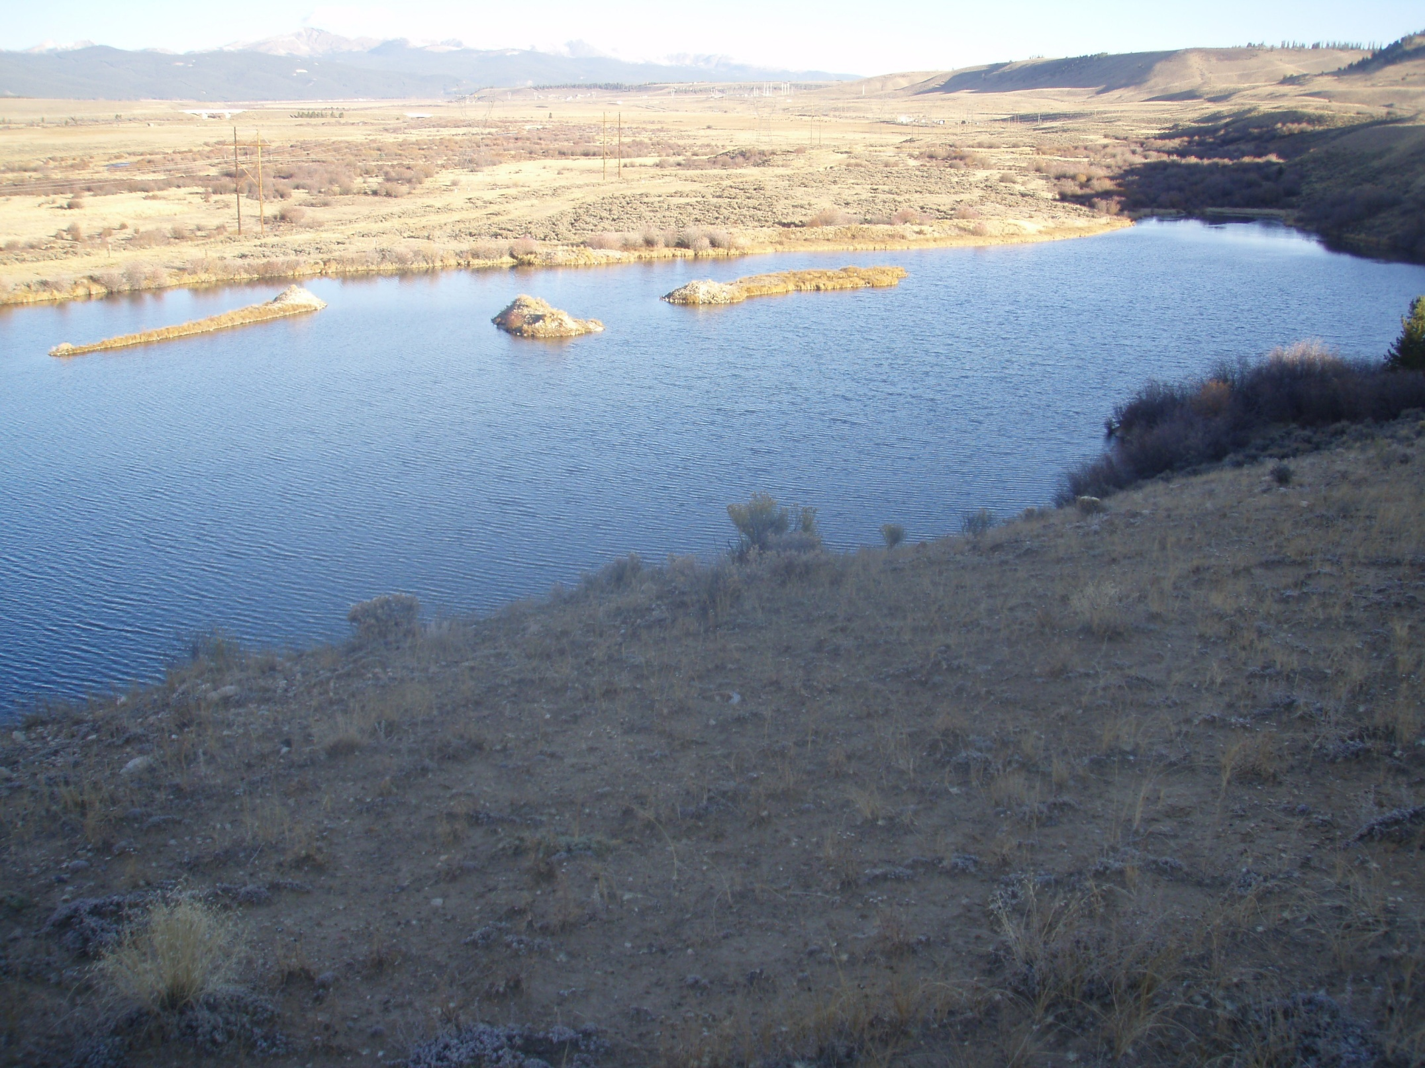

Slide 9
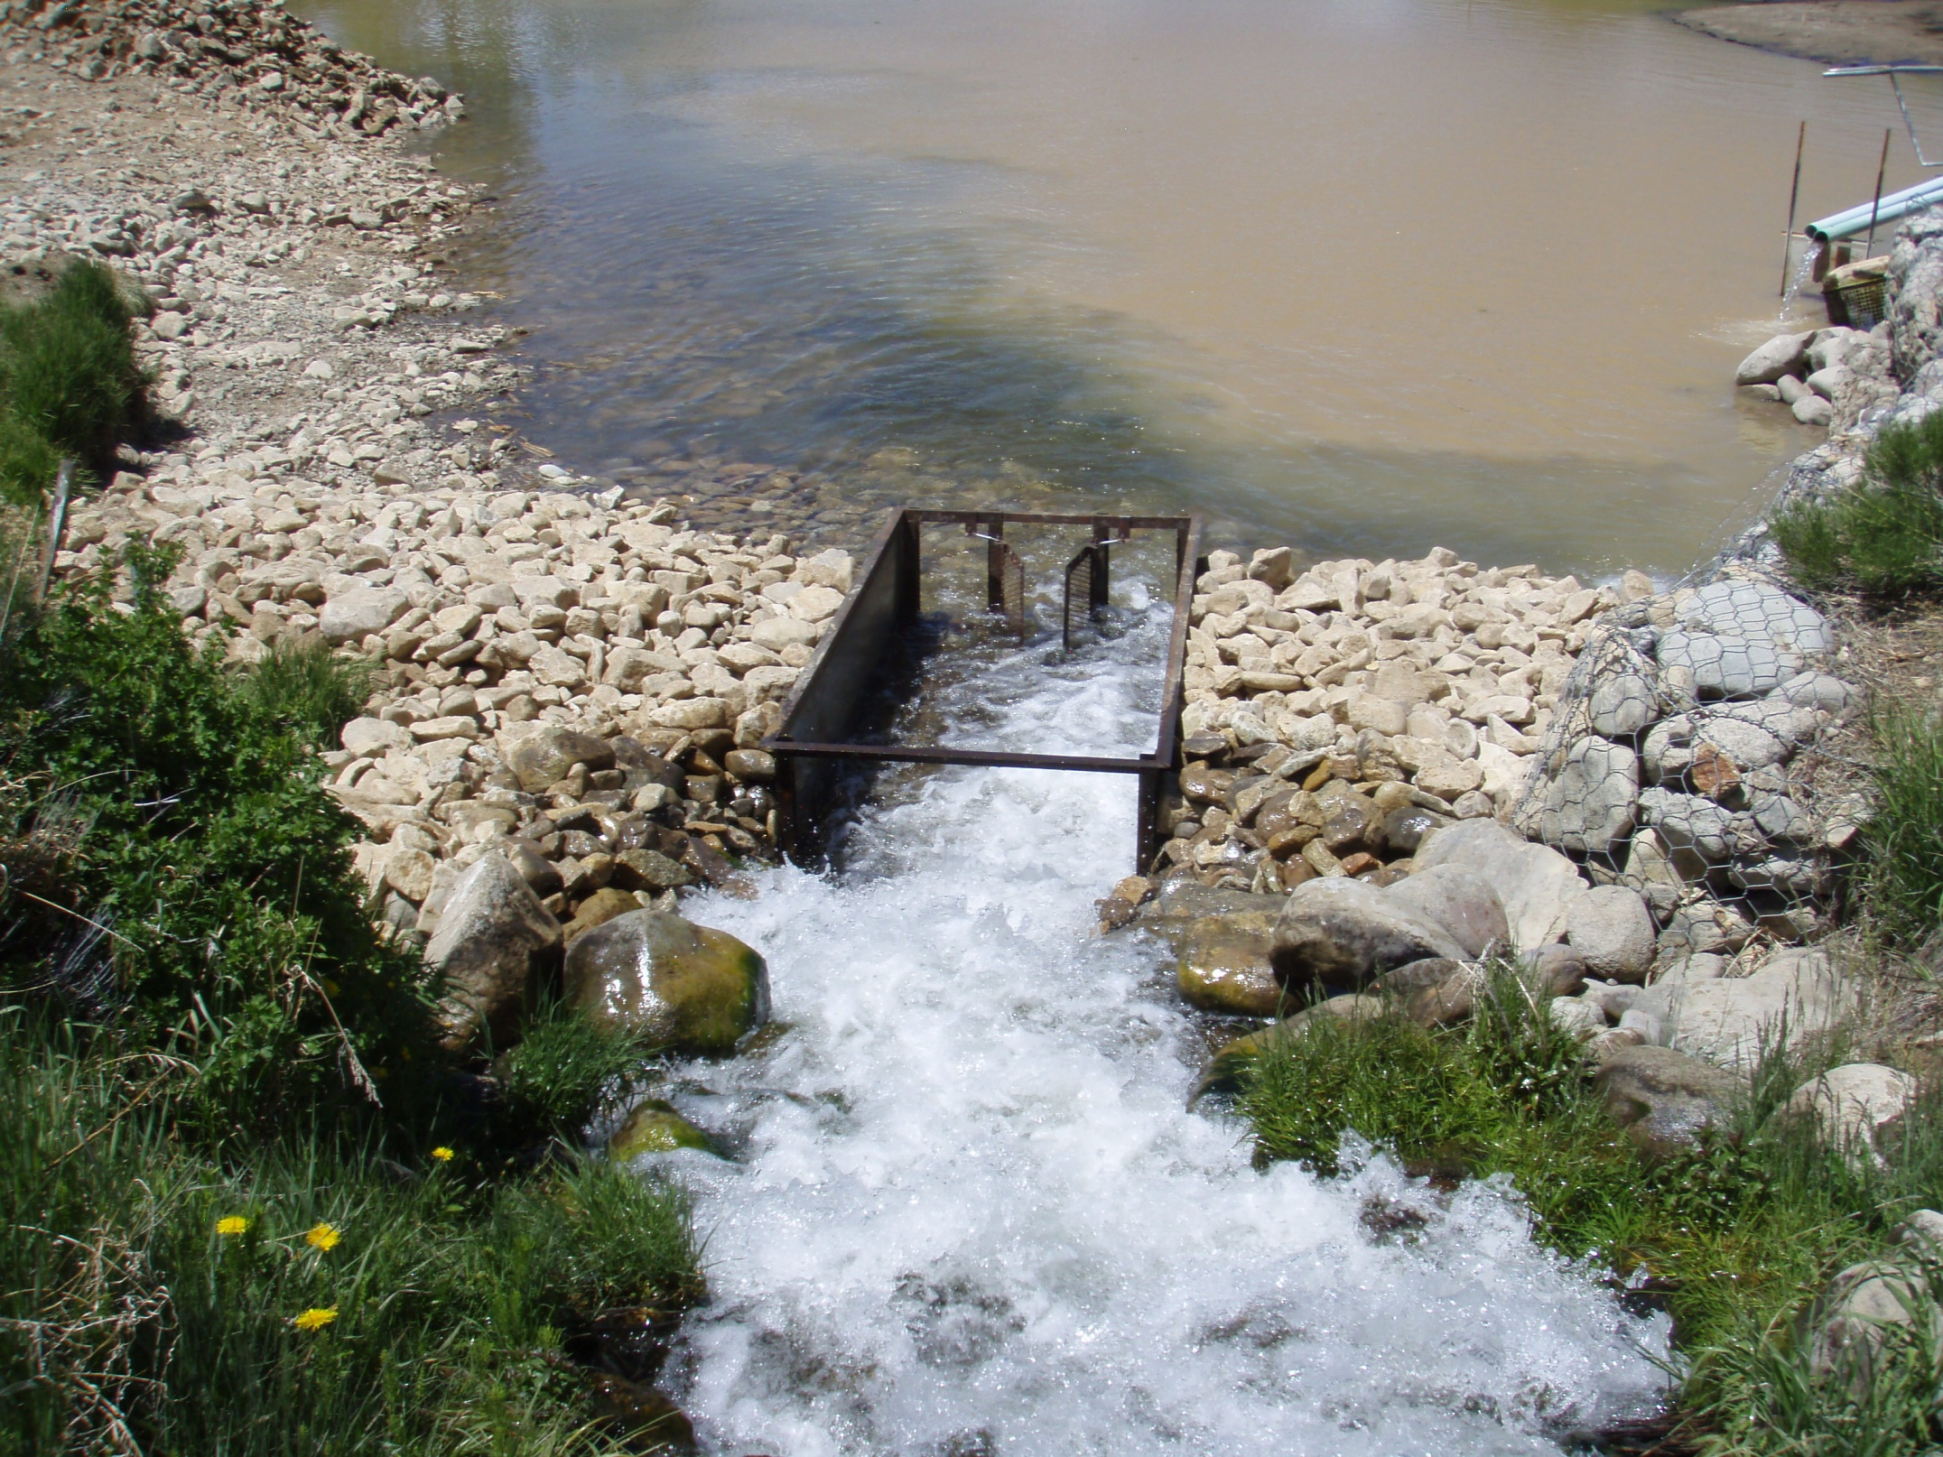

Slide 10
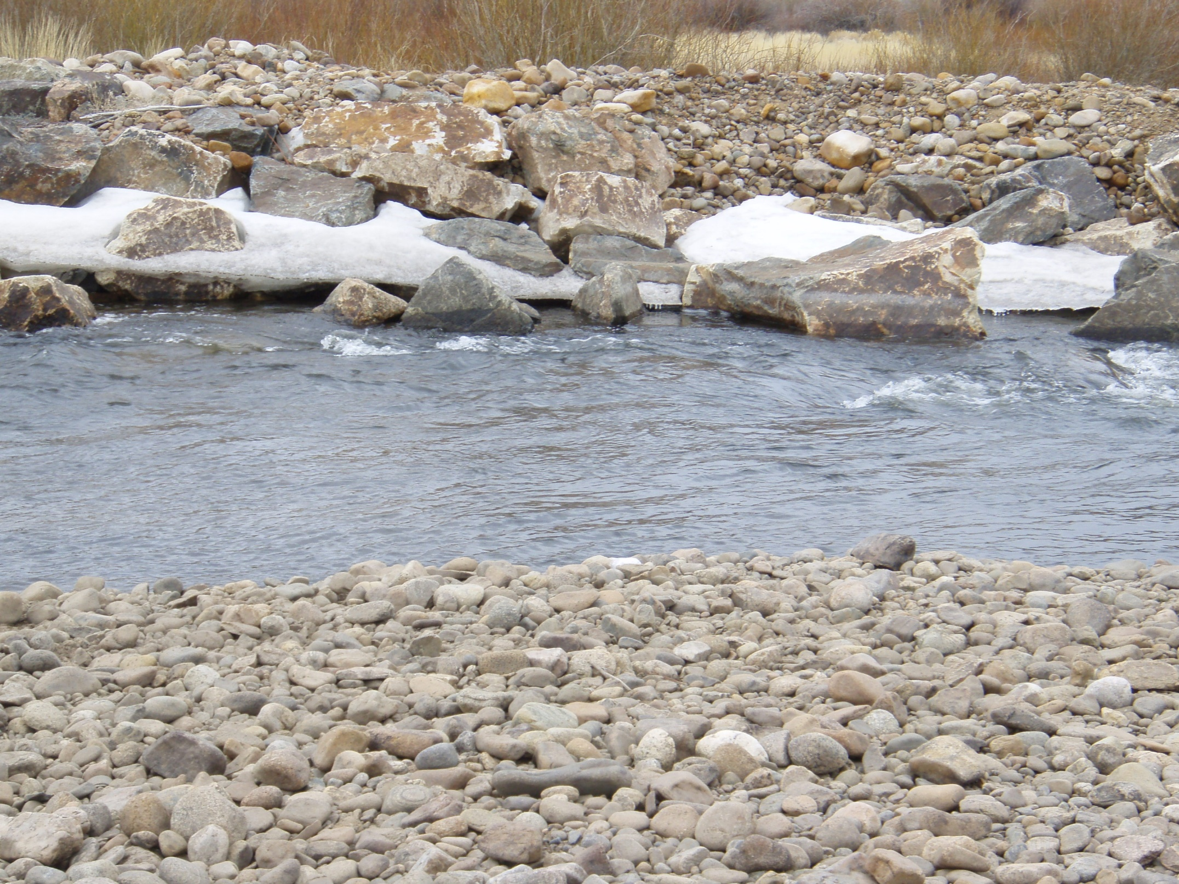

Slide 11
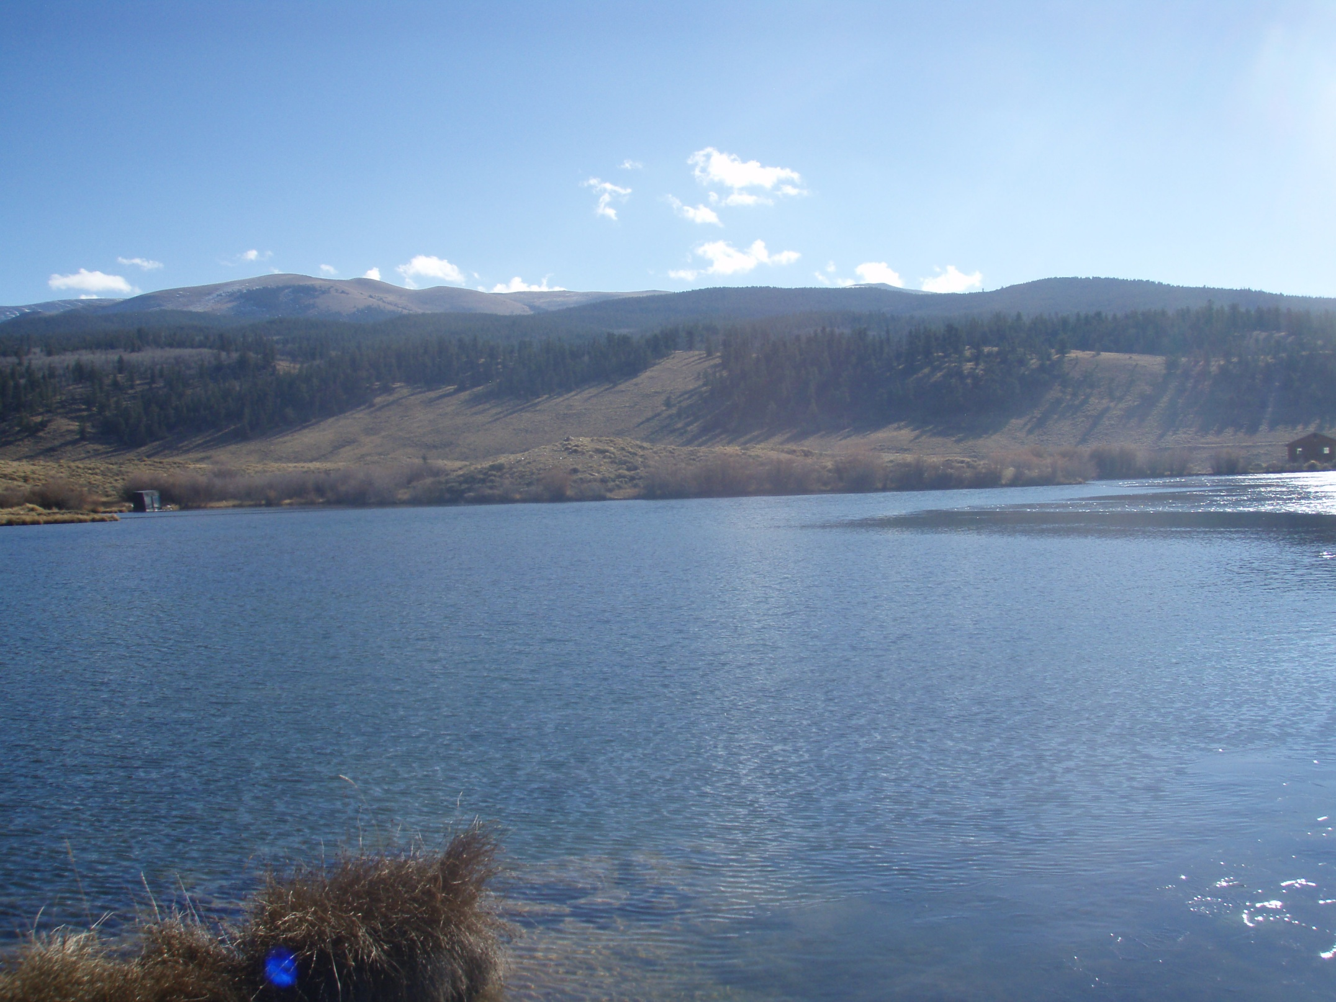

Slide 12
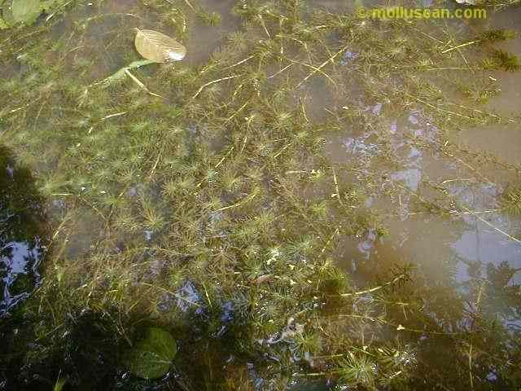
Impacts of Aquatic Weeds
Economic
Environmental
Recreational
Water Industry
Quality
Transfer
Storage

Slide 14
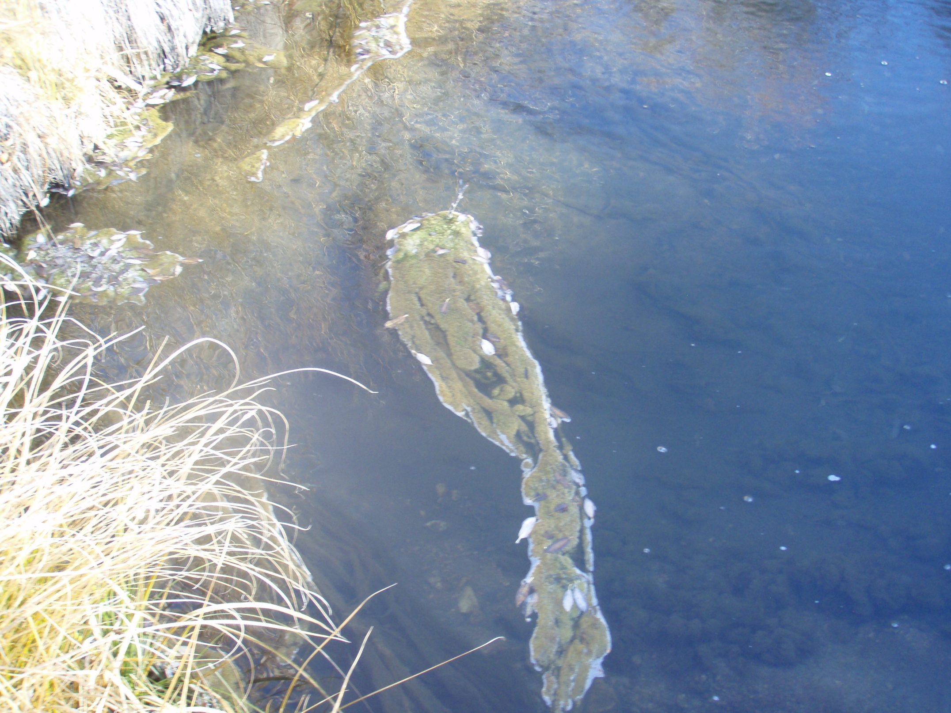

Slide 15
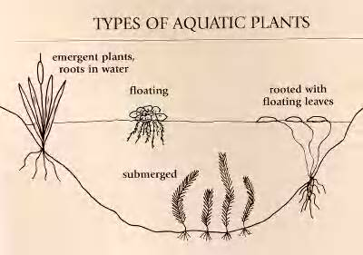
Types of Aquatic Plants

Slide 16
Colorado A.N.S. Plant List
Common Name | Scientific Name
African elodea | Lagarosiphon major
Brazilian elodea W | Egeria densa
Eurasian watermilfoil B | Myriophyllum spicatum
Giant Salvinia A | Salvinia molesta
Hyacinth, water W | Eichornia crassipes
Hydrilla A | Hydrilla verticillata
Parrotfeather A | Myriophyllum aquaticum
Yellow floating heart W | Nymphoides peltata

Slide 17
Plant Identification: Floating Plants

Slide 18
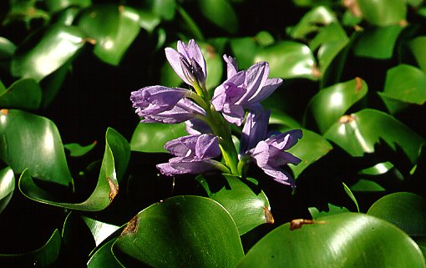
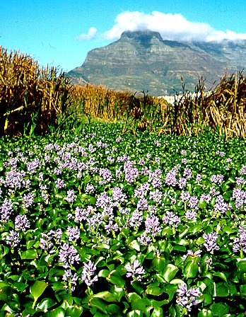
Water hyacinth Eichornia crassipes
INVASIVE
GENERAL NOTES
Brought from Central and South America to the Cotton States Explosion in 1884 for ornamental plants.
Among the highest growth rates known
Notorious for clogging distribution systems
Well known as one of the worst weeds to ever invade North America

Slide 20
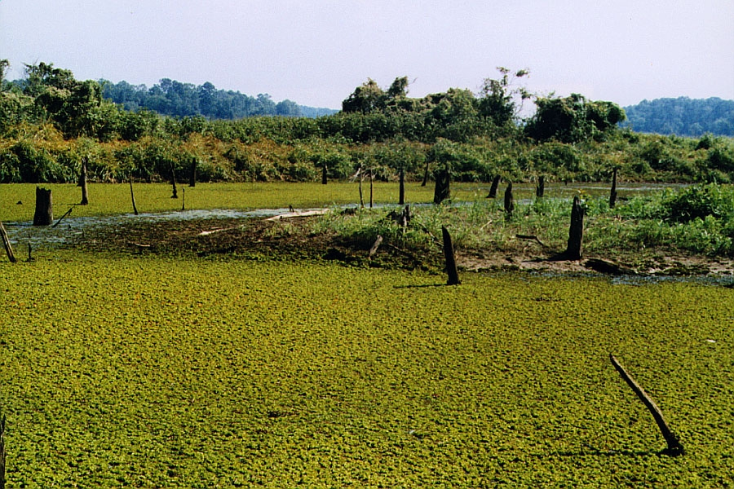
Giant Salvinia
INVASIVE
Photo: University of Nevada Cooperative Extension Fact Sheet 02-69

Slide 21
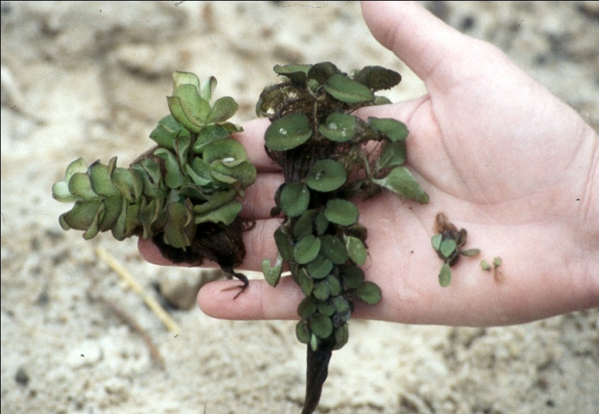
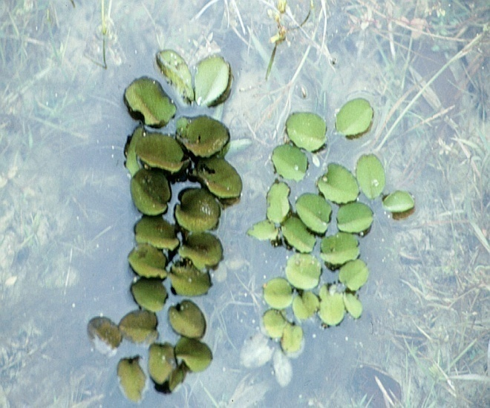
Giant Salvinia - ID
Free-floating fern with small oblong, spongy green leaves along the stem.
Leaves occur in whorls of 3 = 2 floating leaves and 1 submerged leaf.
Young plants have leaves that lie flat on the surface. Older plant leaves become thick and curled at edges forming upright chains that form mats of floating plants.
Mature Plants
Young Plants
Photos: USDA – APHIS

Slide 22
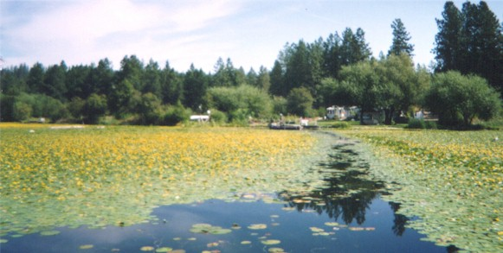
Yellow floating heart

Slide 23
Yellow floating heart Nymphoides peltata
INVASIVE
Escaped ornamental
Native to Eurasia, Japan, China and India
Quickly forms dense surface mats
Reproduces by fragments
Very different 5-petal flowers compared to native water lily cup flowers
Limited control
few applications that have proven effective for control

Slide 24
Plant Identification: Submerged Plants

Slide 25
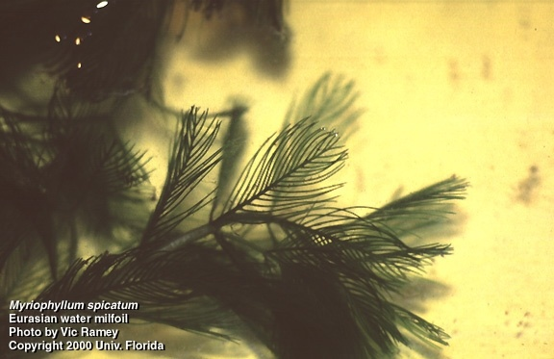
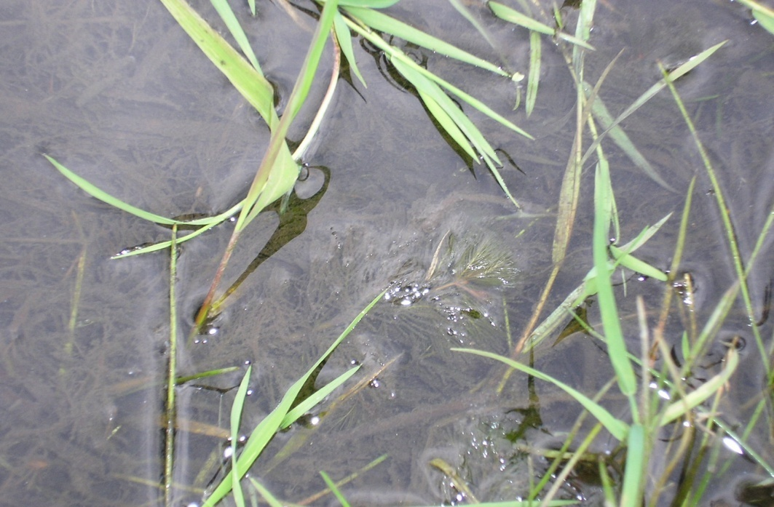
Myriophyllum spicatum
EURASIAN WATERMILFOIL
INVASIVE
Joseph DiTomaso, UC Davis

Slide 26
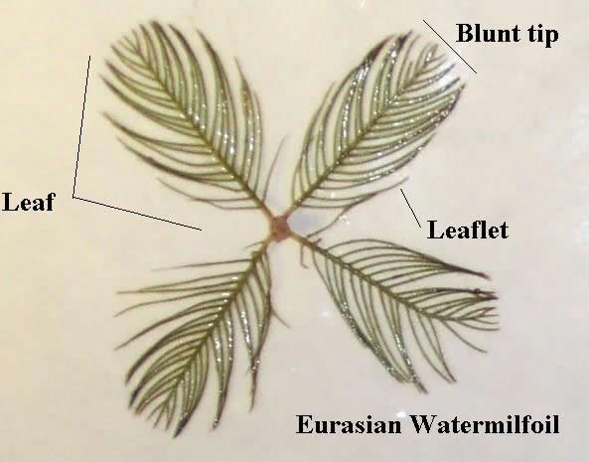
Eurasian watermilfoil Myriophyllum spicatum
Page 88
IDENTIFICATION
Submerged, rooted, perennial, dicot
Long branching underwater stems
Feathery leaves in whorls of 4-5
Leaves have 11-21 pairs of leaflets
Closely spaced
½ inch in length
Blunt or Flat Tip
Collapses out of water

Slide 27
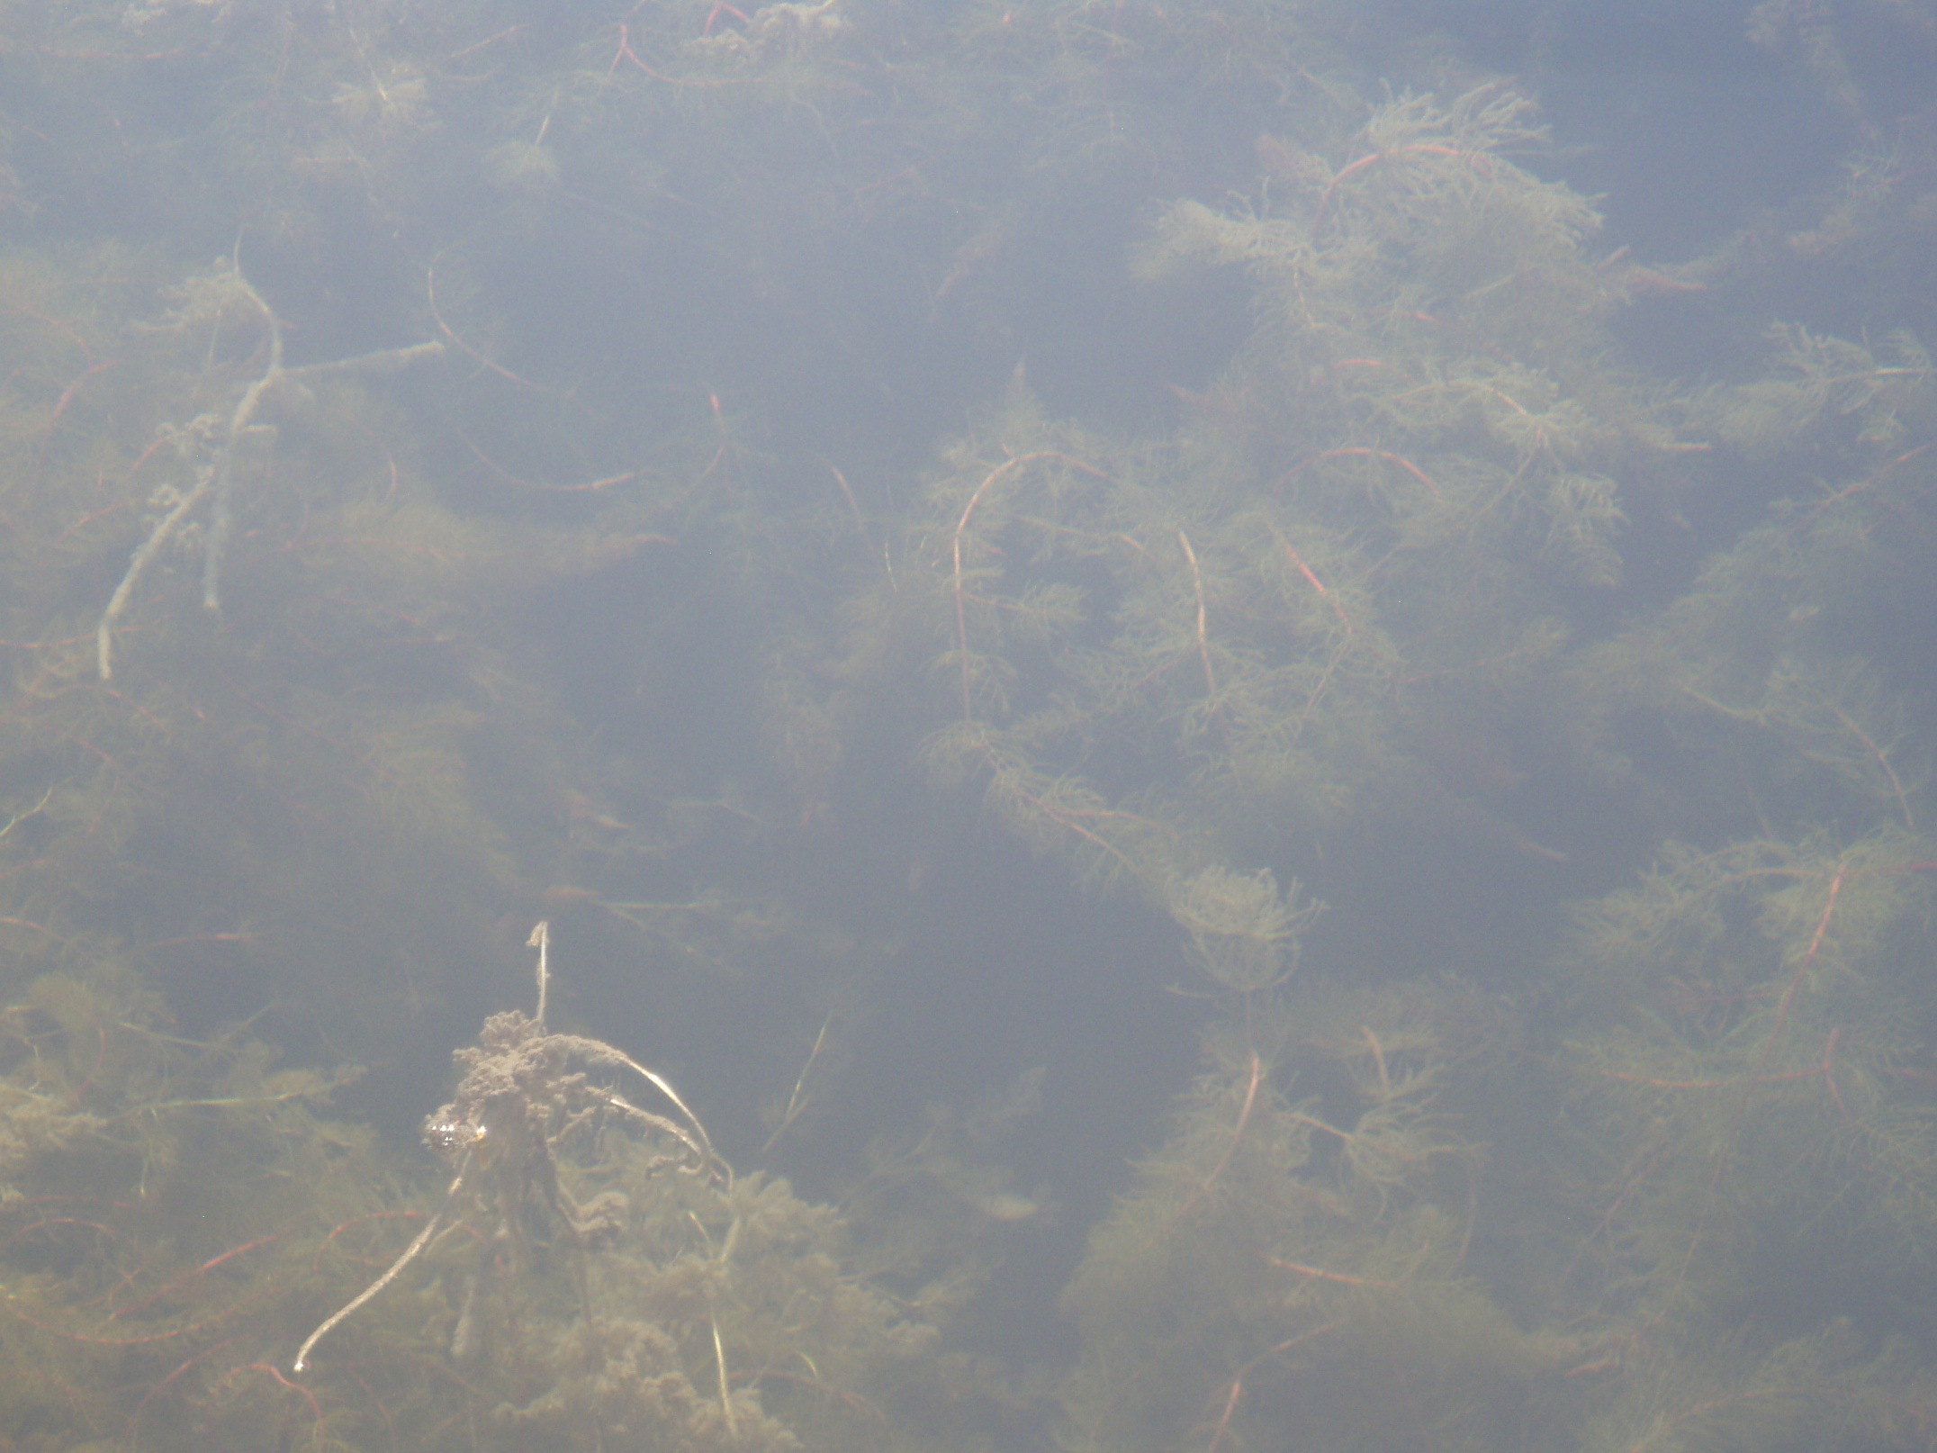

Slide 28
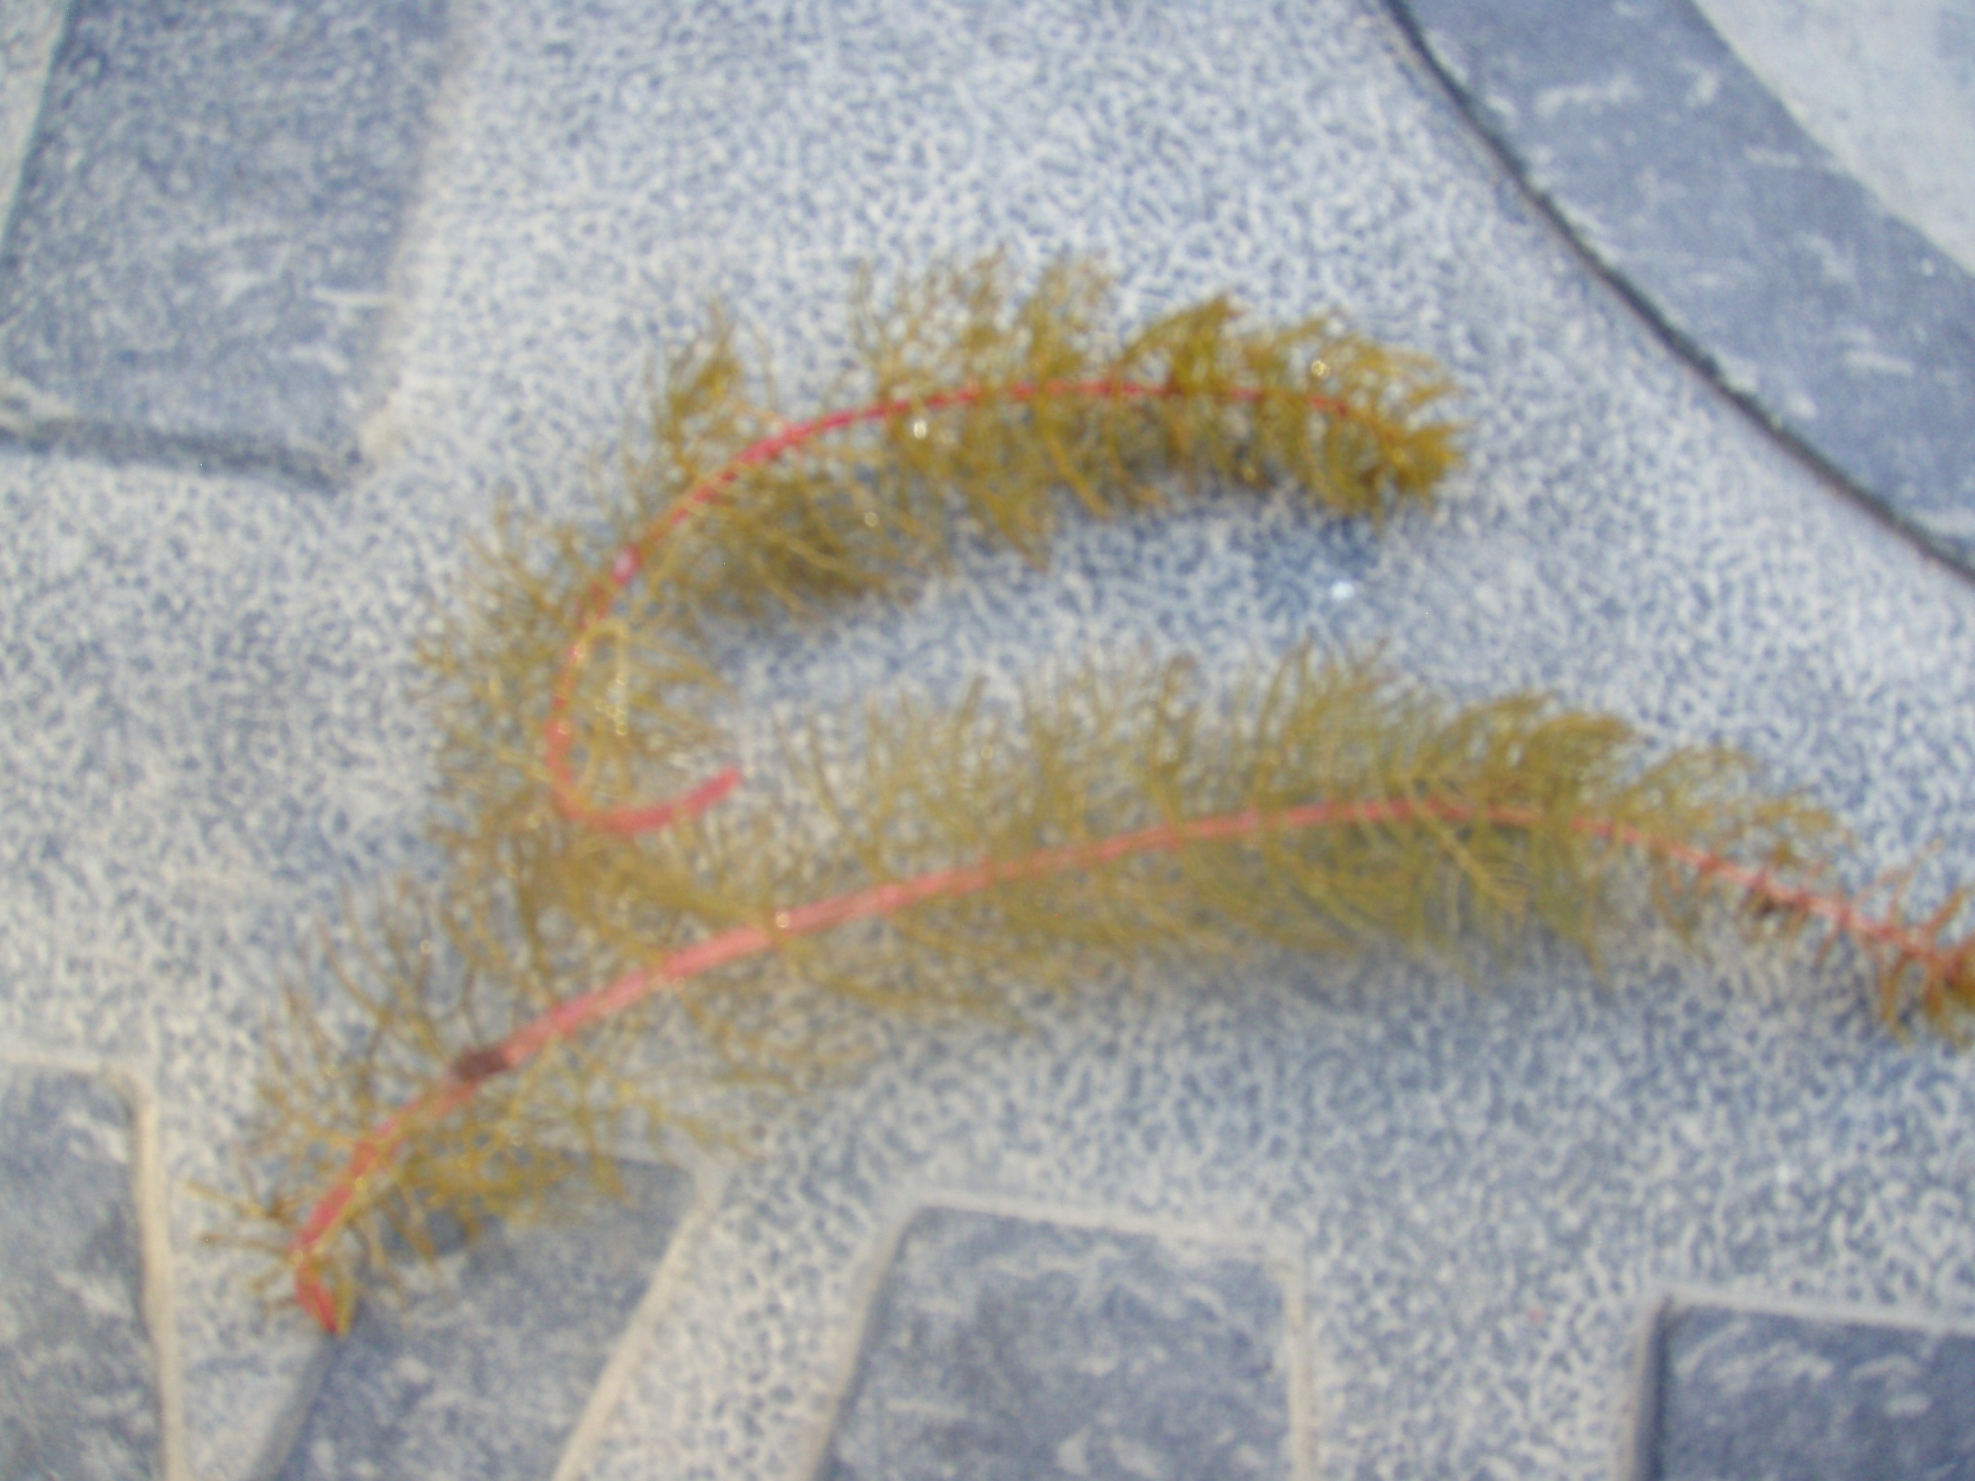

Slide 29
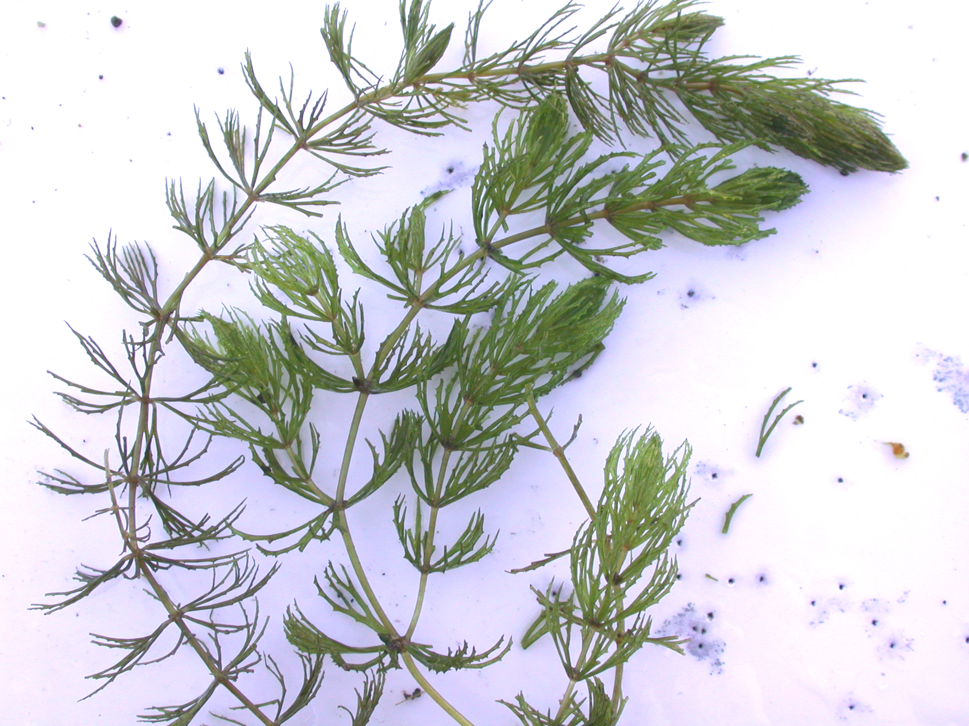
NATIVE

Slide 30
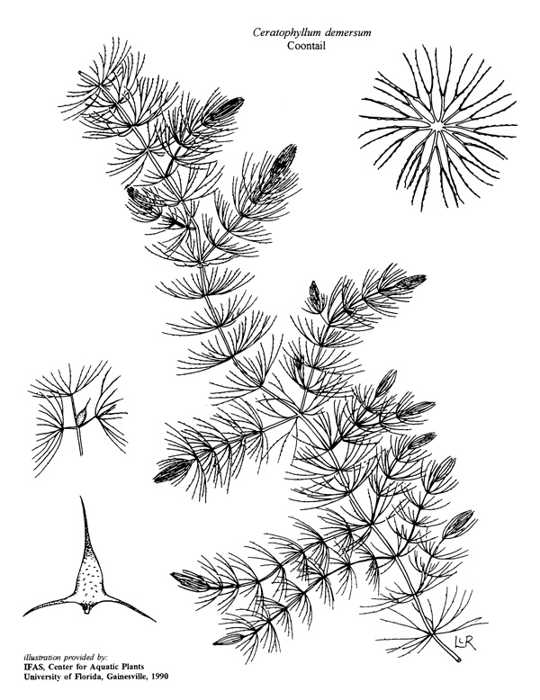
Coontail Ceratophyllum demersum Ceratophyllaceae
Firm, Forked Leaves in whorls
Leaf margins fine toothed
Often mistaken for a watermilfoil
Dichotomously branched leaves are the key to ID
Densely grouped at the stem apex

Slide 31
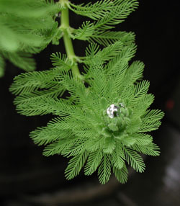
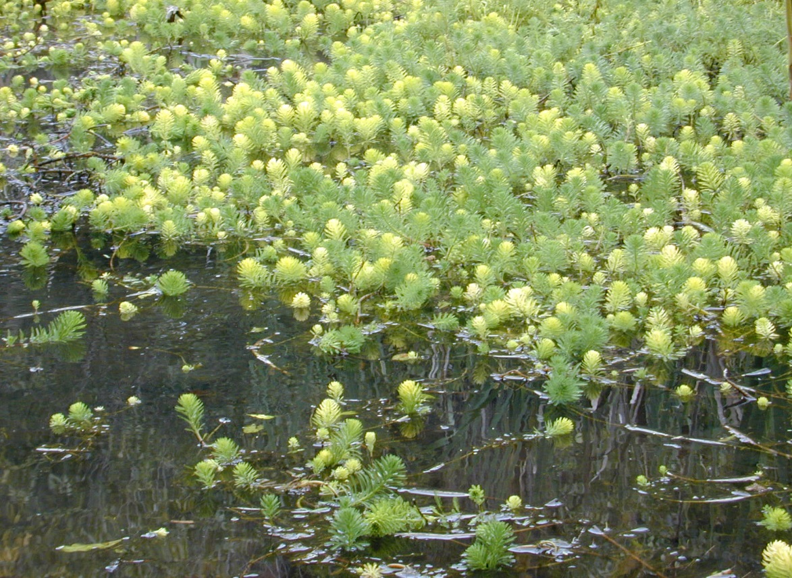
Parrotfeather Myriophyllum aquaticum Haloragaceae
INVASIVE
Introduced from South American for aquariums in late 1800’s.
Plants usually emerged with stems up to 5 m long
Usually in warm temperate to tropical climates

Slide 32
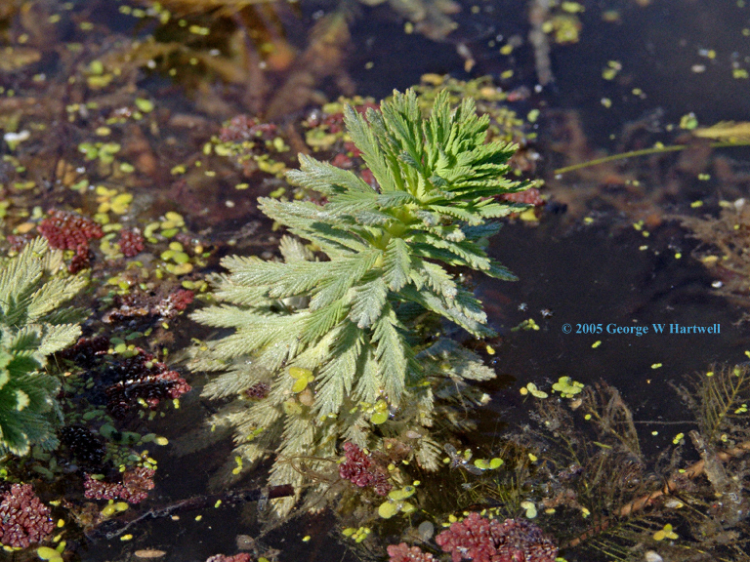
Parrotfeather Myriophyllum aquaticum Haloragaceae
5-6 Leaves Whorled Around the Stem
Flattened midrib that is usually wider than leaflets
Leaflets 20-30 pairs/leaf – up to 7 mm long
Stems light gray-green to red.
Seedlings rarely observed outside of the native range

Slide 33
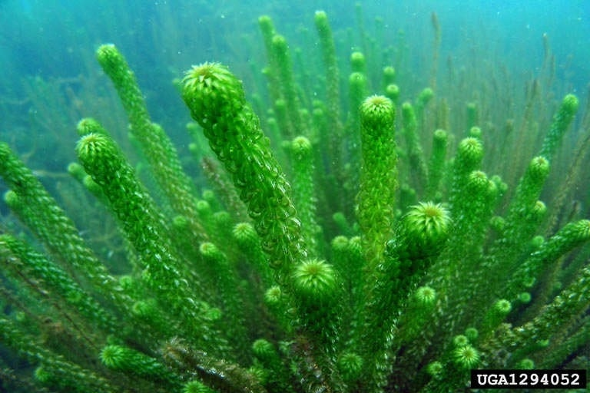
African elodea
INVASIVE

Slide 34
African elodea Lagarosiphon major
INVASIVE
INVASIVE - Not known to USA
Threat to High Elevations – Native to Africa
Rapid growth rate
Major economic impacts to power industry and recreation in New Zealand and England
Federally listed noxious weed - USDA
Prohibited in 12 states!

Slide 35
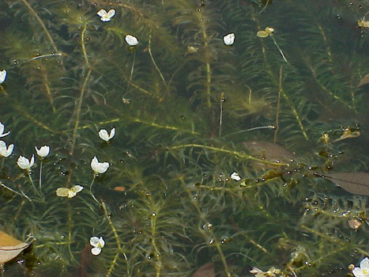
Brazilian Egeria
Flowers
June - October
Frequent flowers
Glossy white petals
Appear wrinkled
Insect pollinated

Slide 36
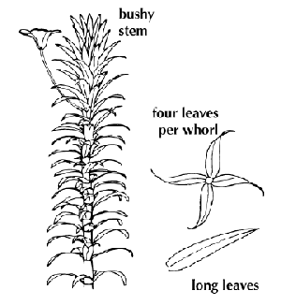
Brazilian Egeria
Leaves
Sessile
Linear to Lanceolate
Whorled 3-6 (# unreliable)
Margins minutely toothed
Visible with low magnification
Midvein smooth

Slide 37
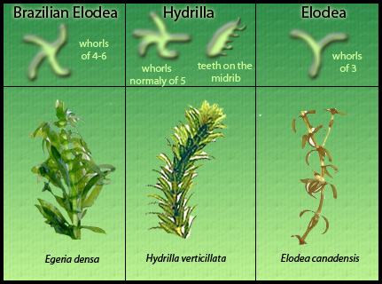

Slide 38
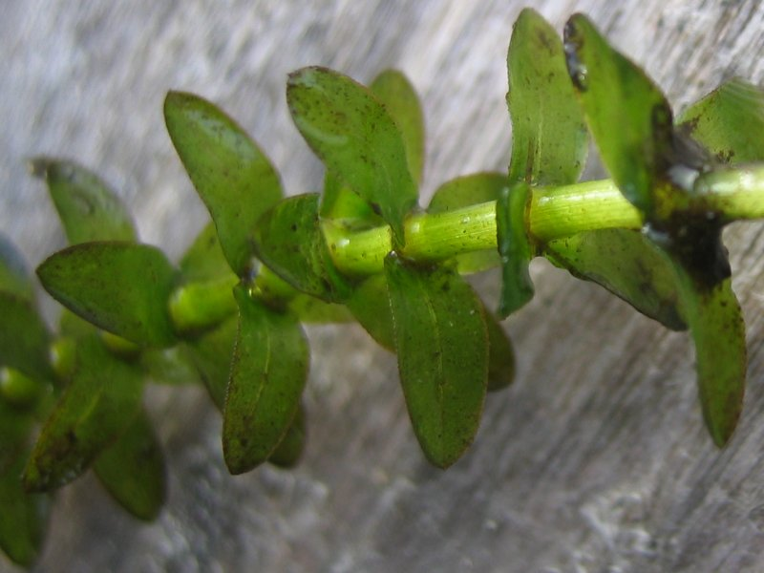
Common Native Elodea Elodea canadensis Hydrocharitaceae
NATIVE
Common plant that is often mistaken for invaders – african and brazilian egeria and hydrilla.
Beneficial fish habitat
Nutritionally valuable for waterfowl

Slide 39
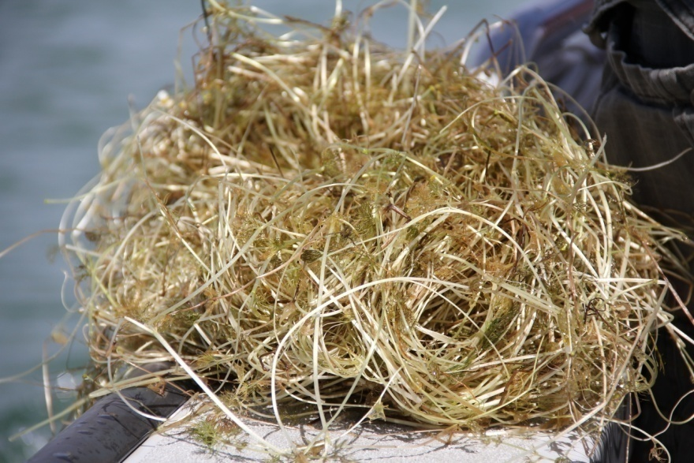
Buttercup Ranunculus sp. Ranunculaceae
NATIVE
Many terrestrial species and 2-3 aquatic species
Deeply dissected submerged leaves
Dainty white flowers with yellow centers rest on the waters surface.

Slide 41
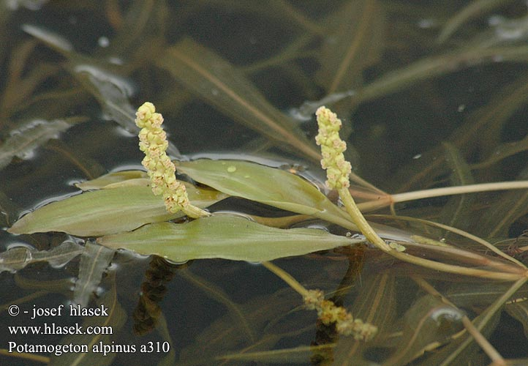
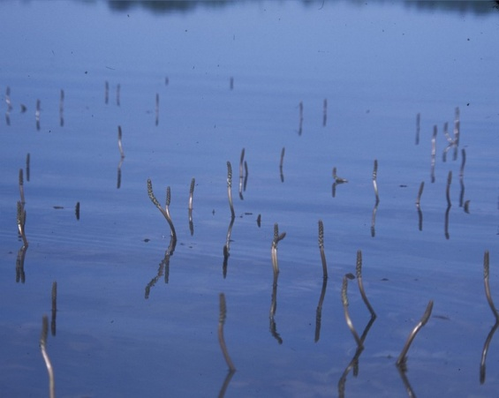
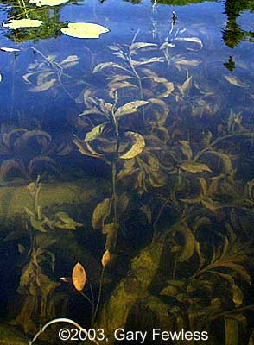
Pondweeds Potomogeton sp. Potomogetonaceae
NATIVE & INVASIVE
16 species in Colorado Flora
Highly plastic
Widespread
Submerged completely
Submerged with floating leaves
Broad leaf & narrow leaf species
Native & Exotic species
Natives are a very important family for wildlife food and habitat
Alternate Leaves.

Slide 42
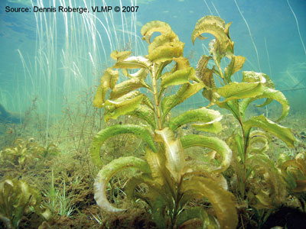
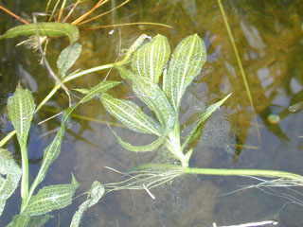
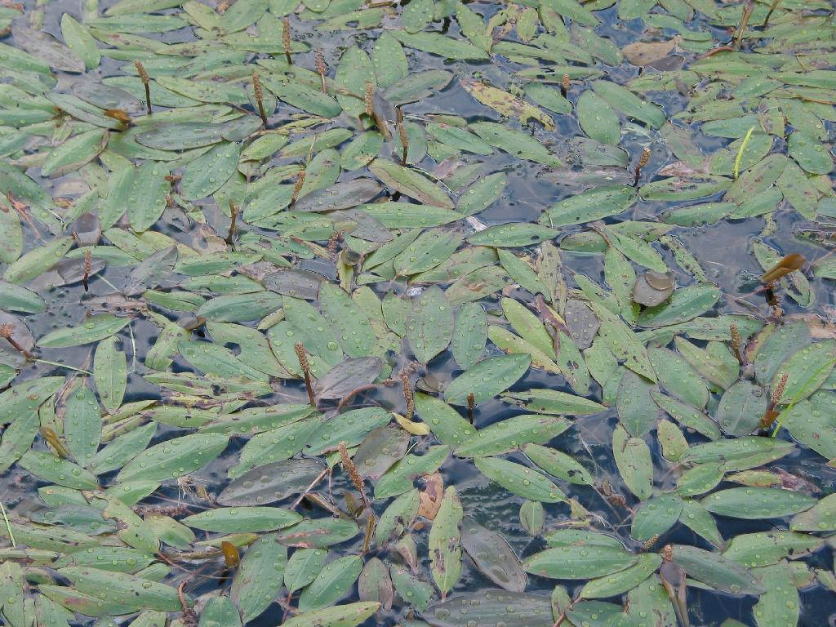
Broad Leaf Pondweeds
NATIVE
Potamogeton amplifolius
Potamogeton illinoensis
Potamogeton nodosus

Slide 43
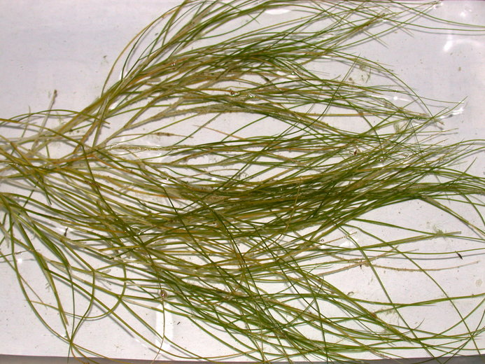
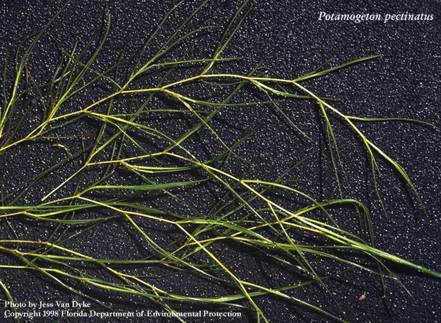
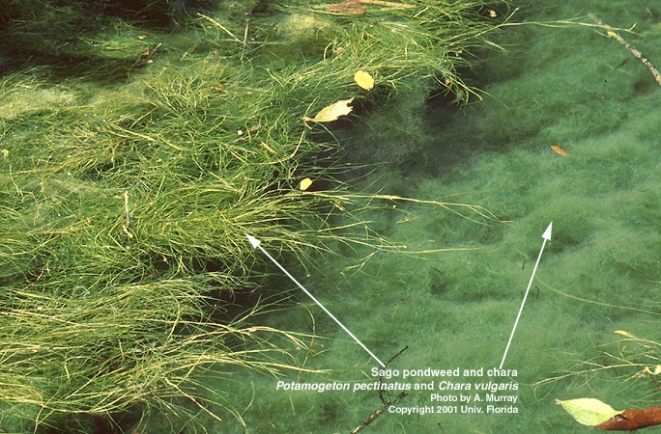
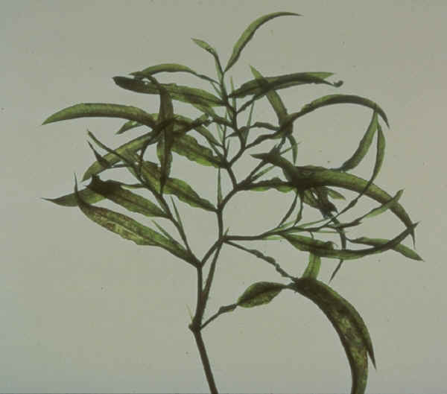
Narrow Leaf Pondweeds
NATIVE
Potamogeton pectinatus
Potamogeton foliosus
Potamogeton gramineus

Slide 44
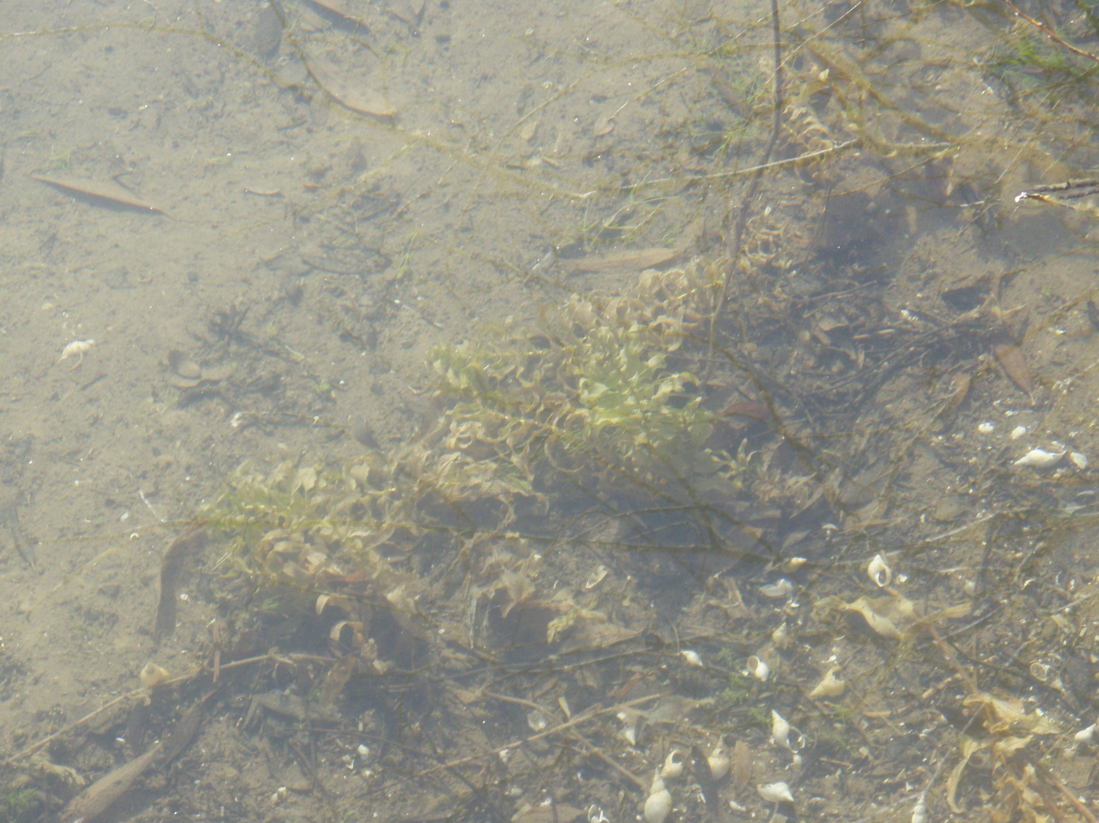

Slide 45
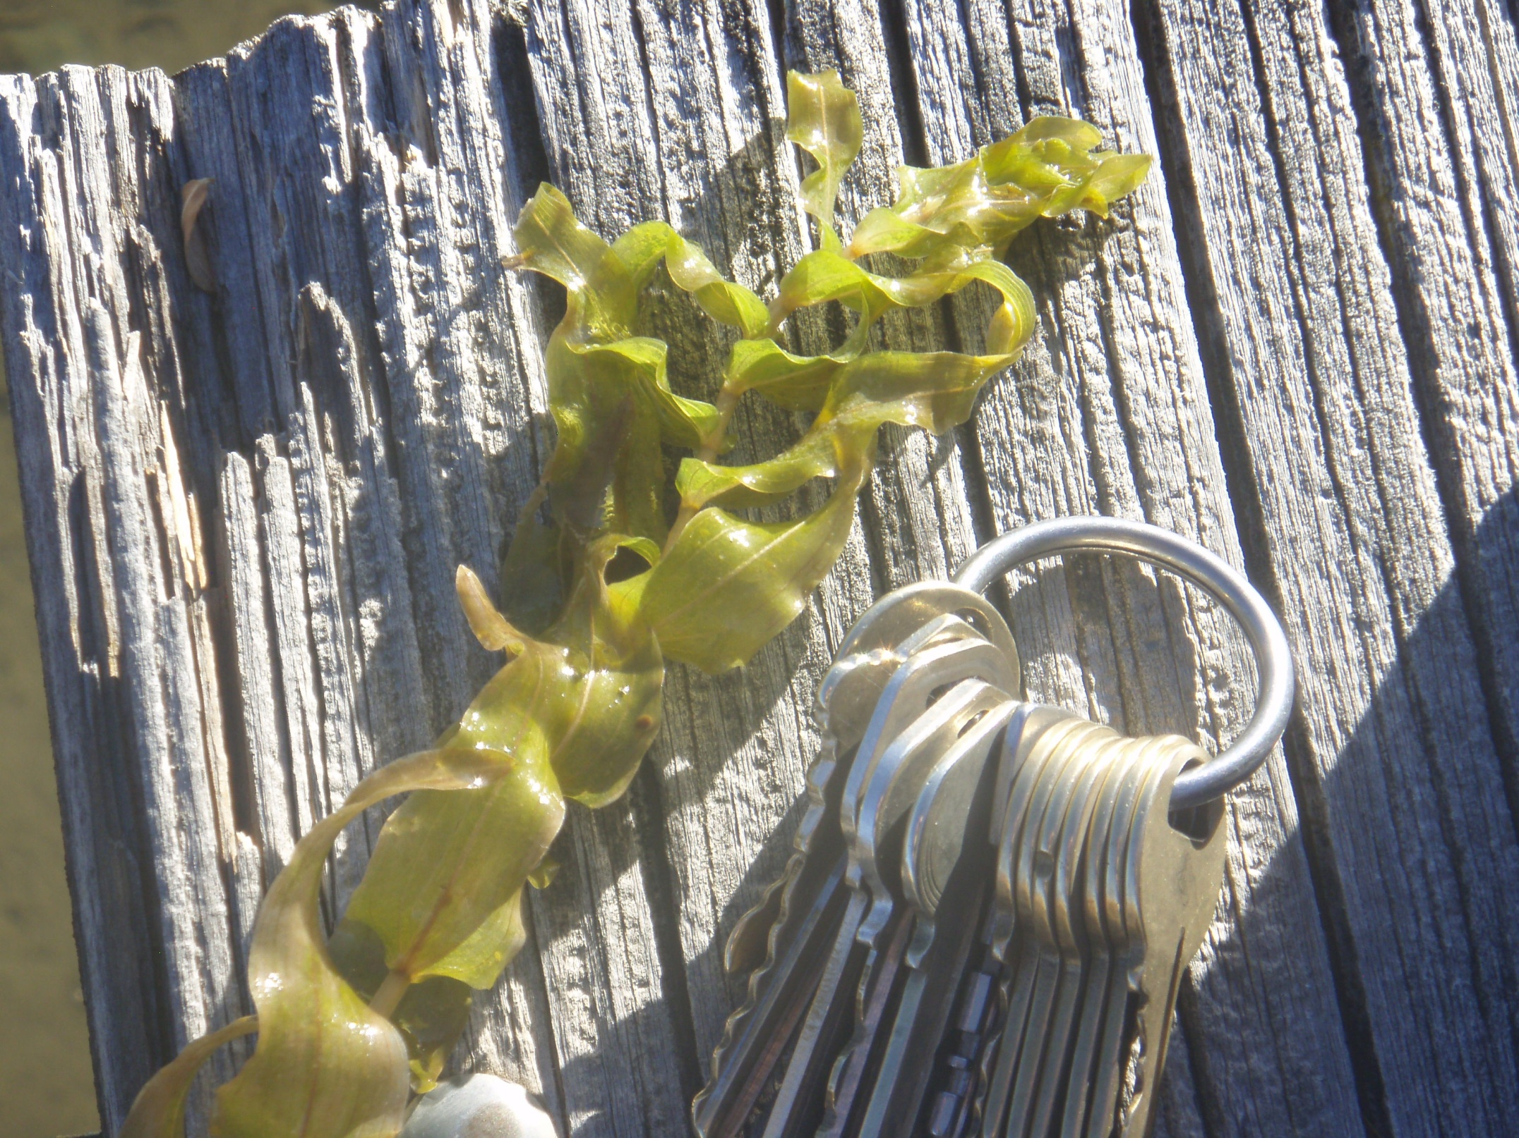

Slide 46
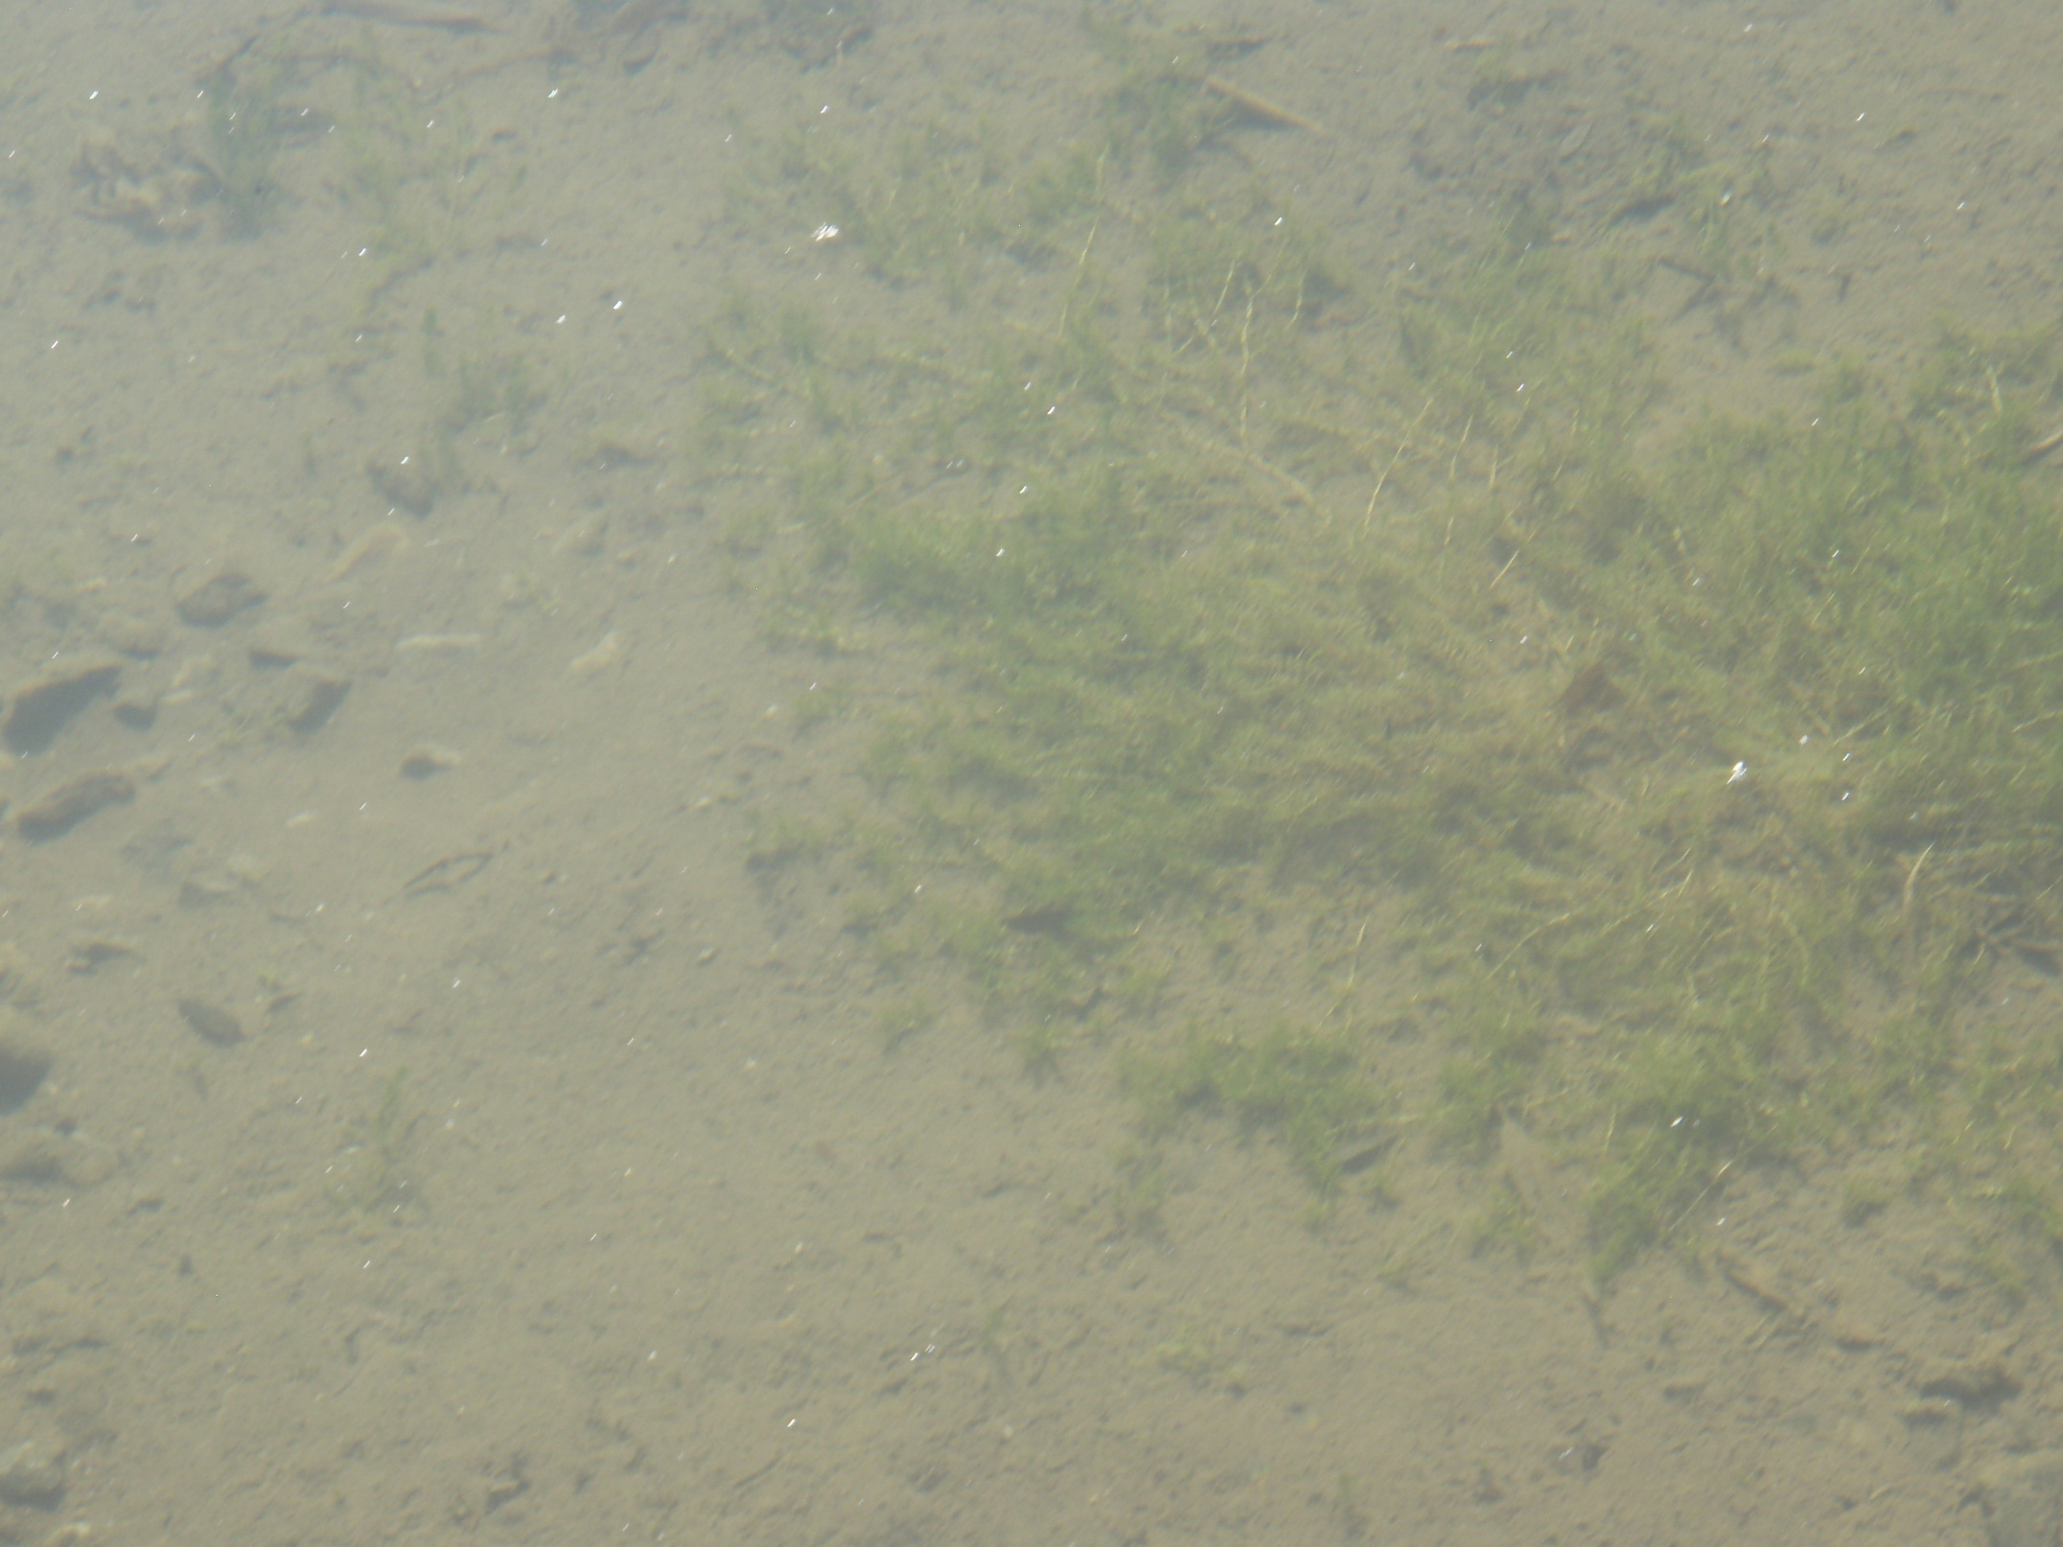

Slide 47
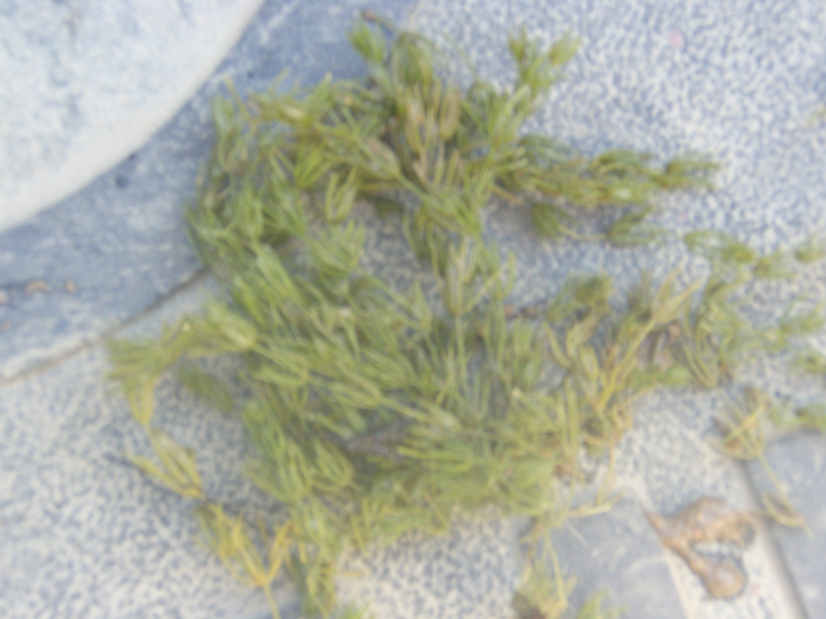

Slide 48
References
1. “Water Weeds and Algae” – Applied Biochemists
2. “Aquatic and Riparian Weeds of the West” – Ditomaso
3. Elizabeth Brown – elizabeth.brown@co.state.us

Slide 49
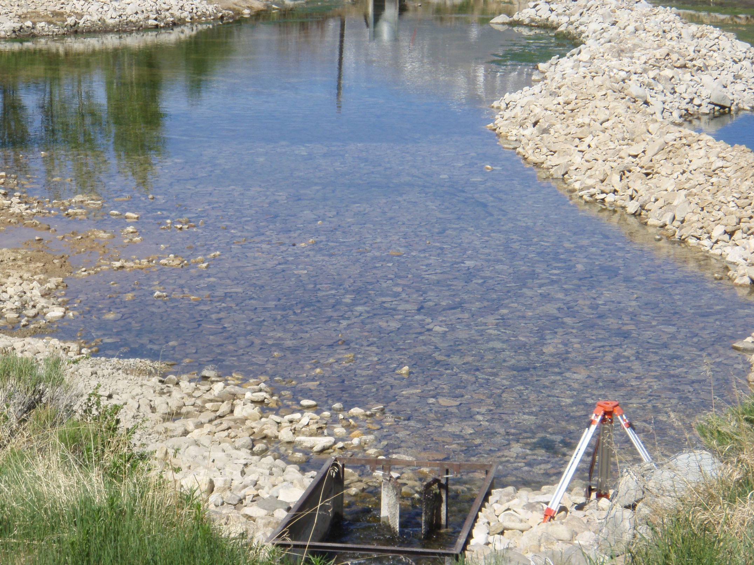

Slide 50
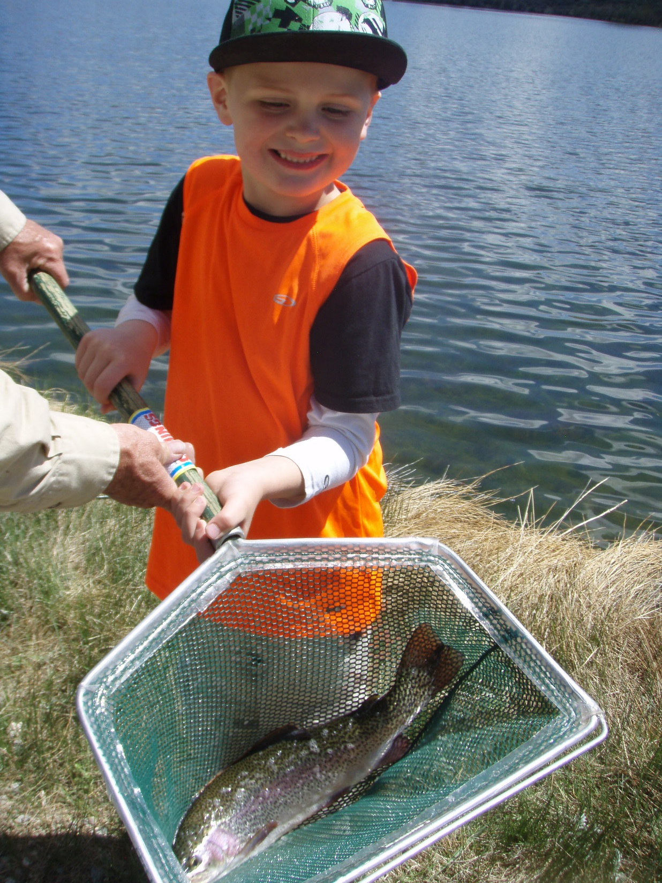

Slide 51
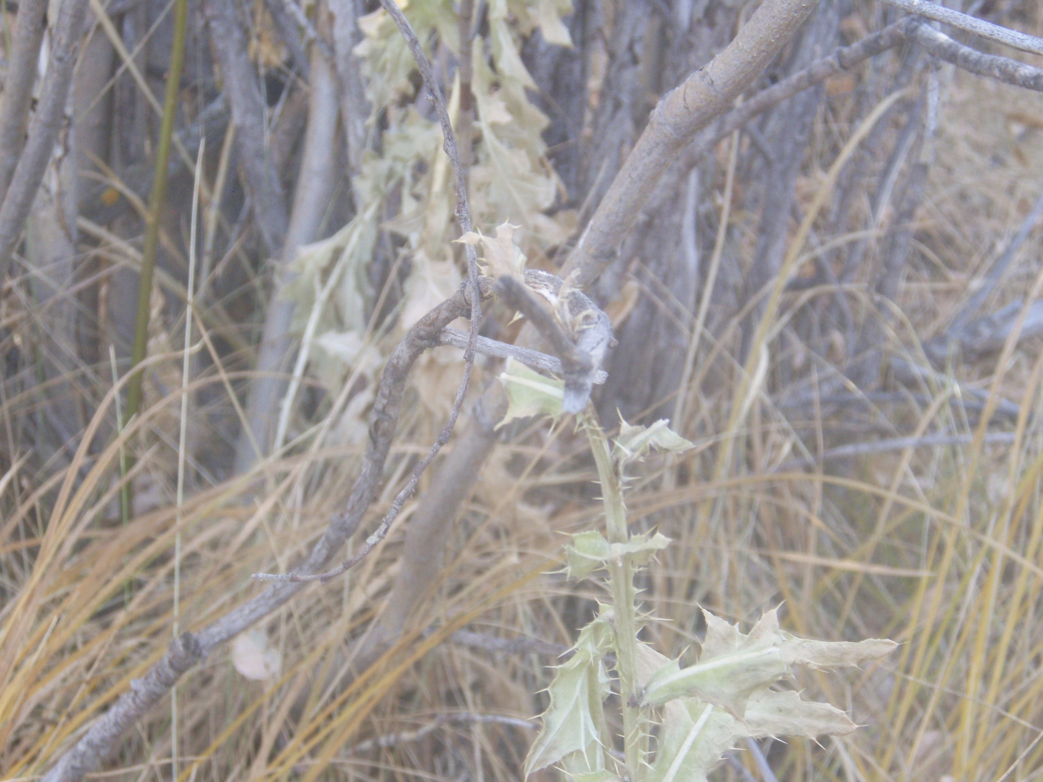

Slide 52
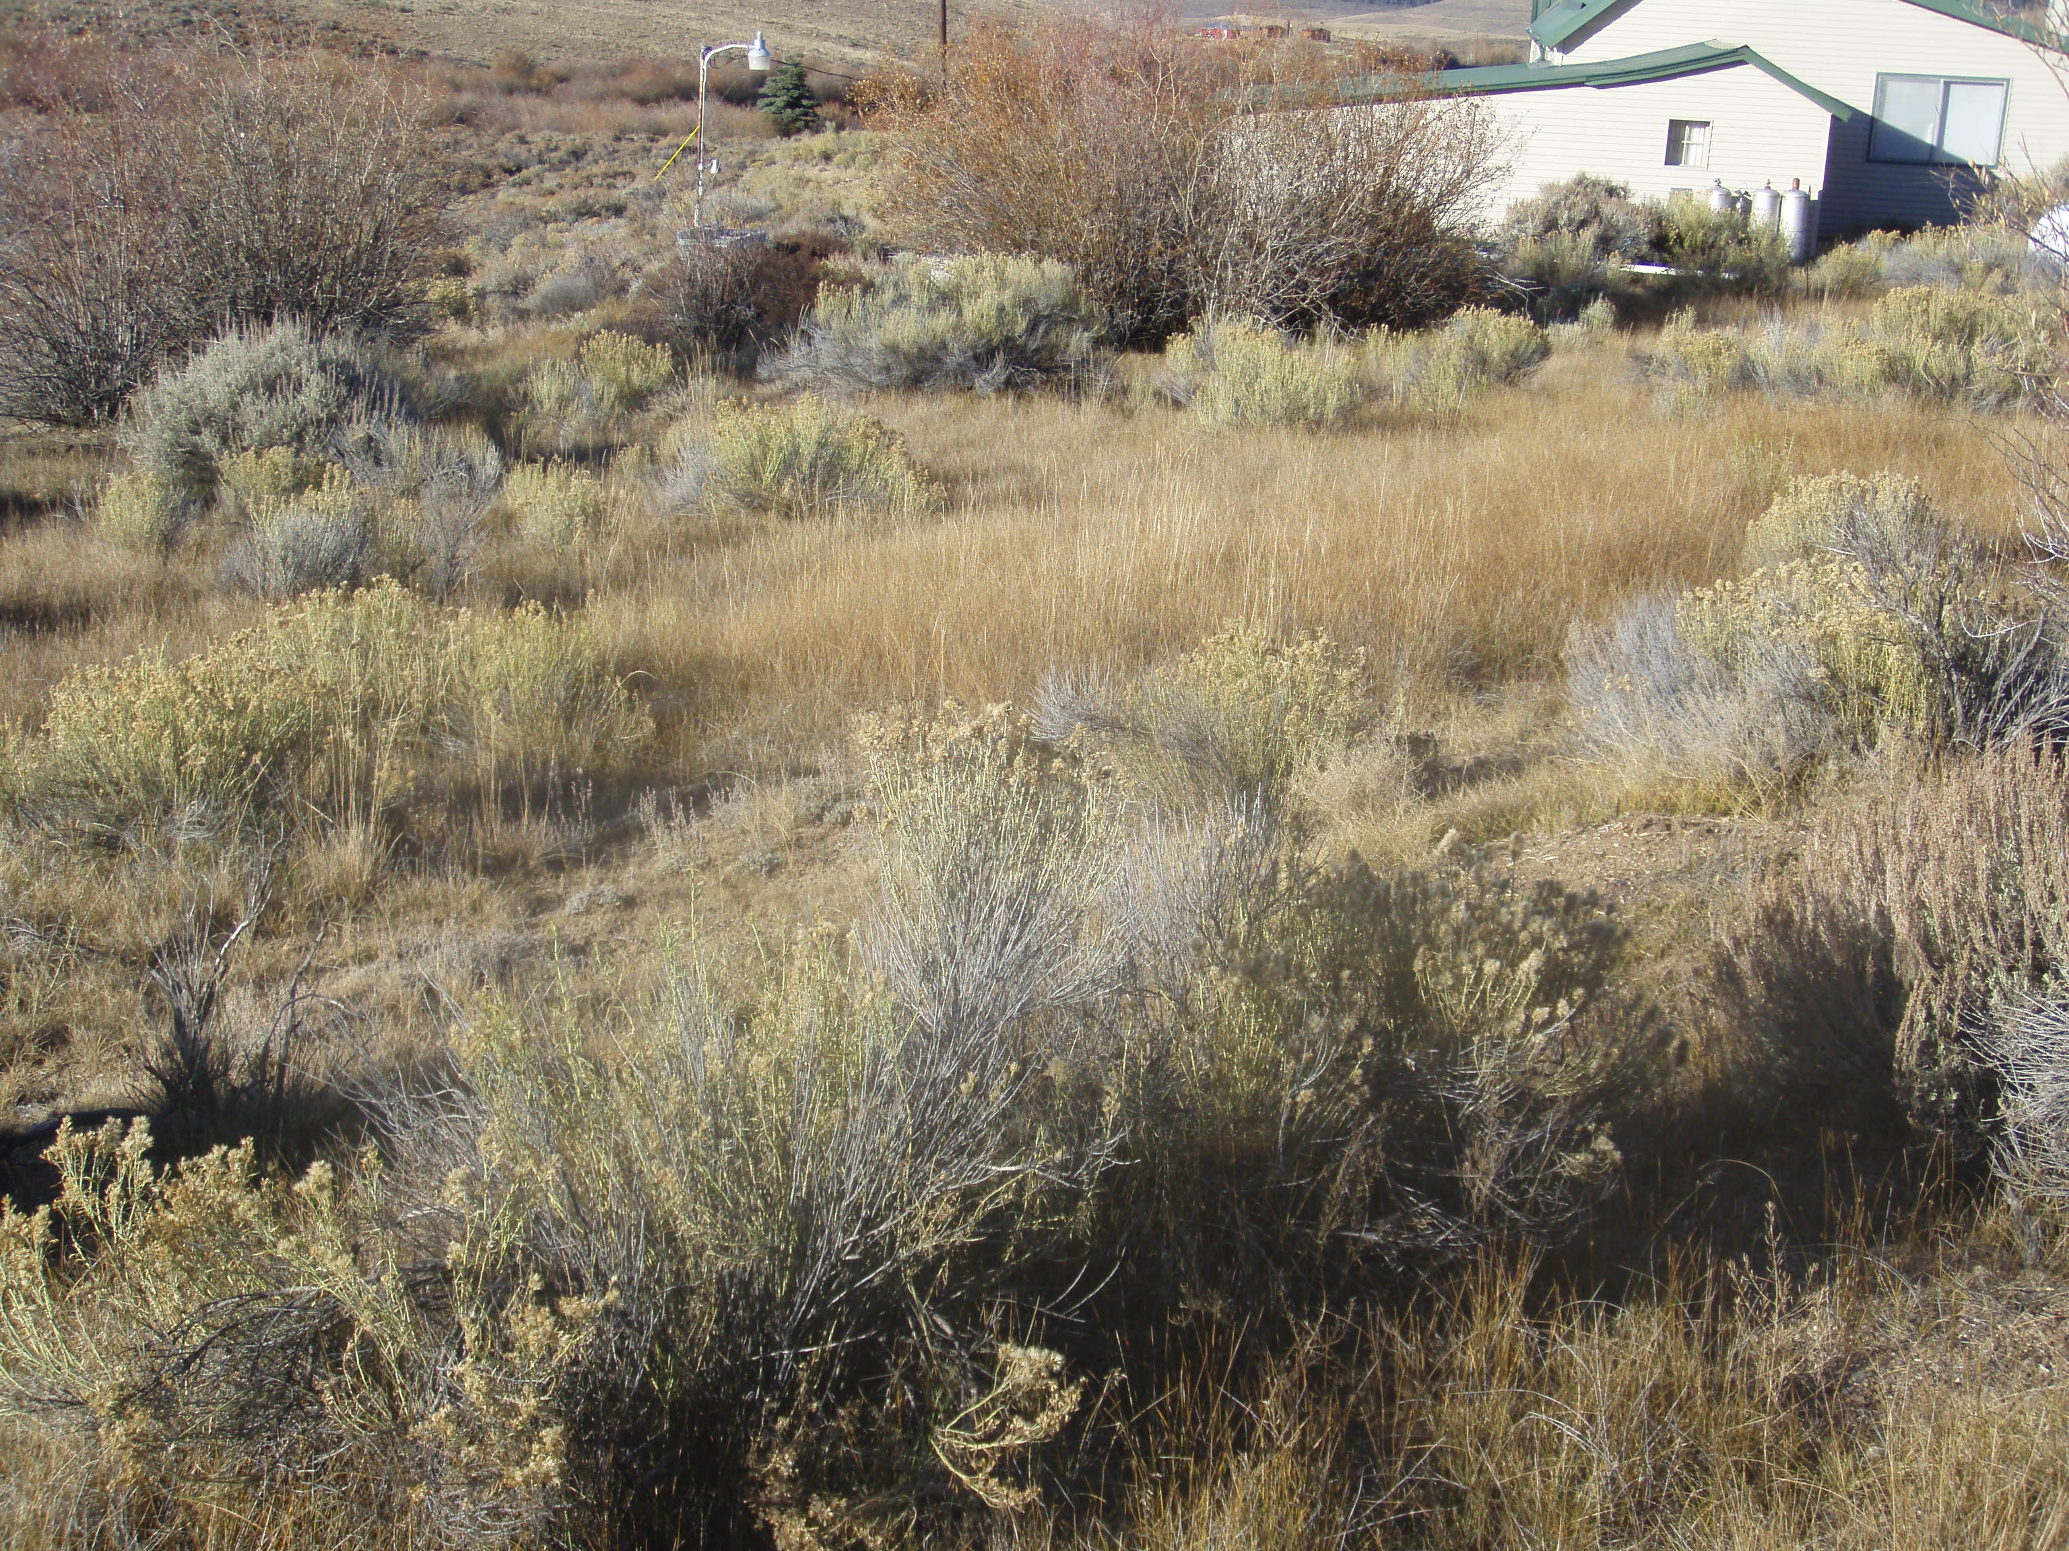

Slide 55
MECHANICAL 3Ds
DRAIN
DRY
DIG

Slide 59
BIOLOGICAL
Regulations regarding use – complicated
Can have collateral damage – reason for regulations
Results highly variable
Diet preferences
Temperature preferences
Activity preferences

Slide 60
CHEMICAL
Need expertise
Need equipment
Treat annually
Affordable
Safe
Possible human conflicts

Slide 61
COMBINATION mechanical – biological – chemical
Lower water
Dig some areas
Treat with herbicides
Add grass carp
Make CDA happy

Slide 63
WARNING!
BE CAREFUL NOT TO THROW BACK FRAGMENTS OF NOXIOUS WEEDS, SUCH AS EURASIAN WATERMILFOIL. FRAGMENTS CAN RE-ROOT AND START NEW POPULATIONS. BY THROWING BACK FRAGMENTS OF EURASIAN WATERMILFOIL, YOU WILL SURELY MAKE THE CURRENT INFESTATIONS MUCH WORSE!

Slide 67
SWIMMING
The Lake George Association

Slide 72
GPS Data
Date
Time
ID Number
Depth
Surveyor ID
Species Present
Field Notes

Slide 74
Greg’s Basic Principles
Set attainable goal with client.
Consider where water goes and uses.
Determine size of treatment area.
Match treatment with weed.
Contact all affected parties before treatment.
Treat early in season, early in day, make the sun your ally.
Never treat more than half the area at a time.
Keep good records.

