Slide 1
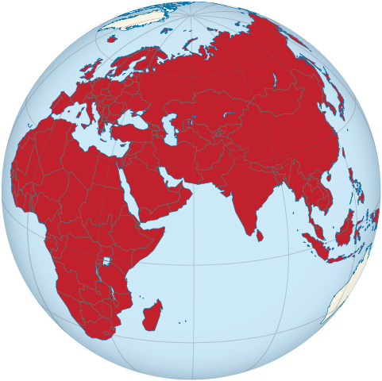
Cheatgrass
Introduced from Eurasia
Notes:
It seems most of our noxious weeds originate in this area

Slide 2
AKA: cheat, downy brome, Junegrass, downy chess, six-weeks grass and many others….
“C” list species for CO
Notes:
Don’t use the term Junegrass as Junegrass is a very important and grazable grass in our foothills area

Slide 3
The phone call…….
Every spring…..
  It’s a miracle grass…..
  The cattle and horses love it…
  It’s soooo green and soft….
  Tell me, where can I get more…..
Notes:
Wait a few weeks and call me back……
10/15/15 – ALREADY FOUND GROWING CHEAT. September had .03” inches of rain.

Slide 4
Annual Grasses
Completes life cycle in one year (summer annuals, winter annuals)
Much energy is put into seed production
        CHEATGRASS
Seeds germinate in late fall or early spring
Some grazing value early in the season
Can cause injury to grazing animals as it matures
Wide area of distribution and habitat (every continent except Antarctica)
Notes:
Doesn’t have to be a calendar year
Summer annuals
witch grass
sandbur
crabgrass
stinkgrass
Barnyardgrass, green and yellow foxtail
Winter/cool season annuals
jointed goatgrass
annual barley
Japanese brome

Slide 5
Bromus tectorum
‘tectum’ is Latin for roof
Native range was central Europe, northern Africa and Asia.

Slide 6
Found in US in late 1800’s
Marketed as “100 day grass”
Human activity facilitated the spread
  Railroads
  Cattle drives
  Wildlife migration
  Found in grain and straw
  Wheat cultivation favored the establishment of cheatgrass, same life cycle
Notes:
Salesmen can always find a rainbow

Slide 7
US distribution
By 1915, found in almost every state
Today it infests over 100 million acres
Early germination in the spring
Fast growing
Promotes a fire regime (and thrives in that regime)
Litter cover enhances germination
Rough seedbed enhances germination

Slide 8
Annuals tend to be prolific seed producers
Produces up to 500 seeds per plant
Matures in late spring or early summer
Seeds are not mature when the fall, must have a dry after-ripening period
Generally seeds do not remain viable for more than a year or two but can range from 3 – 9 years
Cheatgrass can regrow after defoliation

Slide 9
Negative impacts
Displaces native vegetation (“cheats” other plants by stealing moisture)
Creates a fire hazard, fire can damage some perennials
Has a negative impact on perennial forage (loss of production)
Negative forage impacts on wildlife both large and small

Slide 10
Ecological Succession (old view)
improvement
Bare Ground
Notes:
Example: abandoned cropland with no noxious weed inputs.
In NE CO we estimated 75-100 years to move from bare ground to good condition.
When noxious weeds entered the picture, this model no longer works.

Slide 11
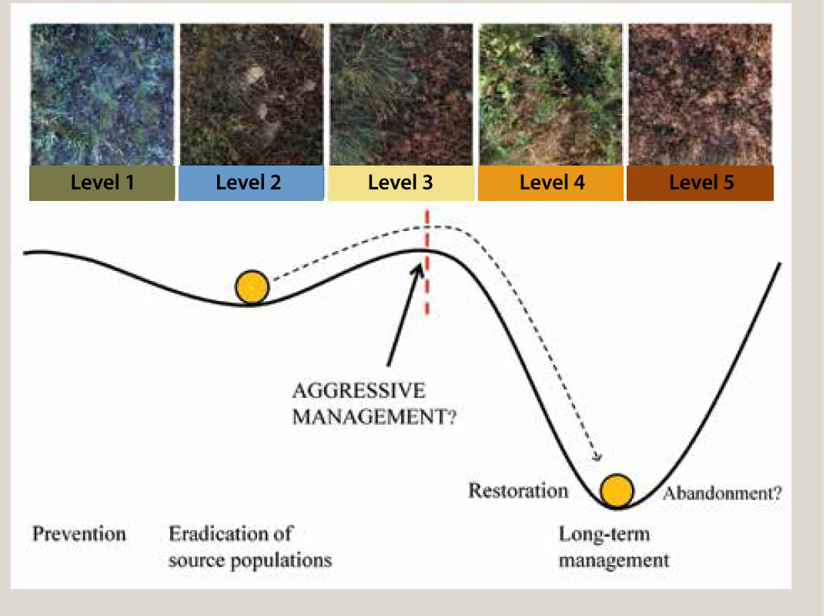
Ecological succession (new view)
Notes:
Ignore pictures for the time being
California fire ecosystem (annual grasses with shrubs that thrive in fire)
Cheatgrass ecosystem – won’t change without extreme inputs
Resilience and resistance (ecosystems vary)
Next slide is a complicated decision matrix

Slide 12
Prepare for a complicated decision matrix

Slide 13
Decision Matrix
Do I have cheatgrass
  No
    Yea!!!!!
  Yes
    Crud!!!!!!
    Start monitoring for so you can determine if management strategies are working

Slide 14
Treatment options
Prevention
Fire – watch out for re-invasion by surrounding infested areas
Grazing- prior to seed set, may harm cool-season perennials
Bio-control – fungi (black fingers of death) Pyrenophora semeniperda
Nitrogen management
Herbicides – see your local weed specialist
Re-seed to add to competition

Slide 15
Prevention
Keep weed seeds out – buy clean seed, keep equipment clean, buy weed-free hay, avoid spread by animal manure, work with neighbors
Keep your ground cover healthy and vigorous – take care not to overgraze desirable perennials.
Organize a weed prevention and management area

Slide 16
Fire
Fire can reduce seed viability, decrease litter and aid in control
However
fire can create bare areas that are susceptible to re-invasion
Must integrate herbicides, revegetation and proper grazing management

Slide 17
Grazing
Has the potential to reduce cheatgrass abundance
Must be timed correctly (germination dates can vary with weather)
Must be careful to not harm desirable perennial vegetation.
(blue grama v. western wheatgrass)
Warm season perennial grasses v. cool season perennial grasses
Continuous (year after year) spring grazing on cheatgrass may harm desirable cool season perennial grasses

Slide 18
Biological
Pyrenophora semeniperda (a fungus) – black fingers of death
Pseudomonas fluorescens (a rhizobacterium)
Not commercially available???

Slide 19
Nitrogen management
Cheatgrass efficiently uses nitrogen
High carbon materials temporarily reduce N in the soil.

Slide 20
Herbicides
See your local weed specialist
glyphosate (Roundup, and others)
imazapic (Plateau, Panoramic)
paraquat (Gramoxone Extra)
rimsulfuron (Matrix)
sulfosulfuron (Outrider)
and others plus combinations
Many herbicides have grazing restrictions – Read The Label
  Grazing restrictions
  Land use restrictions

Slide 21
Revegetation
Expensive
Risky
Last resort

Slide 22
Monitor
Continue to monitor to keep infestations under control.

Slide 23
A brief word about…..
Jointed goatgrass

Slide 24
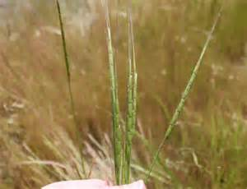
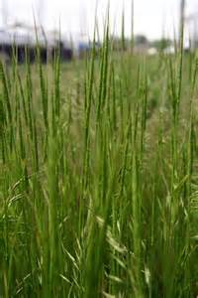
jointed goatgrass
Aegilops cylindrica
Change cultural practices
Notes:
30 bushel goat grass,
Landowner kept his seed and re-planted each year

Slide 25


