Slide 1
How TO INCORPORATE CDA’s Regulatory Updates
IN UPPER ARKANSAS noxious WEED MANAGEMENT

Slide 2
Colorado Noxious Weed Act
8 CCR 1206-2 Rules Pertaining to the Administration and Enforcement of the Colorado Noxious Weed Act8 CCR 1206-2 Maps (63.8 MB)
Annual rule
Species are listed
Definitions for management
Treatment methods
Management plans- county
Seed Longevity & Monitoring
Species’ management plans updated on a cyclical basis
https://www.colorado.gov/pacific/agmain/rules-regulations-1

Slide 3
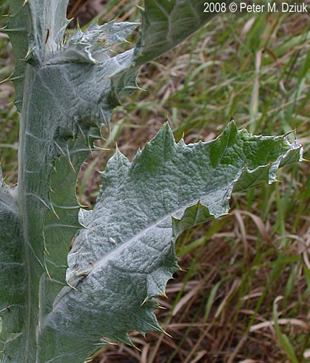
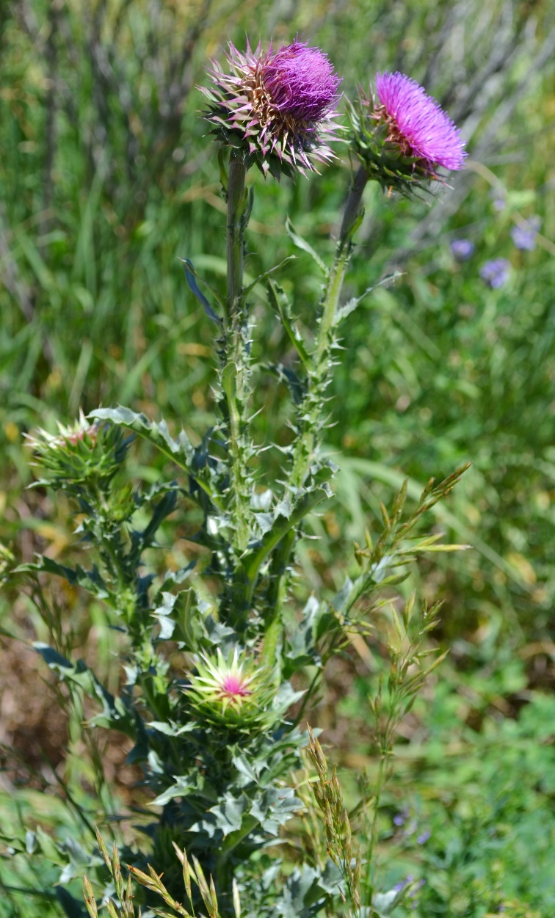
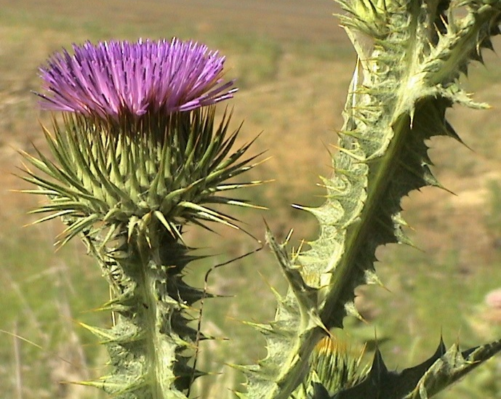
2016 Annual rule
Musk thistle
Asteraceae
Carduus nutans
Bull thistle
Asteraceae
Cirsium vulgare
Scotch thistle
Asteraceae
Onopordum acanthium
O. tauricum
Involucre
Heavily winged (1” wide) spiny angular stem
Leaves tomatose, white
Involucre with stout spines
Biennial
Involucre bracts spine tips
Densely pubescent
Leaves tiny appressed spines
Biennial
Pendant flower head
Prominent white mid rib on leaves
Biennial

Slide 4
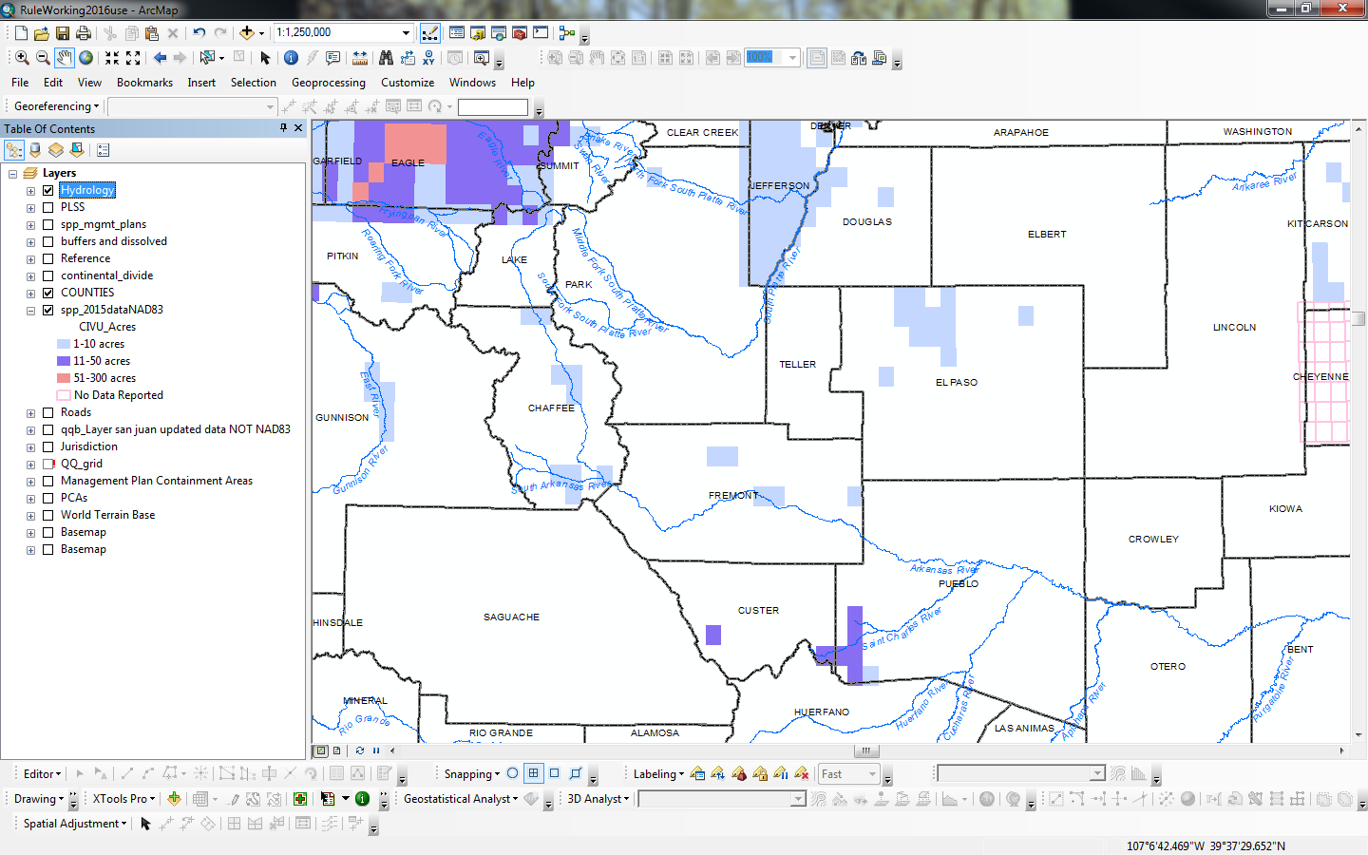
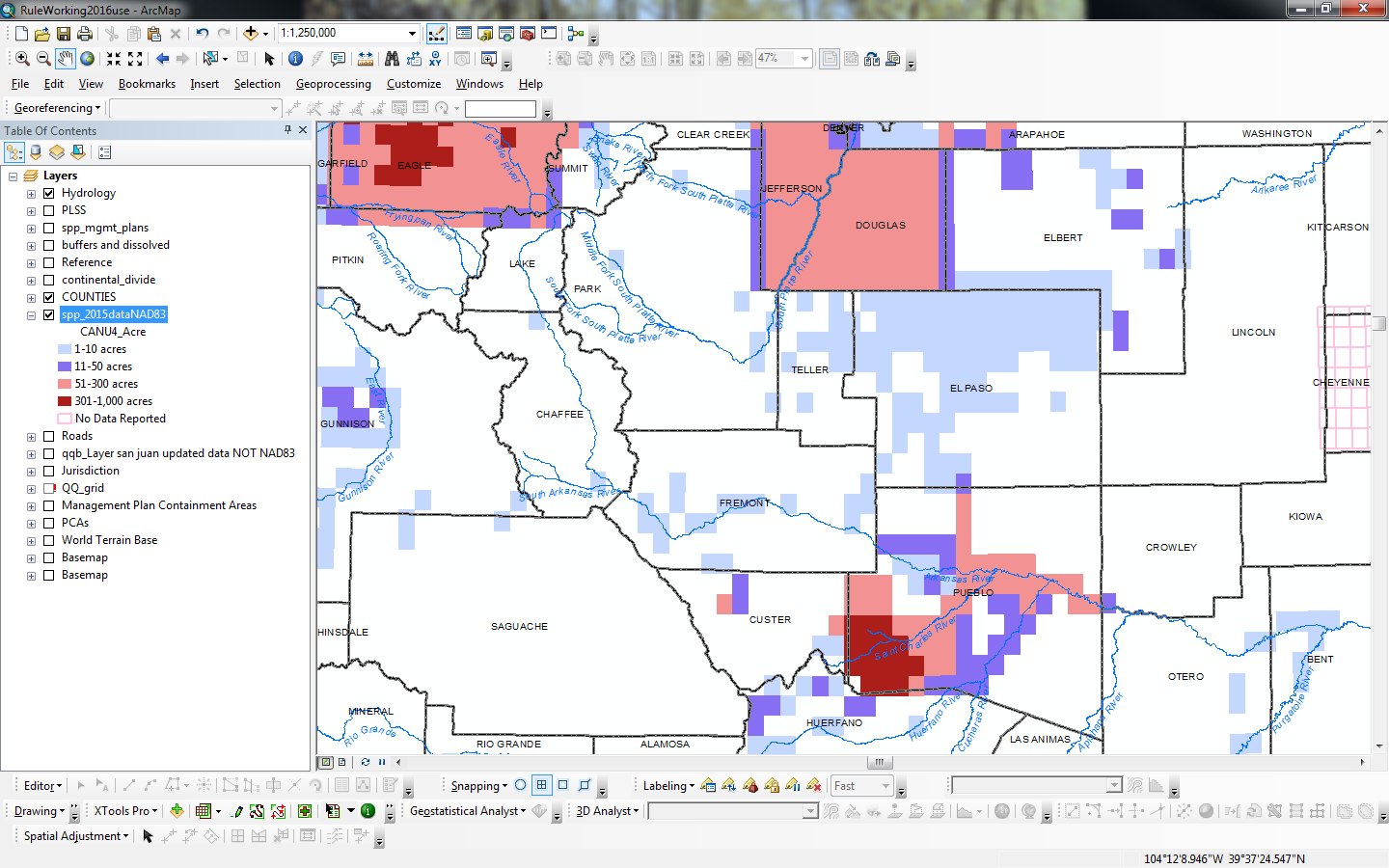
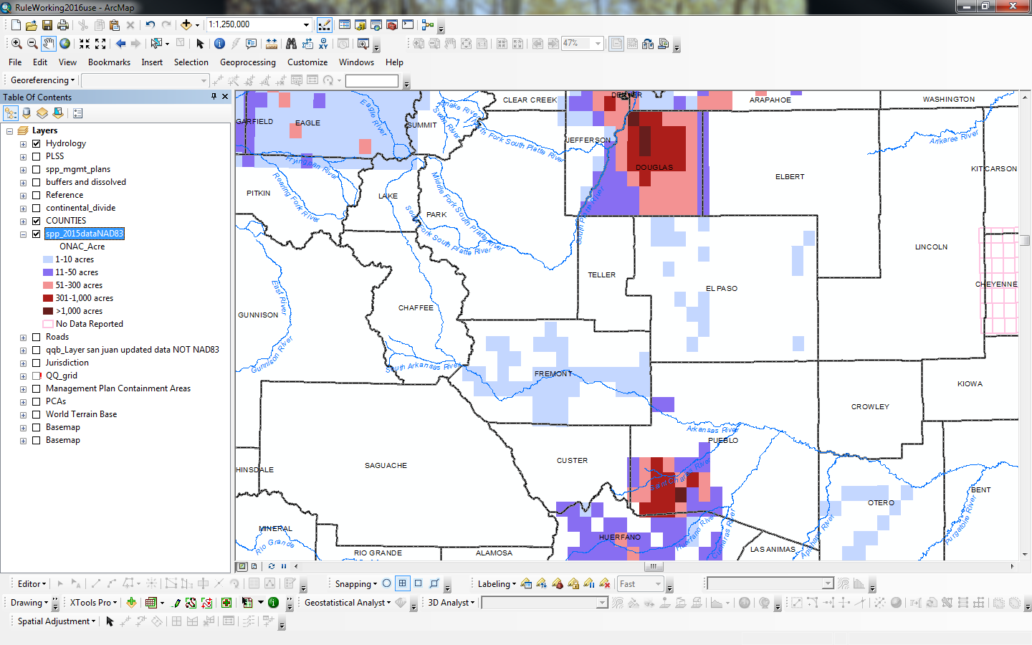
Musk Thistle
Bull Thistle
Scotch Thistle

Slide 5
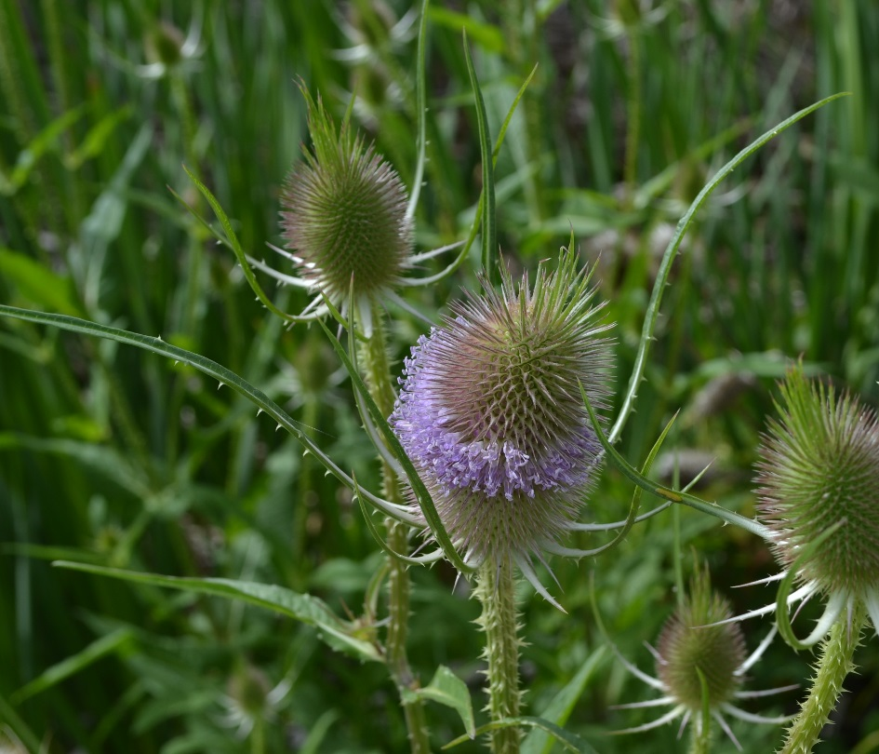
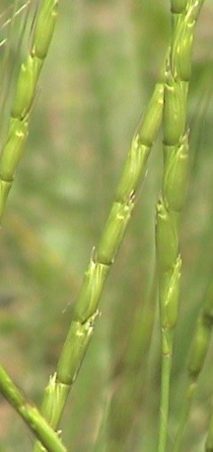
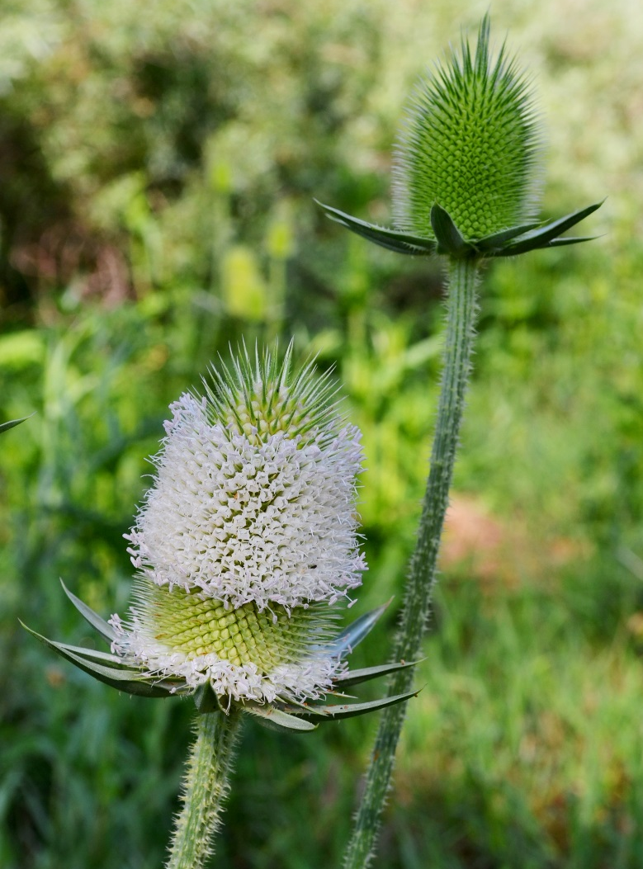
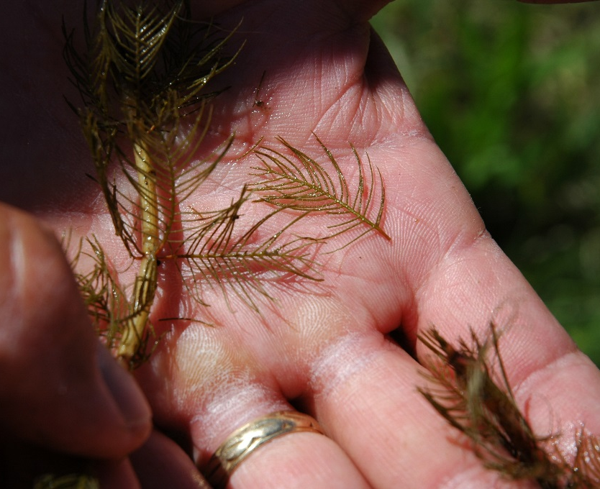
2016 Annual rule
Common teasel
Dipsacaceae
Dipsacus fullonum
Jointed goatgrass
Poaceae
Aegilops cylindrica
Cutleaf teasel
Dipsacaceae
Dipsacus laciniatus
Eurasian watermilfoil
Haloragaceae
Myriophyllum spicatum
Long thin floral bracts 2x long
Biennial- short lived perennial
Inflorescence
segmented spikelets
Annual
Cupped short floral bracts
Biennial- short lived perennial
Opposite leaflets
Perennial

Slide 6
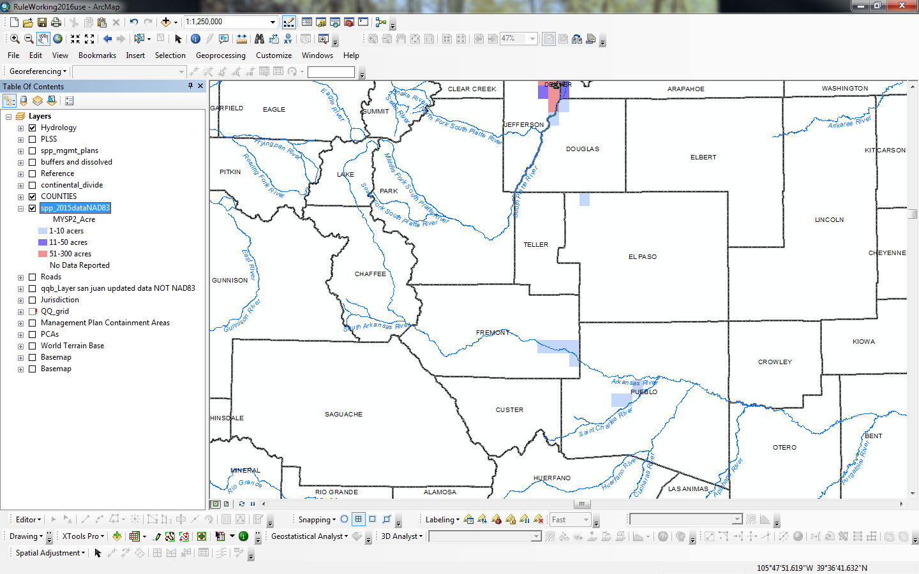
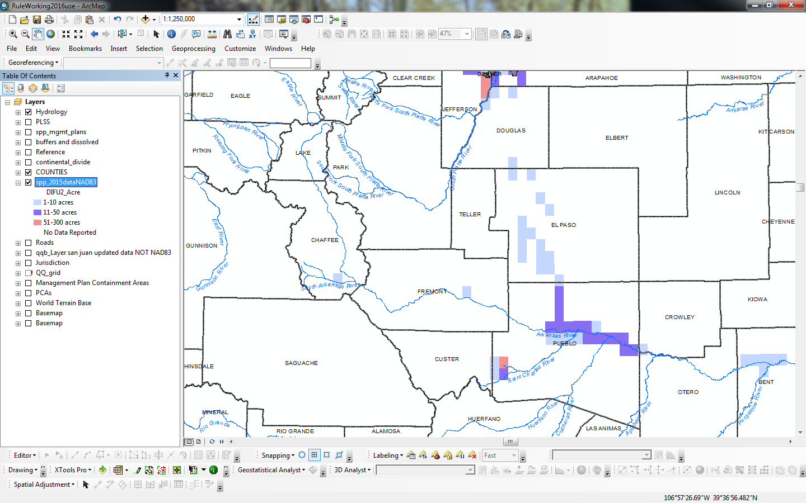
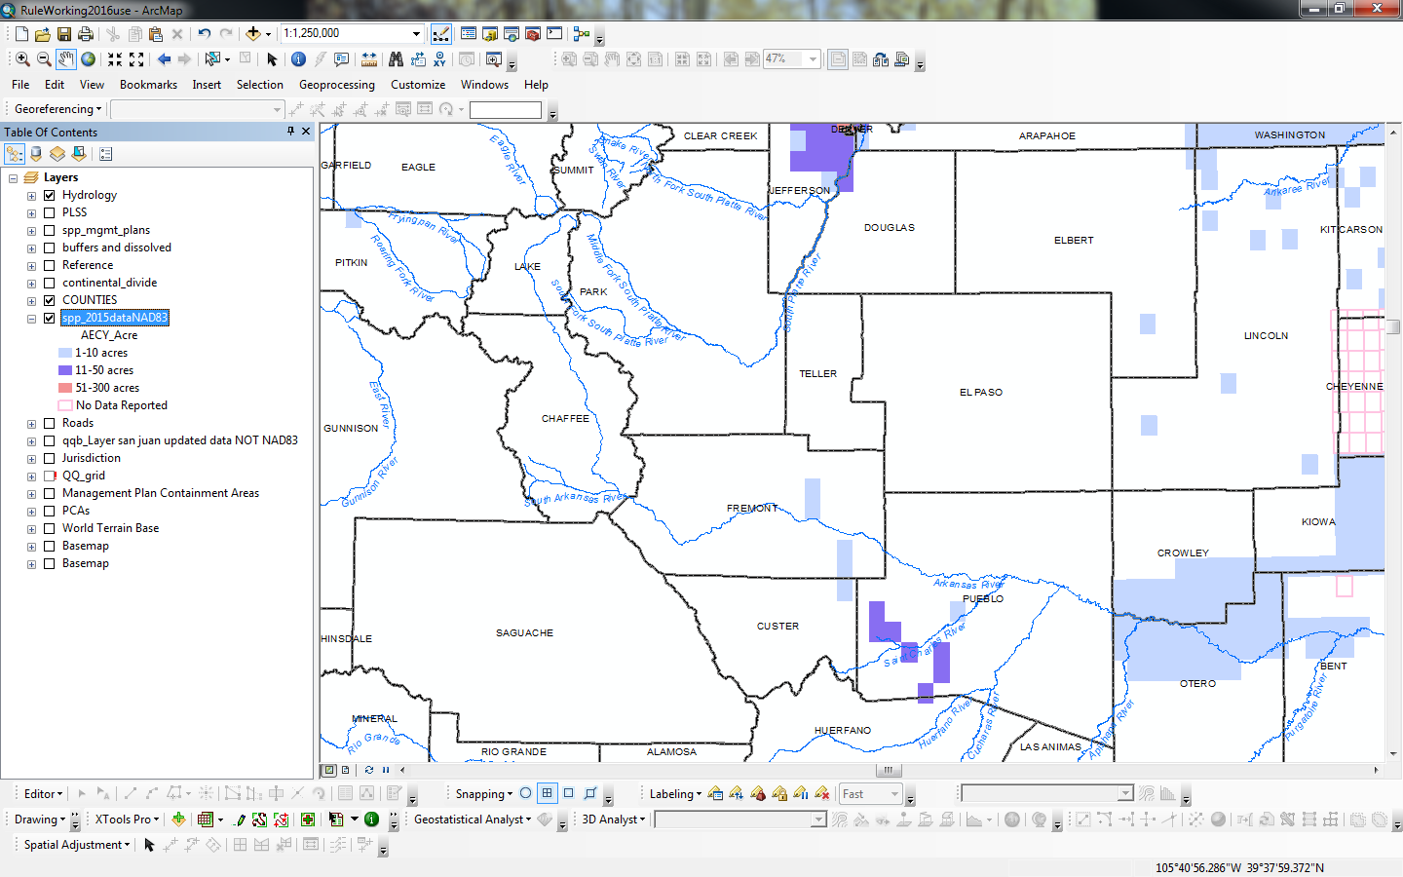
Jointed Goatgrass
Cutleaf & Common Teasel
Eurasian Watermifoil

Slide 7
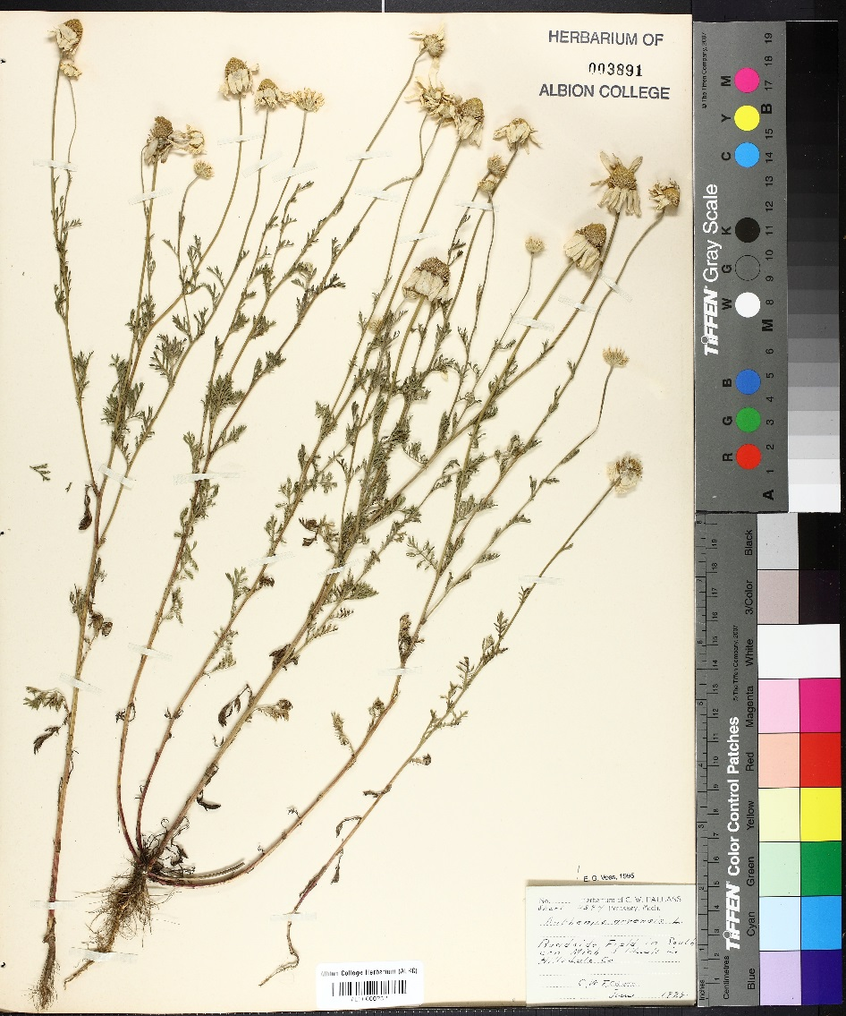
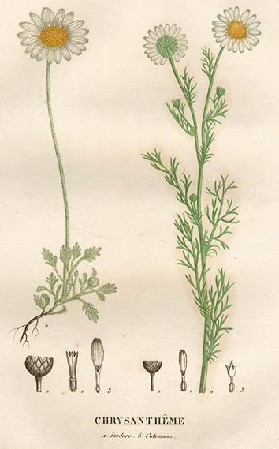
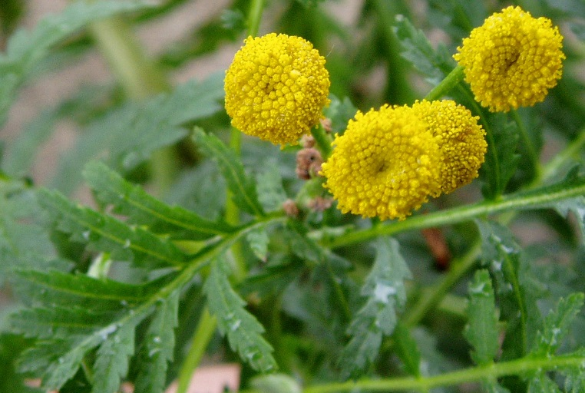
2017 Annual rule
Chamomiles Asteraceae
Mayweed
Anthemis cotula
Scentless
Tripleurospermum perforatum
Bouncing bet
Caryophyllaceae
Saponaria officinalis
Corn Anthemis arvensis
5 petal zygomorphic
perennial
Common tansy
Asteraceae
Tanacetum vulgare
Oblong leaves 15-35 mm long
Annual
Alternate leaves along stem 2.5 – 7.5 cm long
Annual - perennial
Primarily basal leaves
Annual- perennial
Disk flowers
Perennial

Slide 8
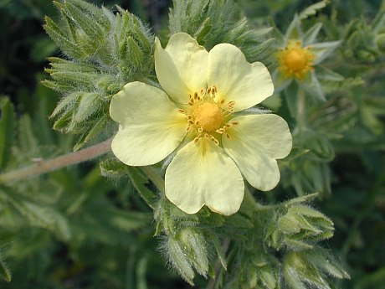
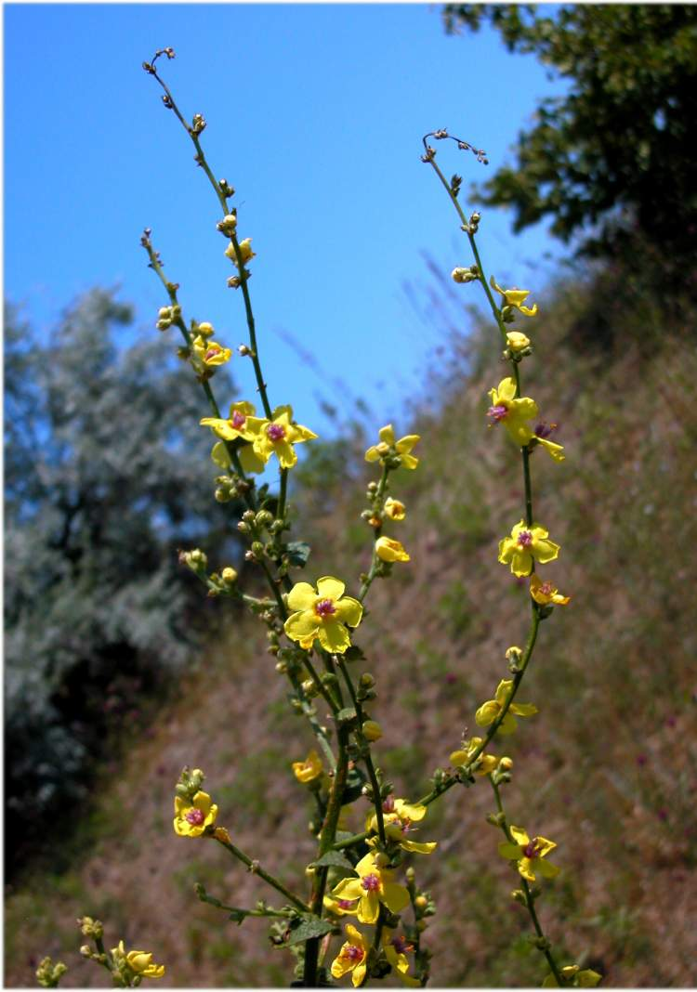
2017 Annual rule
Moth mullein
Scrophulariaceae
Verbascum blattaria
Sulfur cinquefoil
Rosaceae
Potentilla recta
Wild caraway
Apiaceae
Carum carvi
Dame’s rocket
Brassicaeae
Hesperis matronalis
Hirsute; perpendicular to stem
Underside of leaf green
Perennial
Photo: Andrea Moro
Inflorescence glandular-hairy raceme
Biennial
Photo: Memim.com
Stems lack purple spots Leaflet margins entire Stylopodium present
Management Plans by County
Containment Boundaries
Treatment Methods
Infestation Monitoring
Photo: Roland E. Barth
Alternate lanceolate leaves
Biennial- short lived perennial

Slide 9
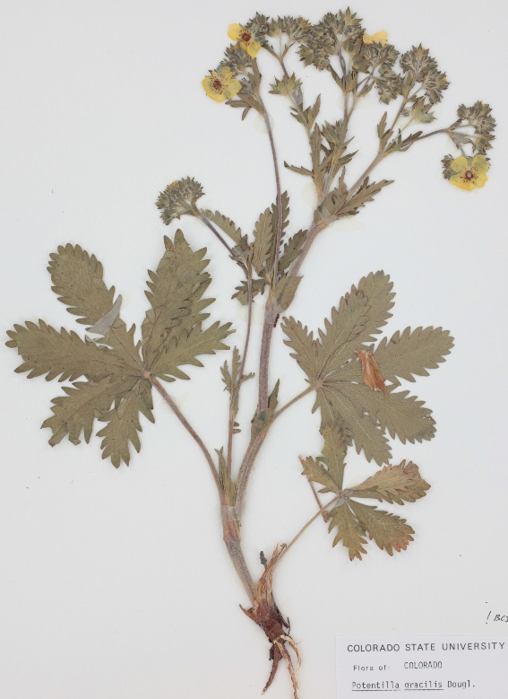
Sulfur cinquefoil Non-native
Rosaceae
Potentilla recta
Slender cinquefoil Native
Rosaceae
Potentilla gracilis
32 Potentilla species in Colorado
32 have Compound leaves
26 hairy
4 Introduced/non-native
1 Endemic native (Potentilla rupincola)
Underside of leaf green
Hirsute; long hairs perpendicular to stem
Densely hirsute
Pale yellow petals (NOT DIAGNOSTIC)
Up to 3 feet tall
Palmate compound leaves; serrate; narrow oblanceolate
Ring-like growth form from center outward
Underside of leaf green
Stems with appressed hairs
Sparse to densely hairy
Yellow petals (NOT DIAGNOSTIC)
Up to 3 feet tall
Palmate compound leaves; shallowly toothed; broad oblong-elliptical

Slide 10
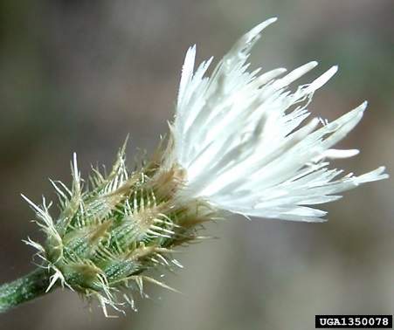
Annual rule
Management Plans by County
Containment Boundaries
Treatment Methods
Infestation Monitoring
Diffuse knapweed (Centaurea diffusa). In addition to the requirements set forth in this Part 4 for the management of all List B species, the following conditions also apply for diffuse knapweed:
Elimination of all populations in Pueblo County must be completed prior to seed development in 2021 and each year thereafter for all land outside the boundaries of an area demarcated by the western, southern, and eastern borders of Pueblo County and the Arkansas River on the north. Except as specified in Part 4.7.7O and Part 4.7.7P, for all land within the area described above, suppression is the specified State management objective (see Rule 4.8, Figure 6.09).
Containment Boundary

Slide 11
Annual rule

Slide 12
Inventory & long-term monitoring
Assumptions & Caveats:
Inaccuracies exist
Data is incomplete
Over-reporting & under-reporting
Not all occurrences are GPS’d
Updates this winter

Slide 13
Inventory & long-term monitoring
Note:
The following species
are listed in CO
but are not currently
known to occur in CO
Camelthorn*
Common crupina
Flowering rush
Giant salvinia
Hydrilla
Medusahead
parrotfeather
Squarrose knapweed
Tansy ragwort
* Historic records

Slide 14
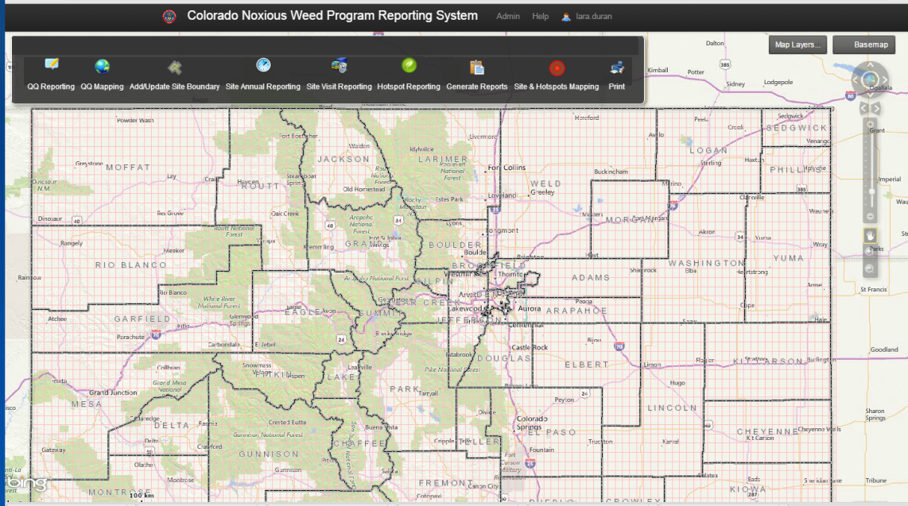
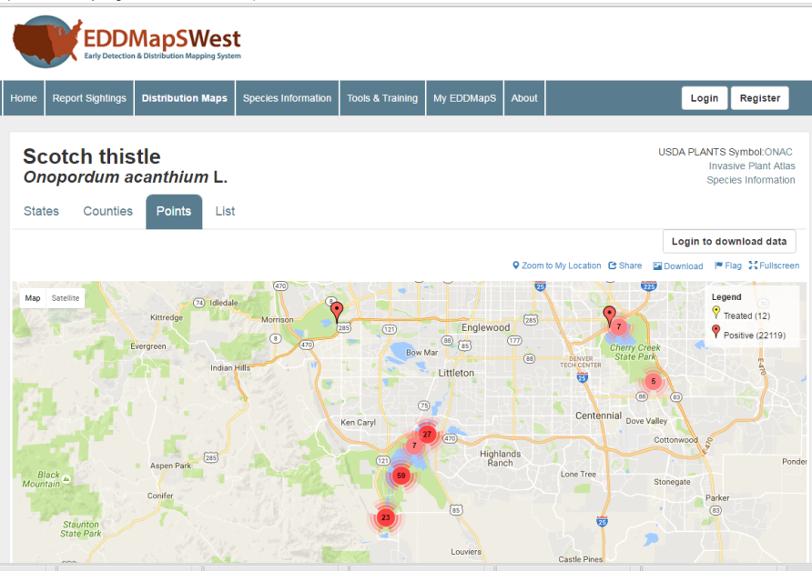
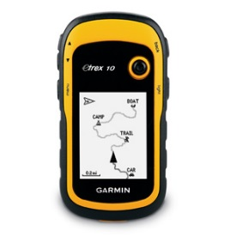
Inventory & long-term monitoring
Use a Protocol
Inventory & Map
Accurate location is important
Scale is relevant
Environment characteristics
List special status species (e.g. rare plants)
List noxious weeds
Accurate species identification
Voucher specimen collection- specialist
Use a variety of databases
Maintain variety of databases
Collect the Basic Data
Site ID
Date
Species Name
Population Size & Density
Development Stage
Geographic Coordinates
Digital Photo
Herbarium Collection*
Make a plan
Use a GPS
DATUM: UTM NAD 83 Zone 12N or Zone 13N
Share the Data
Inventory Methods
State Noxious Weed Program
County Weed Manager
EDDS MapS
Herbaria*
We take on-line data entry, GIS shapefiles, hardcopy maps & notes!

Slide 15
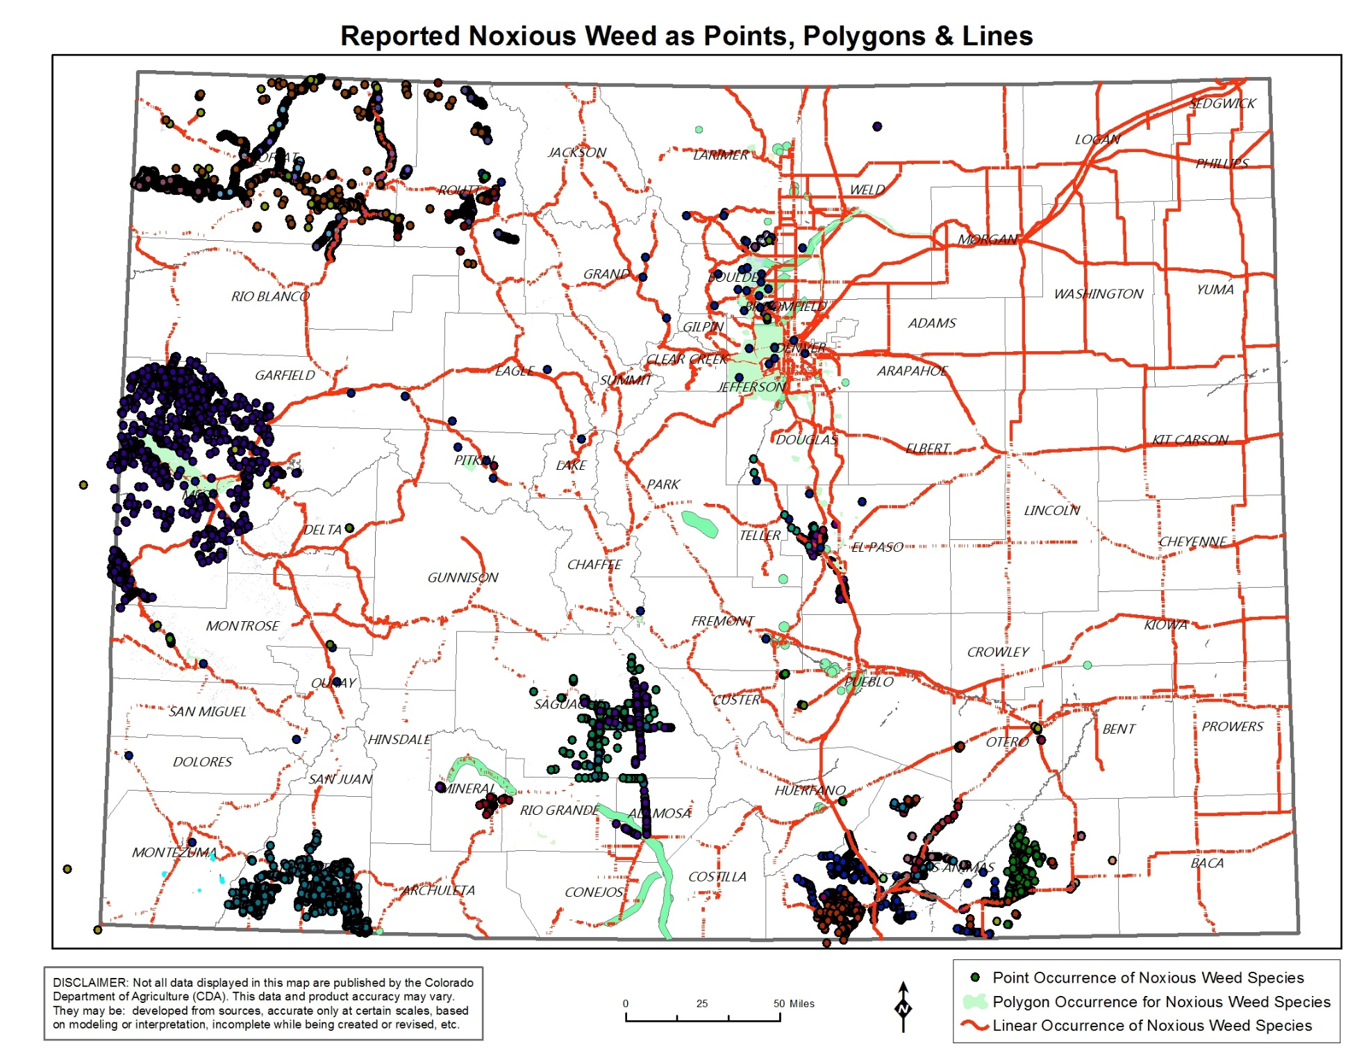
Inventory & long-term monitoring
There Are Lots of Gaps
in our Database!
We accept
Point
Line &
Polygon
Data
List A & B

Slide 16
EDRR Framework
Noxious Weed Program
Prevention & Import Restriction
Early Detection and Rapid Response
Control
Regulation
Education
Preparation
Prevention
Priority Identification (Early Detection & Rapid Response)
Early Detection
Plant Assessment
Rapid Response
Evaluation of Success

Slide 17
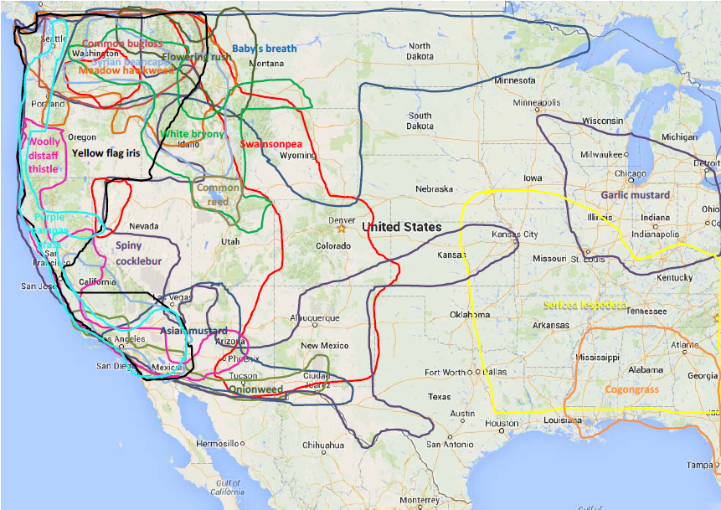
EDRR Framework
Communication Network
State
Federal
Tribes
Counties
Municipalities
Non-profit organizations
Licensed pesticide users
Universities
Professional Societies
Railroads
Others?
Range of Watch List Species in the US

Slide 18
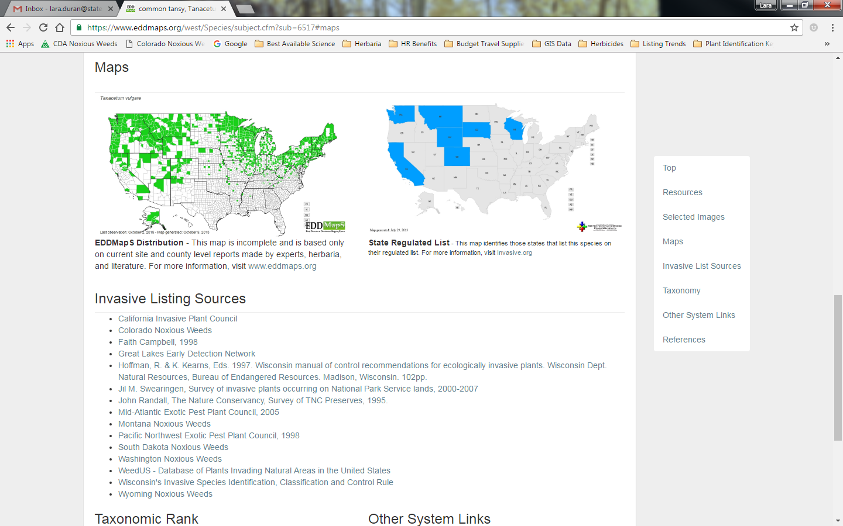
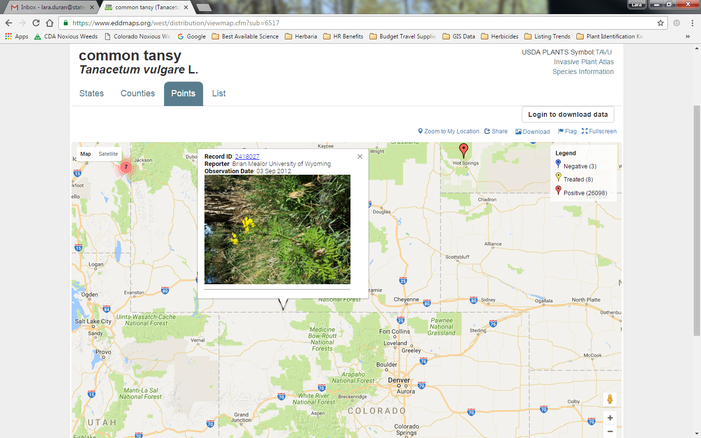
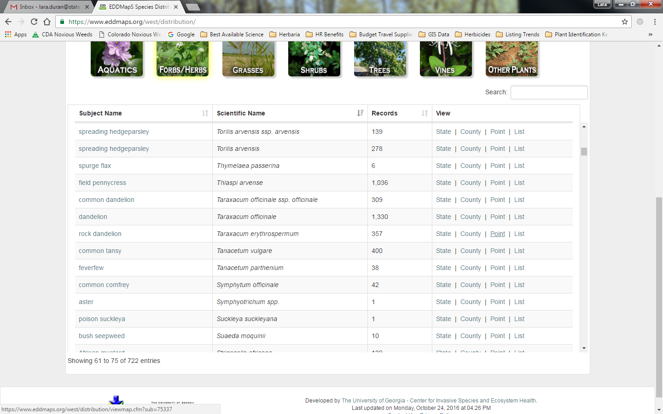
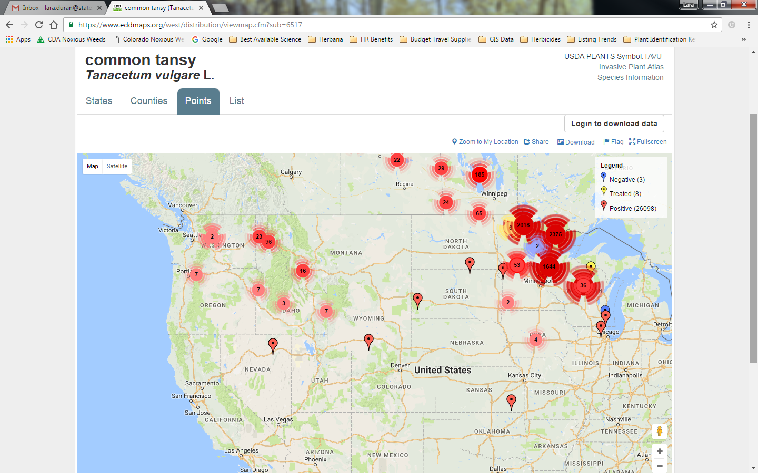
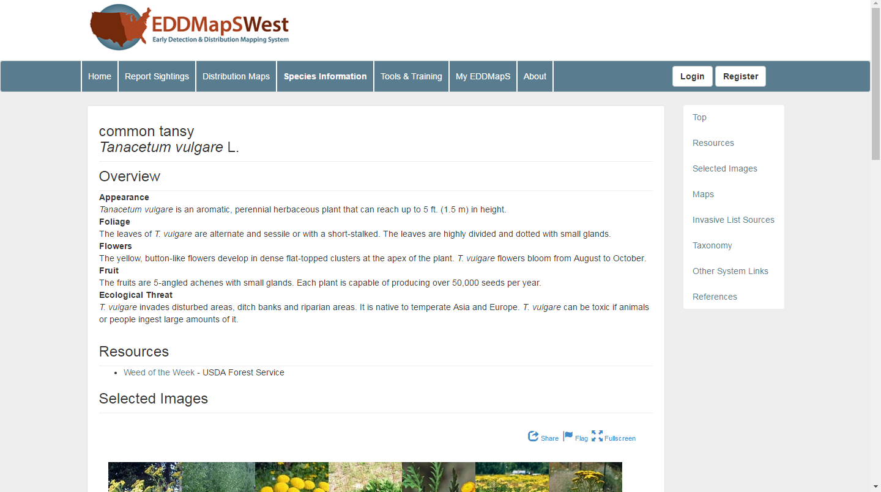
Inventory & long-term monitoring
EDDMapSWest

Slide 19
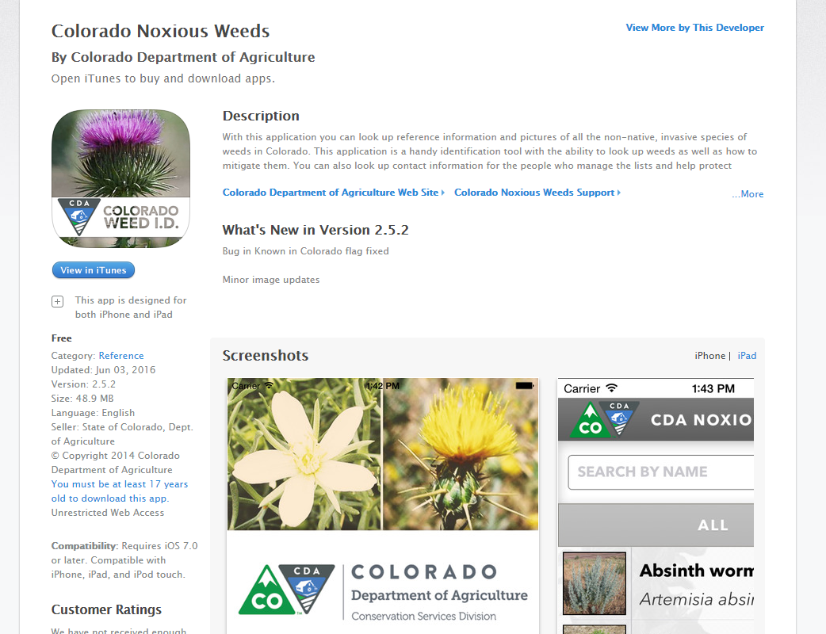
Inventory & long-term monitoring
Additional Mobile App
In Development
EDDMapS West
CNHP Database
Collections to SEINet & CU Herbaria

Slide 20
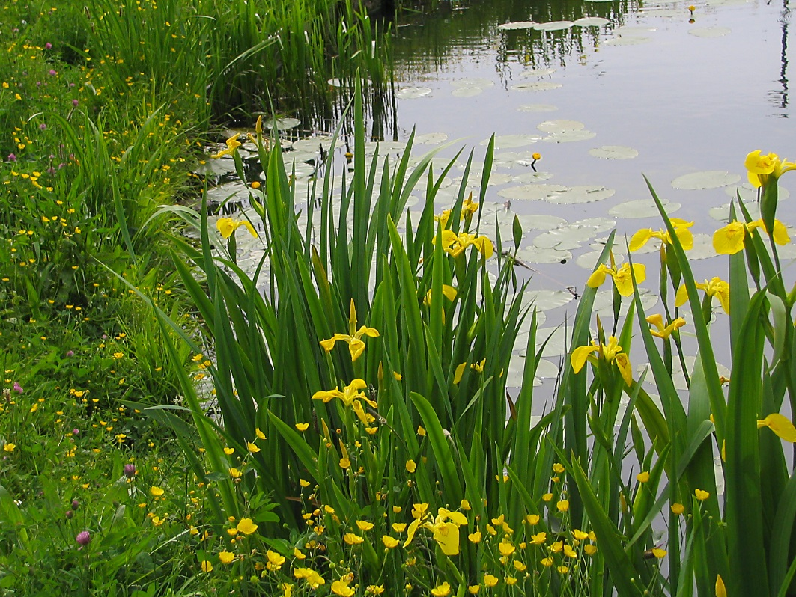
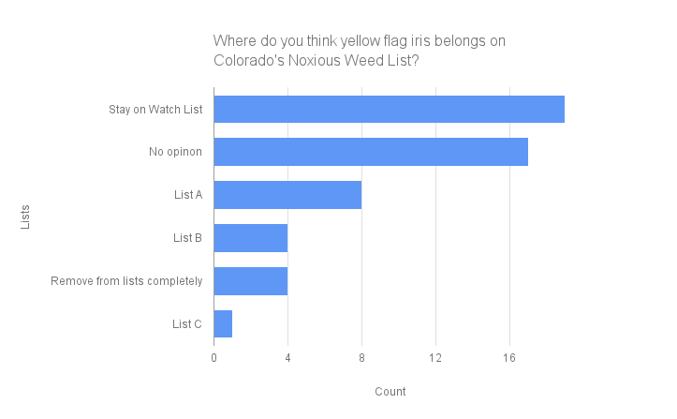
Species’ questionnaires
Yellow flag iris Iris pseudacorus
Photo: plantright.org
SEINet: Boulder & Denver
USDA Plants Database: None
Baby’s breath (Gypsophila paniculata)
Swainsonpea (Phragmites australis)
Common reed (Phragmites australis)

Slide 21
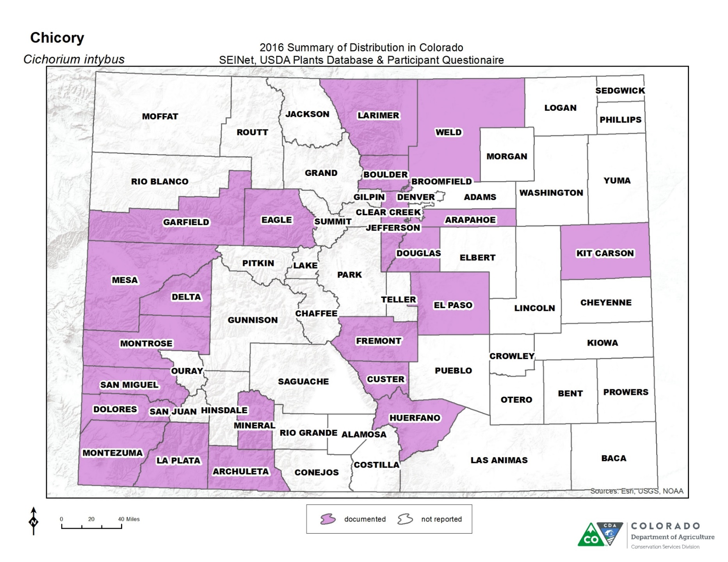
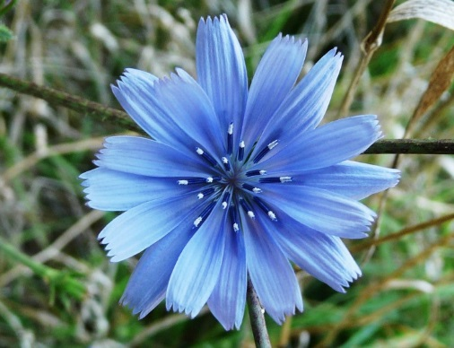
Species’ questionnaires

Slide 22
Annual Rule = County Management Plan
Species Occurrence Data
Population Monitoring
Data Sharing
Species’ Questionnaires
Communication Network
Management Grants

