Slide 1
UACWMA Annual Meeting
Nov. 5, 2015
Winter
Annuals
This presentation is on some other pesky problem weeds that sneak up on us in the early spring.
Notes:
Read from slide.

Slide 2
Introduction
Rick Romano –
District Conservationist
Natural Resources Conservation Service
Canon City Field Office
Silver Cliff Field Office
Notes:
Introduce yourself.

Slide 3
Winter Annuals
Control Methods
Biological – Like the Diorhabda Beetle on tamarisk.
Chemical – Most common method- using herbicides and surfactants as applicable.
**ALWAYS READ THE LABEL. The label is the law.
Cultural – Includes reseeding, irrigation water management and nutrient management.
Mechanical – Includes tillage, fire, hand-pulling.
Notes:
We will talk about integrated pest management.

Slide 4
Winter Annuals-Medusahead Rye
Growth Characteristics
Winter annual grass. Very similar to cheat grass. Germinates in the fall. Fire adapted species.
Grows to 6-24 inches in height.
Flower is a long awned spike.
Fibrous root system.
Seeds mature quickly.
Seed longevity is at least two years.
Grows in undisturbed sites and grasslands.
Grows best on clay soils, where deep soil moisture is available late in the season.
Medusahead Rye
Notes:
Medusahead made its debut in the United States in the 1880’s near Roseburg, OR. It is speculated that it first arrived from Europe with imported animals, either in their bedding or attached to their fur. Like cheatgrass it is a winter annual grass.
It grows to 6 to 24 inches in height.
It has a seed head with long awns that are stiff and slightly barbed. That is what makes them such good hitchhikers.
The name Medusahead comes from those wiry awns. The mature plant has a slender stem with narrow leaves. Roots can grow at cold temperatures and seeds mature quickly.

Slide 5
Winter Annuals-Medusahead Rye
Growth Characteristics, continued
Barbs or awns on the seed head can cause puncture wounds to grazing animals, as well as cling to feet, fur, socks and bootlaces.
Tissues have a high silica content. They are slow to decompose and are highly flammable.
Creates a heavy thatch that reduces germination of other annuals that could compete.
Can outcompete cheatgrass on clayey soils, especially if cheat grass is heavily grazed.
A List species in Colorado
Although all publications say that Medusahead is not found in Colorado, we need to be vigilant.
Medusahead Rye
Notes:
Remember my comment about being a good hitch hiker. Those barbs and the hardness of the seeds make them easy to pick up in socks, shoelaces, in any crack or seam of a boot. Medusa head plants are rich in silica and their litter breaks down more slowly than most other grass species which acts to deter germination of other plants.

Slide 6
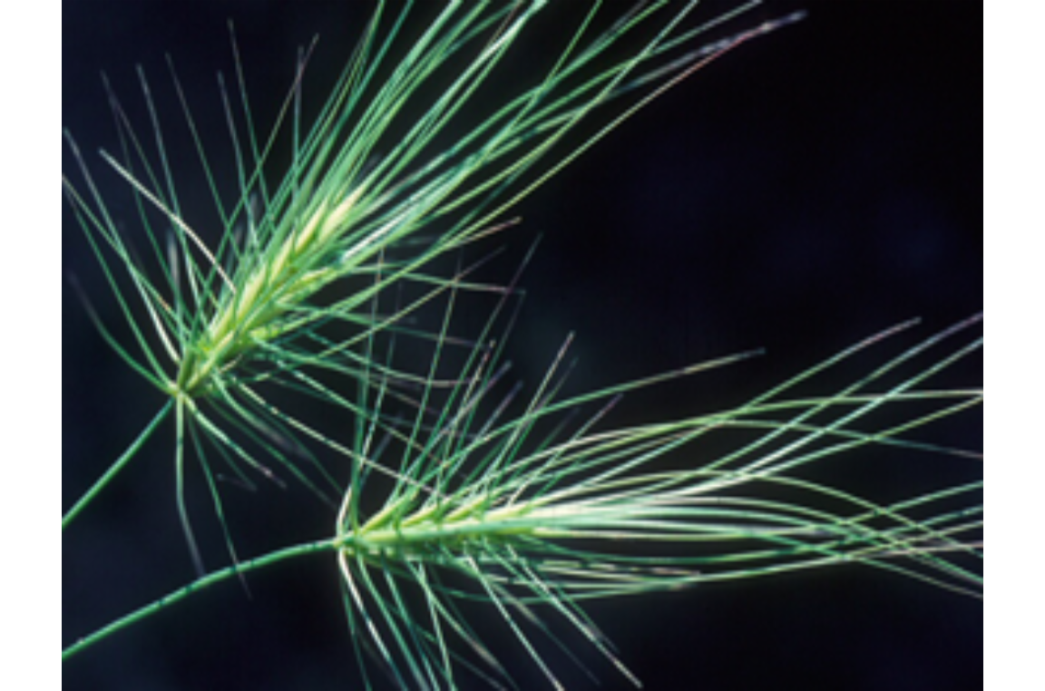
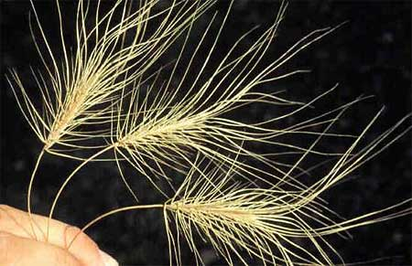
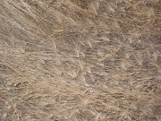
Winter Annuals-Medusahead Rye
Medusahead Rye
Notes:
Here are some images.

Slide 7
Winter Annuals-Medusahead Rye
Biological Methods of Control
At this time there are no known biological agents for Medusahead.
Some research was done analyzing five soil fungi endemic to the western US, but the results were inconclusive.
Two smut diseases and a crown rot were also investigated, but do not appear to be viable agents.
Medusahead Rye
Notes:
Read from slide.

Slide 8
Winter Annuals-Medusahead Rye
Chemical Methods of Control (check label for specifics)
On range and pasturelands,
Sulfometuron + Metasulfuron (Oust Extra-general use) at a rate of 3oz. product per acre, plus 0.25% v/v non-ionic surfactant can be effective if used either pre-emergence in the fall or very early post emergence when plants are actively growing.
Imazapic (Plateau/Panoramic) can also provide some control.
If in a disturbed area, glyphosate can be effective if good coverage is obtained.
Aminopyralid (Milestone) at the 14 fl. oz./acre rate offered up to 90% control.
Other publications suggested that Paraquat, Metribuzin (Sencor, etc.), Atrazine (Aatrex, etc.), and 2,4-D could offer some control.
Medusahead Rye
Notes:
It is best to locate infestations late in the fall or very early in the spring to give you the best chance for control.

Slide 9
Winter Annuals-Medusahead Rye
Cultural Methods of Control
Preventing the establishment of the Medusahead is crucial.
maintaining healthy plant communities is a priority.
Bare ground is prime habitat for weed invasions, so prevent over grazing and reseed as soon as possible any disturbed site.
Pastures need to be properly maintained, watered, fertilized, and aerated to maintain vigor.
Bare areas like corrals need to be monitored.
Seeds do not usually fall far from the plant (unless hitchhiking) so vegetative barriers can be effective.
Medusahead Rye
Notes:
Read from slide.

Slide 10
Winter Annuals-Medusahead Rye
Mechanical Methods of Control
Hand pull or dig from moist soil in spring before seed head emerges from boot.
Make certain to pull all roots and seed heads carefully so as not to scatter seed, if seed is present.
Medusahead is susceptible to tillage, but can have multiple flushes. Disking and plowing before seed set can reduce Medusahead by 90% or more.
A slow, HOT fire before seed set can also reduce Medusahead by 90%.
Medusahead Rye
Notes:
Read from slide.

Slide 11
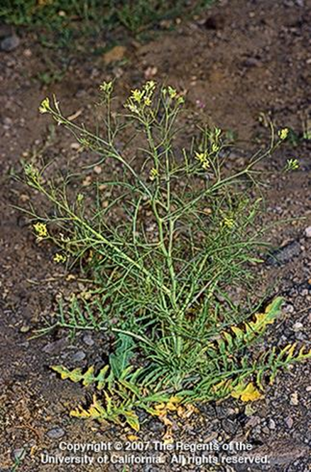
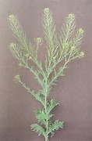
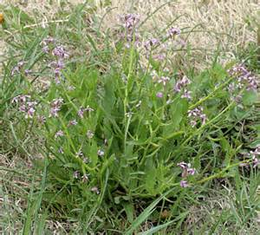
Winter Annuals-Mustards
Mustards
Mainly blue mustard, flixweed, and tumble mustard.
Notes:
Mustard was one of the first domesticated crops. Ancient Greeks and Romans enjoyed mustard (sinapis - Sinapis is a genus of plants in the family Brassicaceae) seed as a paste and powder. In about 1300, the name mustard was given to the condiment made by mixing “mustum”, which is the Latin word for unfermented grape juice, with ground mustard seeds. Mustards are winter or summer annual broadleaf plants and sometimes biennials, but I will be addressing the winter annuals. Cultivars of some mustards that escape hybridize readily with wild types. Wild mustards (and cultivated ones) can harbor pests and diseases that damage closely related crops. They also lessen the value of alfalfa when they get into alfalfa fields. These plants all display similar growth habits, site characteristics and responses to management methods. Annual Mustards typically germinate in the fall, and to a lesser extent in the spring, flower early in spring and dry down in July or August. These species are quick to invade disturbed sites, but are usually not competitive once perennial grasses are established.

Slide 12
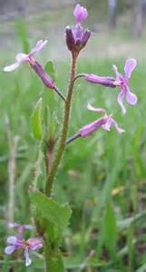
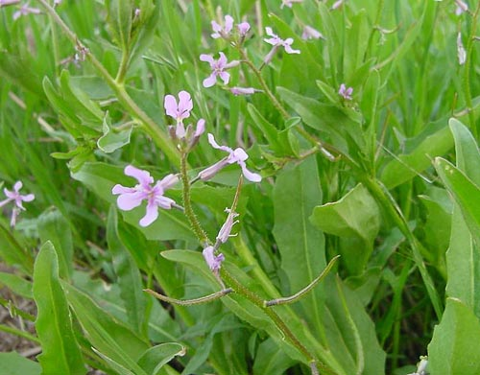
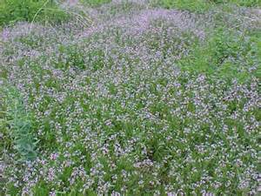
Winter Annuals-Mustards
Blue Mustard
Mustards
Notes:
Most species in the mustard family have yellow or white blossoms, but this one has small blue to purple flowers.
Blue mustard was introduced into the United States from Siberia in or around 1929 and was first reported in Lewiston, Idaho.
Blue mustard is a winter annual weed with seed germinating in late summer and fall. The plant over winters as a rosette. The flower stalk usually elongates, a process known as bolting, in March. Typically, tumble mustard and Flixweed begin bolting 2 or 3 weeks after blue mustard. It is a prolific seed producer and viable seed will be produced within ten days of the flowers opening. Blue mustard is a problem in winter annual crops such as winter wheat, perennial crops such as alfalfa, and noncrop areas.
It is known for it’s strong odor.

Slide 13
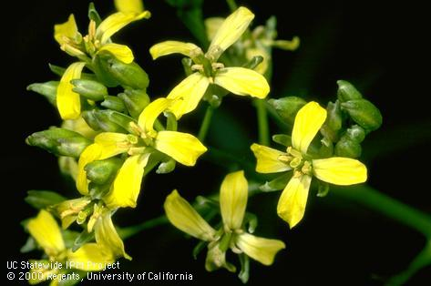
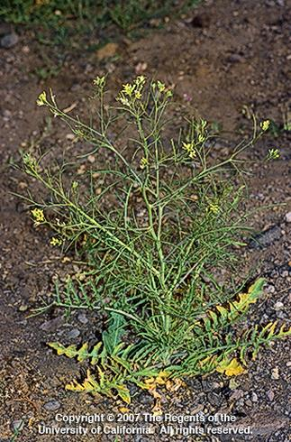
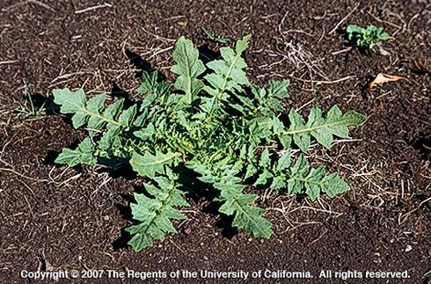
Winter Annuals-Mustards
Tumble or Jim Hill Mustard
Mustards
Notes:
Tumble mustard, also known as Jim Hill mustard, is a broadleaf winter annual and sometime biennial plant with a highly branched top. Tumble mustard exists as a rosette until the flower stem develops at maturity. Leaves at the base of young winter rosettes are coarse and deeply lobed. Leaves near the top are smaller and deeply cut to form threadlike divisions. Flowers bloom from April through September. Tiny, pale yellow flowers with four petals cluster on thick, spreading stalks. Seed pods point somewhat upward. Reproduces by seed. Mature plants tend to break off at the base and tumble in the wind, spreading seed.

Slide 14
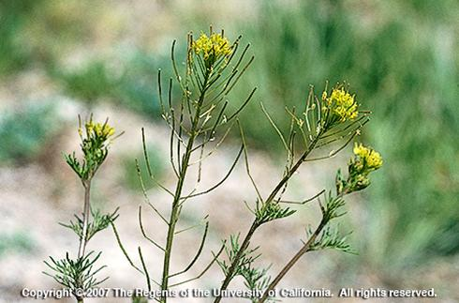
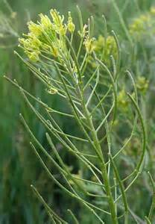
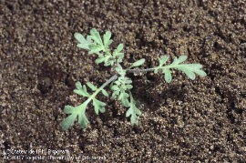
Winter Annuals-Mustards
Flixweed
Mustards
Notes:
Flixweed, sometimes called tansy mustard, is a winter annual or biennial broadleaf plant. Flixweed can be fatally toxic to cattle when the flowering plants are consumed in quantity. Young plants exist as basal rosettes until the flower develops. Mature Flixweed can reach over 2 feet in height. Stems may be branched, starting at the middle of the main stem or above, or unbranched. Leaves are alternate to one another along the stem and are divided into leaflets. Flowers bloom from March through August. Erect branches have long flowering stems with yellow flower clusters. There are roughly ten to twenty seeds per pod. Seeds are tint (less than 1/17 of an inch and become sticky when moistened.

Slide 15
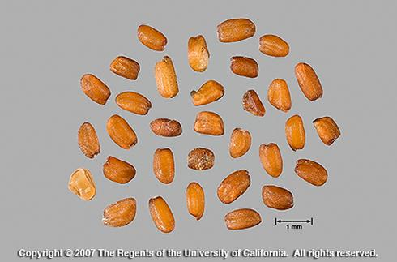
Winter Annuals-Mustards
General Growth Characteristics
Winter annual, sometimes spring.
Over winters as a rosette.
Flower early in spring
The flowers appear in racemes and have four petals.
Flowers are followed by pods which are linear and have a persistent beak at the tip
Seeds generally fall near the parent plant (unless it tumbles) and can survive at least 11 years under field conditions.
Mustard
Notes:
In general what do all these mustards share……
Raceme=An inflorescence having stalked flowers arranged singly along an elongated unbranched axis, with the flowers at the bottom opening first.

Slide 16
Winter Annuals-Mustards
Issues associated with the weed
Mustards can be toxic.
Flixweed is poisonous if consumed in large quantities, but some mustards can be grazed.
Some mustard seeds contain alkaloids that can be toxic to livestock if ingested in large amounts.
Some plants are high in sulfur-containing compounds throughout the plant which can cause irritated digestive tracts and thyroid problems in livestock.
Winter annuals can also over winter insect pests.
Mustards can form dense patches that can outcompete native plants if allowed to fully establish.
Mustards
Notes:
Read from slide.

Slide 17
Winter Annuals-Mustards
Mustards
Mainly blue mustard, flixweed, and tumble mustard.
.
Notes:
These plants all display similar growth habits, site characteristics, site characteristics and responses to management methods. Annual Mustards typically germinate in the fall, and to a lesser extent in the spring, flower early in spring and dry down in July. These species are quick to invade disturbed sites, but are usually not competitive once perennial grasses are established. The key is getting to them while they are young.

Slide 18
Winter Annuals-Mustards
Biological Methods of Control
At this time there are no known biological agents available for the mustards, primarily because of their close relationship with other economically important mustard crops.
It is thought that some ground beetles may eat seeds lying on the soil surface.
Mustards
Notes:
Read from slide.

Slide 19
Winter Annuals-Mustards
Chemical Method of Control (check label for specifics)
Mustards have a unique tolerance to numerous herbicides used in controlling noxious weeds. The most effective herbicides for controlling annual mustards are Metsulfuron (Escort), Imazapic (Plateau/Panoramic), Rimsulfuron (Matrix) and Chlorsulfuron (Telar).
Apply at post emergence, from rosette to bud stage, when the small plants are actively growing.
Chlorsulfuron, Imazapic, Rimsulfuron can also be applied as a pre-emergent. Control methods should be used before mid-April at the very latest.
The use of a non-ionic or nonionic/anionic surfactant or crop or vegetable oil approved for agricultural uses at the label rates will usually result in better weed control.
Mustards
Notes:
Chemical Methods of Control. Read from slide.

Slide 20
Winter Annuals-Medusahead Rye
Cultural Methods of Control
Wild mustards can be palatable to livestock, but if eaten in excess can cause gastric distress or death. Grazing is not an effective control method.
Pastures need to be properly maintained, watered, fertilized, and aerated to maintain vigor.
Burning is not an effective control method, as the plants remain succulent into the seeding stage and they produce too early in the season to use broad scale fire.
Flaming can be used to control young plants.
Mustards
Notes:
Cultural Methods of Control. Read from slide.

Slide 21
Winter Annuals-Mustards
Mechanical Methods of Control
Manual removal or cultivation before seeds develop can control populations.
Physical removal is easiest during the seedling stage.
Control methods implemented over a period of years will eventually exhaust the seedbank.
Mowing during the bud to bloom stage can help suppress seed production.
Mustards
Notes:
Mechanical Methods of Control. Read from slide.

Slide 22
UACWMA Annual Meeting
Nov. 5, 2015
Winter
Annuals
The end….
Or is it?
The use of trade names in this presentation does not imply endorsement of the product named or imply criticism of products not named.
Notes:
Questions?

